Slide 1
Experience of Jewish people
Notes:
Acknowledgements
Lesson plan and materials created by Paul Salmons
© Paul Salmons, 2010, All Rights Reserved. Updated 2014.
Additional editing by Darius Jackson & Andy Pearce
Artwork by Cheryl Lowe.
Credits
Photos

Slide 2
Notes for teachers
These cards are for use with the lesson ‘What happened to the Jews of Europe and non-Jewish victim groups?’
Ideally these slides should be printed in colour on A4 paper and laminated
For further guidance please refer to the detailed lesson plan

Slide 3
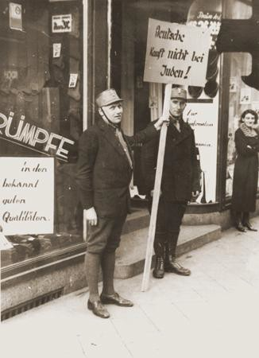
April Boycott
This is the first official action by the Nazi state against the Jewish population.
1933 1 April
Nazi Stormtroopers (SA) stand in front of Jewish-owned shops and businesses, doctors’ surgeries and law firms to prevent customers from entering.
Members of the SA block the entrance to the Jewish-owned Erwege store on Fackelstrasse to enforce the April boycott of Jewish businesses. Photo: www.ushmm.org

Slide 4
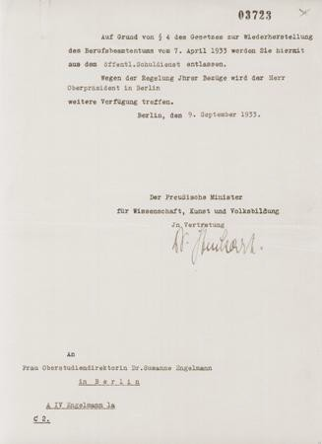
Law on the Restoration of the Professional Civil Service
1933 7 April
Jewish government workers are fired.
Civil servants thought to be against the Nazis are sacked and ‘non-Aryans’ are forced to resign from their jobs.
Letter to Dr Susanne Engelmann informing her that she had been sacked from her teaching position under the Civil Service Law of April 7, 1933.
Photo: www.ushmm.org

Slide 5
Law on Admission to the Legal Profession
1933 7 April
Jewish people are not allowed to be lawyers or judges.

Slide 6
Law on Editors
1933 4 October
Jewish newspaper editors are sacked.

Slide 7
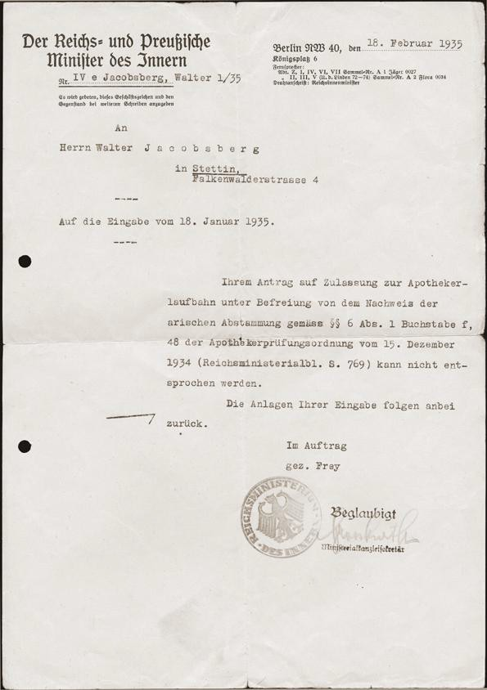
Law Against Overcrowding in Schools and Universities
1933 25 April
.
The number of Jewish students allowed to go to state schools and universities is limited.
A letter sent to Walter Jacobsberg by the German interior ministry,
telling him that his application to go to a school of pharmacology has been rejected, due to his ‘non-Aryan’ status.
Photo: USHMM

Slide 8
Nuremberg Laws
1935 Sept and Nov
Anyone with three or four Jewish grandparents is considered to be a Jew. People with two Jewish grandparents are considered to be Jews if they are also part of the Jewish religious community, or if they are married to a Jew.
Marriage between Jews and ‘Aryans’ is banned.
Sex between Jews and ‘Aryans’ is illegal.
Jews are not allowed to be Reich citizens or to vote.
Jews are defined in law by ‘race’, not religion.

Slide 9
Measures against Jews
All Jewish-owned businesses are registered with the Nazi authorities and marked with the Star of David.
1938
Jewish people must tell the Nazis about all the property they own that is worth more than 5000 Reichsmarks.
Jewish passports are stamped with the letter ‘J’.
Jewish men must take the middle name ‘Israel’.
Women must take the middle name ‘Sara’.

Slide 10
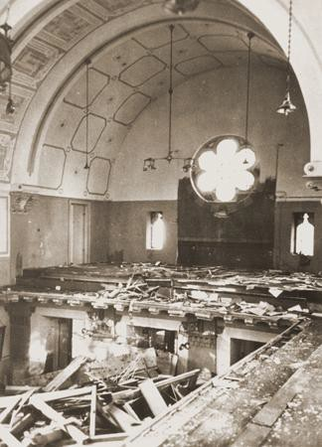
The November Pogrom (Kristallnacht)
1938 9-10 November
Across the Third Reich, a night of violence against Jewish people results in nearly 100 murders.
Jewish homes and Jewish-owned businesses and shops are attacked, and cemeteries are vandalised. 267 synagogues are burned or destroyed. At least 20,000 Jewish men are rounded up and sent to concentration camps. Hundreds die in the camps within weeks of arrival.
Prayer books lie scattered on the floor of the choir loft in the Zerrennerstrasse synagogue, destroyed in the November Pogrom. 10 Nov 1938. Pforzheim, [Baden] Germany. Photo: USHMM

Slide 11
Law for the Elimination of the Jews from the Economic Life of Germany
1938 12 November
Jews are not allowed to own shops or businesses.
Businesses are closed down. Owners are forced to sell them for much less than they are worth.
All Jewish managers are to be sacked.

Slide 12
Jewish community fined
1938 12 November
Jewish people are said to have ‘provoked’ the damage caused by Nazis and others in the November Pogrom.
German Jews are forced to pay a fine of one billion Reichsmarks for the damage caused by these riots.

Slide 13
Jewish children
1938 15 November
Jewish children are expelled from all state
schools.

Slide 14
Jewish houses
1938 28 December
Jews to be forced into ‘Jewish houses’.
Hermann Göring orders that Jewish families will be forced to sell their homes and move in together in ‘Jewish houses’.

Slide 15
Central Office for Jewish Emigration
1939 24 January
Hermann Göring gives Reinhard Heydrich the job of forcing Jewish people to leave Nazi Germany.

Slide 16
Hitler’s speech
1939 30 January
Adolf Hitler claims that if there is another world war it will have been caused by the Jewish people.
If so, Hitler says, the result will not be the destruction of Germany but ‘the annihilation of the Jewish race in Europe.’

Slide 17
Creation of Ghettos
1939 21 September
Jews are to be grouped together in ghettos in the towns to make it easier
to control and later deport them.
Orders of Reinhard Heydrich
Ghettos are created in Nazi-occupied Poland.
Ghettos are parts of villages, towns or cities where Jewish people are separated from non-Jews.
In some places, ghettos are temporary. Elsewhere, they last for a long time.
Ghettos are created in order to control the Jewish population. At this time, the Nazis do not know what they ultimately want to do with Jewish people.

Slide 18
The Madagascar Plan
1940 3 July
The approaching victory gives Germany the possibility, and in my view also the duty, of solving the Jewish question in Europe. The desirable solution is: all Jews out of Europe.
Franz Rademacher, Reich Foreign Ministry
A plan is suggested to dump all the Jewish people of Europe onto the African island of Madagascar.

Slide 19
German army guidelines for behaviour of soldiers in Russia
1941 4 June
Just before the German invasion of the Soviet Union, German soldiers are given special instructions. They are told to destroy all opposition and resistance in the newly-occupied lands.
Jewish people are to be treated as partisans, saboteurs and resisters in ‘the complete elimination of any active or passive resistance.’

Slide 20
Heydrich to develop a ‘total solution’
1941 31 July
The mass murder of Jewish people has begun.
Reinhard Heydrich is given the power to plan a ‘total solution of the Jewish question’ in all parts of Europe that the Germans control.
In the East, four special killing units called Einsatzgruppen are formed. They follow the German army as it moves further into the Soviet Union. Their task is to murder Jewish people in cities, towns and villages. Many local people help the Einsatzgruppen.

Slide 21
Jewish people are trapped in Nazi Europe
1941
18 Oct 1941 Himmler telephones Heydrich and orders: ‘No emigration by Jews to overseas’.
23 Oct 1941 Gestapo Chief Heinrich Müller passes on Himmler’s order that Jewish people are not allowed to go overseas.
4 Nov 1941 Adolf Eichmann tells the Foreign Office that emigration of Jews from all over Europe has been stopped.

Slide 22
Forced deportation of Jews
1941 October
From October 1941, Jewish people are deported by train from Greater Germany to ‘the East’.
In the first few weeks 20,000 German Jews are deported to the Lodz ghetto. It causes terrible overcrowding.
Deportations to Lodz are then stopped. From November 1941 until October 1942, 49,000 German Jews are deported to Riga, Minsk and Kovno instead. Nearly all are shot on arrival.

Slide 23
Operation Reinhard
1941
Himmler puts Odilo Globocnik, a leading SS man, in charge of exterminating the Jewish population inside Nazi-occupied Poland.
October
At this time, around 2.5 million Jewish people were inside Nazi occupied Poland (known as the General Government). Globocnik’s had two jobs: ‘resettling’ these people (code for killing them) and seizing their personal possessions. He recruits staff to run the programme and to run the places where people will be killed: death camps. Three of these camps will be constructed for Operation Reinhard – Belzec, Sobibor and Treblinka.

Slide 24
Decision to murder all Jews in Europe
1941
December
11 Dec 1941 Hitler declares war on the United States.
“With regard to the Jewish question, the Führer is determined to settle the matter entirely. He prophesied to the Jews that if they again brought about a world war they would be annihilated. That was not just an empty phrase. The world war is here; the extermination of the Jews must be a necessary consequence.
”
13 December 1941, Josef Goebbels wrote in his diary
18 Dec 1941 Himmler’s notes for a report to Hitler: ‘Jewish question: eradicate them as partisans’.

Slide 25
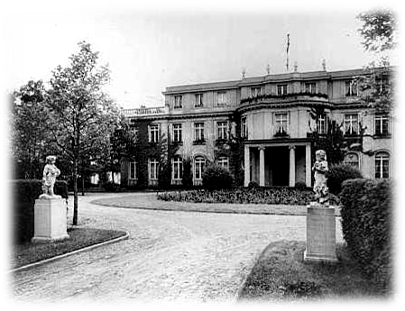
Wannsee Conference
1942 20 January
By December 1941 a decision is taken at the very highest level of Nazi leadership to extend the mass killings of Jews in the occupied Soviet Union to the murder of every Jewish man, woman and child that the Nazis could reach.
Reinhard Heydrich then calls a meeting of lower level officials to coordinate this programme of total mass murder. They agree the basic details over breakfast at a lakeside villa near Berlin.
The villa where the Wannsee Conference on the ‘Final Solution to the Jewish Question’, organised by Reinhard Heydrich, took place. Wannsee, Germany. Ullstein Bilderdienst www.ushmm.org
Photo: USHMM

Slide 26
Death camps
1941 to 1942
The first death camp is built at Chelmno to murder the Jews of Lodz and its neighbouring towns. Killing begins at Chelmno in December 1941, using gas vans.
In 1942 death camps are built at Belzec, Sobibor and Treblinka in Nazi-occupied Poland. They are built to murder Poland’s Jews in gas chambers.
The largest death camp is Auschwitz-Birkenau. There Zyklon B gas is used to murder about one million Jewish people from all over Europe.
Tens of thousands of others are also murdered in Auschwitz, by starvation, shooting and gas, including Poles, Roma and Soviet prisoners of war.

Slide 27
Globocnik reports
1944
Odilo Globocnik submits his final report for Operation Reinhard to Himmler
January
Operation Reinhard – the programme to murder the Jews of Nazi-occupied Poland – was ended in late 1943. By then, around 1.7 million Jewish people had been murdered in Belzec, Sobibor and Treblinka and in related shootings. In addition, some Poles, Roma and Soviet soldiers had also been killed in the Reinhard camps. In his report Globocnik tells Himmler they have seized money and belongings worth hundreds of millions of Reichsmarks.

Slide 28
Death marches
1944 to 1945
As the Soviet Army forces the Germans to retreat from eastern Europe, Himmler orders all concentration camp prisoners be brought into Nazi Germany.
This is to stop them from telling their stories to the Allied armies and because the prisoners are needed to work for the German war effort.
Tens of thousands of camp prisoners are loaded onto open trains or made to walk hundreds of miles. The guards have orders to shoot those who collapse or who cannot keep up. Thousands are shot or die from exhaustion and of cold in the harsh winter of 1944-5.

Slide 29
Hitler’s Political Testament
1945 29 April
With the war lost, and the Soviet army entering Berlin, Adolf Hitler decides to kill himself. He sits down to write his last words.
Hitler raves against the Jewish people above all others, blaming them for all of Germany’s problems and for the world war that he himself caused.
He calls upon the German people to: ‘...observe the racial laws most carefully, to fight mercilessly the poisoners of all the peoples of the world, international Jewry.’

Slide 30
The end of the Holocaust
1945 May
On 8 May 1945, Germany surrendered unconditionally to the Allies.
After Hitler’s suicide Admiral Karl Dönitz became the leader of Germany. With the war clearly lost, Dönitz and his representatives took steps to formally surrender to the Allies. This came into effect at 11pm on 8 May. Nazi Germany was no more.
The military defeat of Nazi Germany meant that the persecution and murder of Europe’s Jews had come to an end. But for those who survived, pain and suffering remained.

