Slide 1
Surviving survival?
Life and trauma after the Holocaust
Notes:
Lesson Introduction:
Explain to students they will be learning more about Leon Greenman’s later life, after he had retired from work as a market trader and bookseller.
Outline how they will be working with information cards. Through this process they will be aiming to:
Expand knowledge and understanding of Leon’s story and mission in later life.
Consider the long-term impact of the Holocaust on those who survived
Explore whether life can ever be ordinary and fulfilling after experiencing genocide
Note the need to begin by establishing what is known about Leon so far.

Slide 2
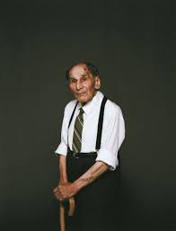
This is Leon Greenman What do you see when you examine this photo?
©Joel Redman
Notes:
Exploring an Opening image & Learning More About Leon.
Ask students what do they see when they examine this photo. Refer to lesson plan for questions:
Ask how old they think he is when this photo was taken? Explain that Leon is 97. Students may notice the tattooed number on his arm (98288) and his firm grip on the walking stick. Ask if students can remember the circumstances that led to the tattoo being there and the horrors that this tattoo represents (Auschwitz concentration camp). You might follow this by asking students what it must have been like for Leon to have that permanent reminder of the trauma he endured in the concentration camps and the ‘death march’. You may also wish to ask students, as they examine the photo what they see when they look at Leon, now at the remarkable age of 97? (Strength/determination/vulnerability – all three?)
Remind students of the original encounter with Leon. To help students you might ask:
What was life like for Leon before the war?
Where did he meet his wife?
What was his job?
When was his son born?
Where were they living?
What changed everything for them?
The next slide may prompt memory and pooling of knowledge.

Slide 3
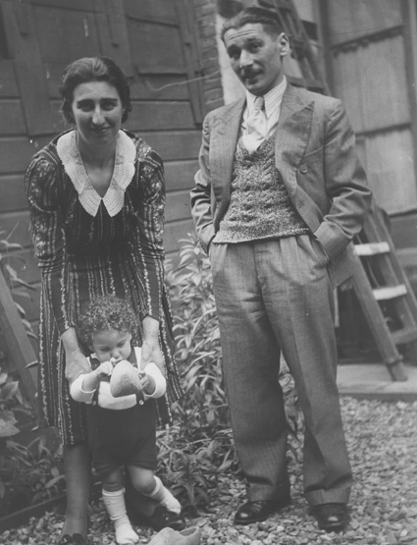
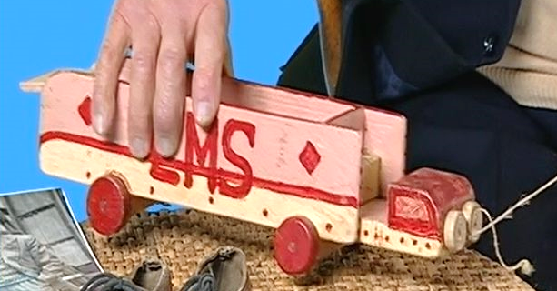
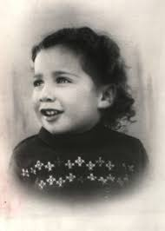
Looking back: What happened to Else and Barney?
©Jewish Museum, London
Ruth-Anne Lenga, with thanks to the Jewish Museum, London
Ruth-Anne Lenga, with thanks to the Jewish Museum, London
Notes:
Looking Back
Through directed questioning, revisit the family’s deportation from Westerbork transit camp in the Netherlands, what happened to the Greenman’s on their arrival at Auschwitz-Birkenau in January 1943, and the murder of Leon’s wife Else and son, Barney. Ask students what they remember happening to Leon in the years Leon spent as a Jewish prisoner at the hands of the Nazis, before finally being liberated in April 1945.

Slide 4
Leon's later life: What happened after Leon was liberated?
©Jewish Museum London
Notes:
Leon’s later life:
Ask them if they think Leon was free once he was liberated? (Here you can probe what students understand about liberation for an individual who has lost everything). Suggest to students there is much still to find out about Leon’s life, particularly his later years when he was in his 80s and 90s.
What did the future hold for Leon?
What was the best he could hope for?
Did he remarry or find happiness?
How would he try to make a meaningful life for himself?
What did he do that was remarkable?
What problems did he face?

Slide 5
Reflecting on Leon’s life: What questions are we left with about Leon?
What did the future hold for Leon?
What was the best he could hope for?
Did he remarry or find happiness?
How would he try to make a meaningful life for himself?
What did he do that was remarkable?
What problems did he face?
Task: Using the information cards 1-3 answer as many of these questions as you can. Record your findings on a large sheet of paper.
Notes:
Fact finding: Learning more about Leon
Forward the questions on this slide as examples of some of the questions which are still to be addressed in their encounters with Leon and outline the activity ‘Learning more about Leon’. Organise students into small groups as you see most appropriate. Distribute the downloaded information cards 1-3 to these groups (Leon’s fight, Leon’s later life, Londoners Honour Leon). Explain to students they are going to piece together a picture of Leon’s later life in his 80s and 90s.
Allow 15 minutes for the 3 Rs - read, research, and respond. When all members of the group have conducted their research invite the class to feedback in plenary style. Share results in a 1-minute feedback session from an appointed rapporteur for each group. Emphasis should be on what students discovered about Leon’s later life and what it reveals about how the Holocaust affected him. The questions on the slide 7 can help focus thinking:
What was Leon’s mission in later life and how did he pursue this?
How did others respond to his activities?
How did the Holocaust continue to feature in Leon later life?
Was Leon ever free of the Holocaust?
How did he live with the memories?
What do we understand about survival?
Do you think it is possible to lead a normal life after the Holocaust?
Allow class feedback. Suggest to students there is much still to find out about Leon’s life, particularly his later years when he was in his 80s and 90s.

Slide 6
Fact Finding: Surviving survival information cards
Notes:
Distribute the downloaded information cards 1-3 in groupings you see most appropriate (Leon’s fight, Leon’s later Life, and Londoners honour Leon). Share results in a feedback session from an appointed rapporteur for each group.

Slide 7
How do you think Leon coped with the long-term effects of the Holocaust?
What was Leon’s mission in later life and how did he pursue this?
How did others respond to his activities?
How did the Holocaust continue to feature in Leon’s later life?
Was Leon ever free of the Holocaust?
How did he live with his memories?
What do we understand about survival?
Do you think it is possible to lead a normal life after the Holocaust?
Notes:
(10 mins) Discuss with students whether they think Leon could ever leave behind what happened to him and ‘move on’? What have they found out which suggests he could never do that?
Explain that Card 4 will need them to use all their skills of empathy to see things from Leon’s perspective.

Slide 8
Card 4:
The struggle of trauma
Notes:
(5 minutes)
Share Card 4 (The struggle of trauma). Explain that this describes how difficult it was to live with the memories and how nightmares haunted Leon and tortured him. Explain also how art helped him but that the problems continued daily from the time he was liberated to his elderly years.
Invite students to try to consider what trauma may be still be present in Leon’s life despite the remarkable work he is doing to make the world a better place.
Feedback

Slide 9
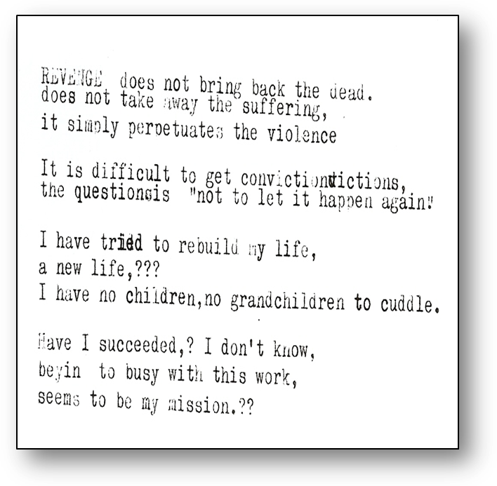
Card 5: Leon’s unfinished poem
By Leon Greenman. With kind permission from Ruth-Anne Lenga
Notes:
Leon’s unfinished poem
On screen and Card 5
Ask students to follow as you read the poem and draw their attention to the fact it was discovered in in home by his close friend Ruth-Anne Lenga ( Programme Director of UCL Centre for Holocaust Education) after Leon passed away. She picked it up, read it through and realised it was a deeply moving last reflection of Leon on his life.
Prompt questions might include:
What is meant by the word revenge?
Why does Leon write the word in capitals?
Why does he appear to reject taking revenge?
Who might Leon be referring to as the ones who should be convicted and why might that be difficult?
When Leon says he tried to rebuild his life what can you infer about how challenging that was for him?
From what you have learned about Leon after the war what did he do to try to prevent the Holocaust happening again
Why has he placed 3 question marks after ‘ a new life’? How would you respond to the final question he poses?
What is the mood of the poem?
What might the mood say about Leon’s feeling at the time of writing?
Instruct students to think carefully in silence and write notes about the two questions on the next slide
What title would you give this poem which was written by Leon?
If you were to complete the poem for Leon what would you say?

Slide 10
Questions to consider
What title would you give this poem?
If you were to respond to Leon, what would you say?
Notes:
What title would you give this poem?
If you were to respond to Leon, what would you say?

Slide 11
Thinking this through at home
Think of a suitable title to Leon’s unfinished poem
Respond to the final question Leon poses. This can be done in poem form or in a short letter to him, or simply a statement.
Answer the following 2-part question using a mobile phone voice-clip emailed to teacher or in written form:
Do you think it is possible for someone to lead a ‘normal’, ordinary life after something as traumatic as genocide? What evidence can be drawn from Leon’s later life to support your argument?
Notes:
Explain the homework task

Slide 12
Leon on his life after the Holocaust
©USC Shoah Foundation
Notes:
Play the separate film from USC Shoah Foundation IWitness
Explain to students that during this lesson we have learned much about Leon’s struggles to live with the past but also have learned of his outstanding determination not to be beaten down or overwhelmed with bitterness. Indeed, as we have discovered, Leon spent his life trying to fight racism for there to be a better world. In this final clip Leon speaks of the life he has led.
Hear from Leon – This is the only real piece we have of him talking about the challenge of survival and is very short.

Slide 13
Surviving survival?
Notes:
Acknowledgements
Lesson plan and materials created by Ruth-Anne Lenga
© Ruth-Anne Lenga, 2023 All Rights Reserved
Leon’s poem is used with kind permission from Ruth-Anne Lenga.

