Slide 1
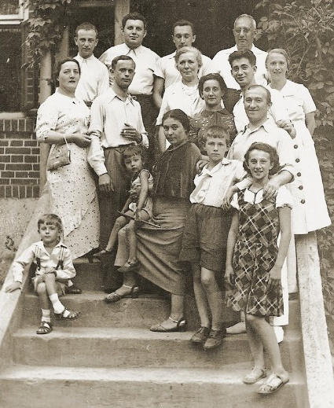
Striving to live
How did Jewish people respond and resist during the Holocaust?

Slide 2
Aims
Key Question: How did Jewish people respond and resist during the Holocaust?
Lesson 1:
To consider the various challenges Jewish people faced

Slide 3
'Who' are we talking about?

Slide 4
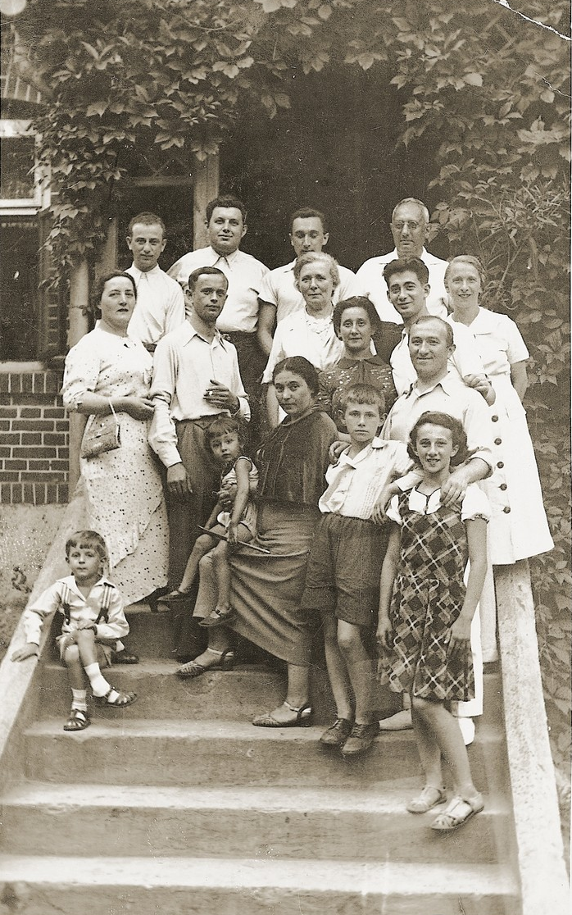
Poland in the 1930s
How would you describe these people?
How are they related?
As the Holocaust unfolded, if people like these had wanted to ‘fight back’, what challenges do you think they would have faced?
Would some people have found it easier to act than others?
Photograph of the Szwajcer family
Czena, Poland, 1936
Poland 1930s
United States Holocaust Memorial Museum #25051

Slide 5
What challenges did
Jewish people face?

Slide 9
Rozenfeld - Ringelblum Archive/Jewish Historical Institute

Slide 13
The Auschwitz Album donated by Lilly Jacob-Zelmanovic Meier
Yad Vashem. Photograph 132

Slide 14
‘In front of the building there were pots of geraniums and a sign saying “Hackenholt Foundation”, above which there was a Star of David. The building was brightly and pleasantly painted […]
[…] I do not believe that the people who had just arrived had any idea of what would happen to them.’
Professor Wilhelm Pfannenstiel, Waffen-SS hygienist

Slide 15
Rudolph Vrba - The World at War TV series. Episode 20 - ‘Genocide 1941-1945’ (1974)

Slide 16
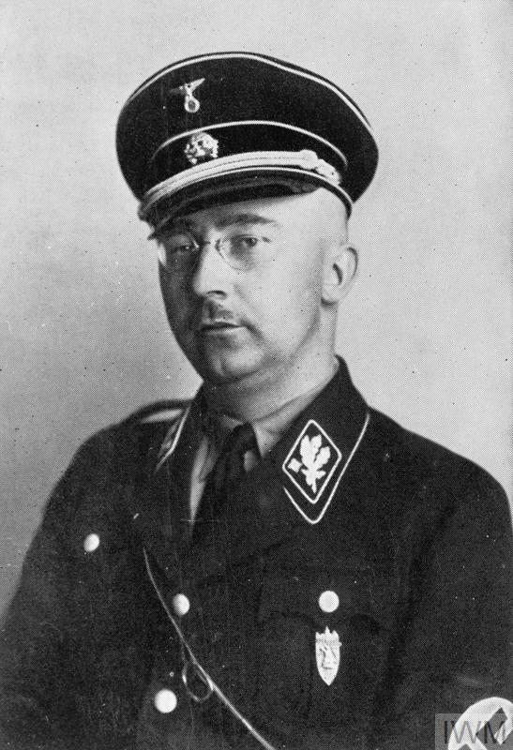
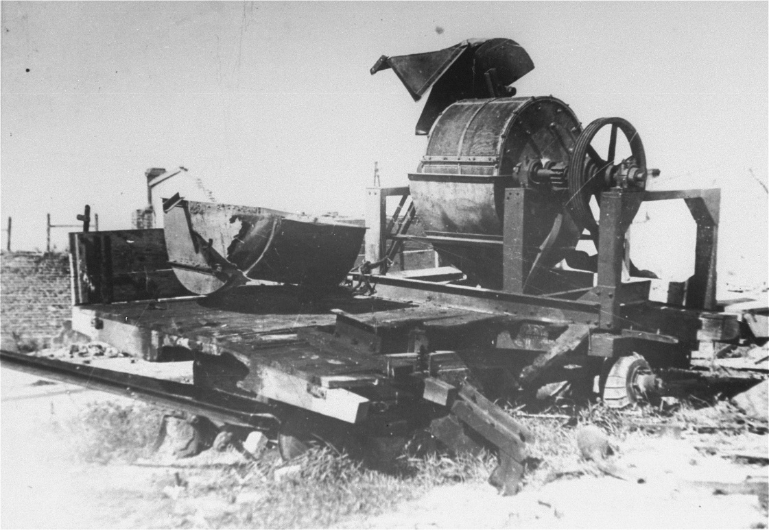
‘This is an unwritten and never-to-be-written page of glory in our history’
Speech by Himmler Before Senior SS Officers in Poznan, October 4, 1943
Yad Vashem Shoah Resource Center, The International School for Holocaust Studies
View of the bone crushing machine used in the Janowska concentration camp to grind the bones of victims after their bodies were burned.
United States Holocaust Memorial Museum #69978
Heinrich Himmler (1900 - 1945)
Formal portrait of Himmler.
IWM HU 7315

Slide 17
Aims
Key Question: How did Jewish people respond and resist during the Holocaust?
Lesson 2:
To consider how and why people responded in the ways they did

Slide 18
How did Jewish people respond and resist?

Slide 19
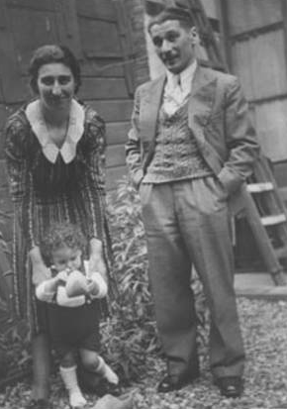
Leon Greenman
D
Born in London in 1910, Leon Greenman lived in Rotterdam in the Netherlands with his wife Esther (‘Else’) and their two and a half year old son Barney. In October 1942 they were rounded up with other Jewish families and interned in Westerbork transit camp. Leon, Else and Barney were deported to Auschwitz in January 1943. Else and Barney were murdered upon arrival.
Of the 700 people who arrived from Westerbork that day, 50 men were counted off for work. Leon was one of the men selected. Not knowing of the fate of his wife and young child, Leon used his initiative to survive. He connected with people for mutual support. He visited barracks in Auschwitz III-Monowitz offering to sing for extra bread or soup and supplemented his rations by using his barber skills. He made decisions such as choosing where to sleep during a death march to ensure he didn’t die in the frozen night. He was determined to see his family again and tell the world what had happened.
Seriously ill with pneumonia, Leon had a dream where Else and Barney were missing. Telling a friend of his dream and that he no longer wanted to go on, his friend asked what Else and Barney would do if they returned to England and found Leon had given up. This made Leon resolve to survive in the hope of being reunited with his family.
An Englishman in Auschwitz, page 96. Vallentine Mitchell Publishers
1942
Leon Greenman with his wife Esther (‘Else’) and son Barney (Barnett)
Jewish Museum, London

Slide 20
Reflection
Questions for discussion:
What, if anything, do these case studies have in common?
Are there differences between these case studies? If so, what are these?
Did people always achieve what they were trying to do? Does it matter if they didn’t?
What is the most significant factor for why people responded or resisted as they did?
What do these case studies suggest about Jewish people’s responses and resistance during the Holocaust?

Slide 21
Statements
Statements to correct:
The reason why people didn’t ‘fight back’ was because they didn’t have weapons.
Women couldn’t ‘fight back’ or join partisans because they had to take care of their families.
The only way to resist during the Holocaust was to take up arms.
There was little point in resisting because the perpetrators would always win.
Given the terrible conditions, it was impossible to fight back in the ghettos or camps.
Children and teenagers didn’t respond because they were too young to understand what was happening.

Slide 22
Striving to live
Notes:
See lesson plan for acknowledgements and credits.

