Slide 1
Who were the victims of Nazi persecution?

Slide 2
Starter
During the period of Nazi Germany (1933-1945), a number of minority groups were persecuted.
1. What does ‘persecute’ mean?
2. Which groups do you know were persecuted during this time?

Slide 3
What ‘persecute’ means
Persecute means to treat someone badly over a period of time because of their religion, political beliefs or ethnic background.
People can be persecuted in different ways.
Who was persecuted during the Nazi period? Was everyone treated in the same way?

Slide 4
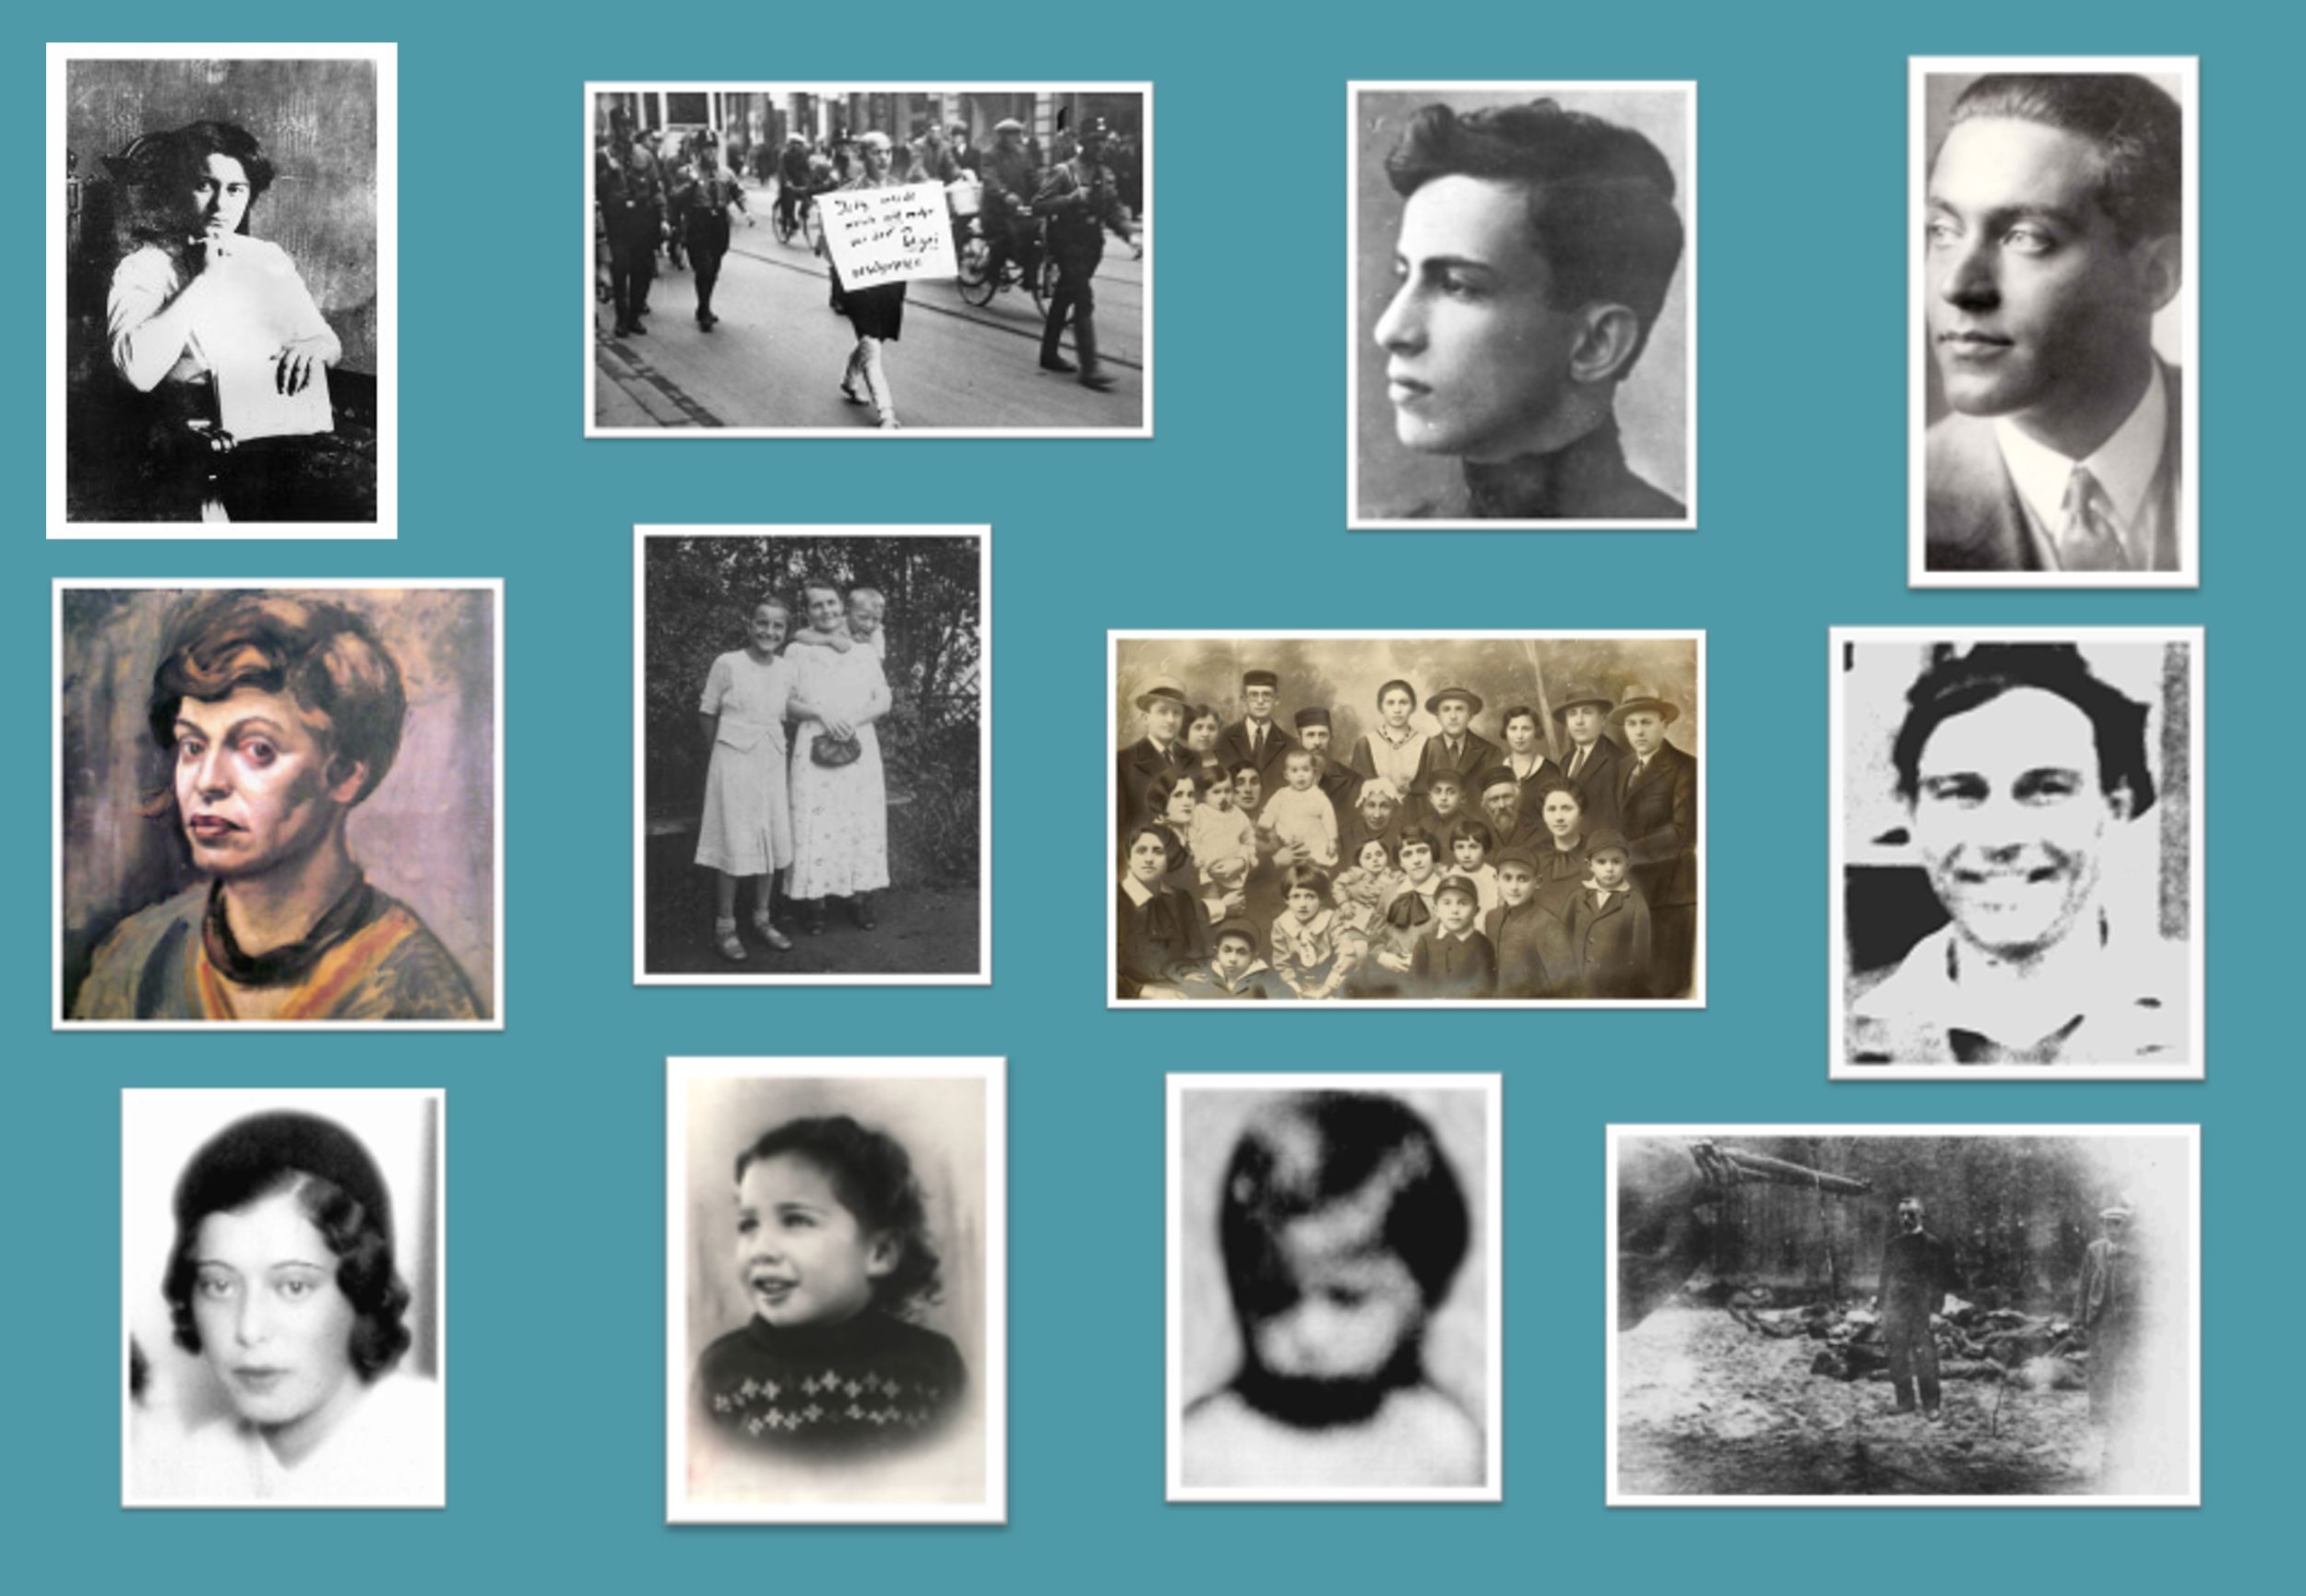
Personal stories
You have a collection of stories of people who were persecuted during the period of Nazi Germany.
Each story tells us more about how different groups were treated.
Read each story. Use the Key Terms guide to help you. Record essential information on your grids.

Slide 5
Name | How were they persecuted? (e.g. ‘arrested for ___’, ‘sent to a concentration camp’, ‘lost their job’, ‘killed in 1941 by ___’)

Slide 6
Who was persecuted during the Nazi period? Was everyone treated in the same way?

Slide 7
