Slide 1
Nazi Antisemitism: where did it come from?
Notes:
Opening Slide. Image If you are asked about the image here, it depicts Süßkind (“Susskind”) von Trimberg, a Jewish poet from the Holy Roman Empire in the thirteenth century, and it is taken from the Codex Manesse. You may wish to explore this image, commenting on the depiction of the Jewish poet in contrast to the Christian figures in the picture. He wears a Judenhut and traditional facial hair marking him as Jewish, yet he is richly dressed in a dyed fur cloak, indicating a level of material comfort. The Christian figure is likely to be a land-holding bishop of some kind (which were common in the Holy Roman Empire) who is a patron of Süßkind, or is hearing a performance (medieval poetry being largely an oral tradition). The centre of power on the left-hand side of the image is explicitly Christian – with a banner showing the cross and a crook indicating the bishop’s role as ‘shepherd’ of the Christian flock. It might be worth reflecting with participants on how even a successful Jewish figure in the medieval world was dependent on the good will of an exclusively Christian land-holding class (either ecclesiastical or secular) that they could never join and were excluded from – Jews could not hold land in most of Europe, could not marry Christian feudal aristocrats and could of course not advance in the Christian church. Jews were expelled from a number of cities in the Holy Roman Empire, dependent on local politics, and were constantly at risk of pogrom, expropriation or exile.

Slide 2
On the next two slides are several antisemitic images of Jewish people. These are not based in reality but on lies and false beliefs – we are going to work together to deconstruct them to understand antisemitic beliefs, but we know they do not reflect real Jewish people. It is completely normal to feel upset or uncomfortable about images like this.
Notes:
Share the aims and objectives with your students. Important: Before moving to Slides 3 and 4 explain to students that they are going to be studying several hateful antisemitic images – images which depict a false and imagined vision of what Jewish people were like – totally distinct from the real Jewish people your students will have come across in their study of pre-war Jewish life. Emphasise that these images do not reflect real Jewish people who actually lived, but an imagined, stereotypical version which existed only in the imagination of the majority Christian population.

Slide 3
Notes:
Images: Left: ‘How Jewish traders cheat’ from The Poisonous Mushroom (1938) (Yad Vashem Photo Archive) Right: ‘How the Jews came to us’ from The Poisonous Mushroom (1938) (Yad Vashem Photo Archive) These images are from the propaganda book known as The Poisonous Mushroom which sought to ‘teach’ young German children about the nature of Jews and how they were different from so-called ‘Aryans’. The book draws on a number of false antisemitic stereotypes and a long history of visual images to mislead young children in Nazi Germany. Ask students to identify how the ‘Jewish’ individuals are being depicted in this images. What is being said about them? How are they being depicted and why? What are they doing in each image? Your students will have seen a number of photographs of Jewish people from their lessons on pre-war Jewish life, so emphasise how these cruel caricatures are totally different from reality – inventions designed to mislead young people into becoming antisemites.

Slide 4
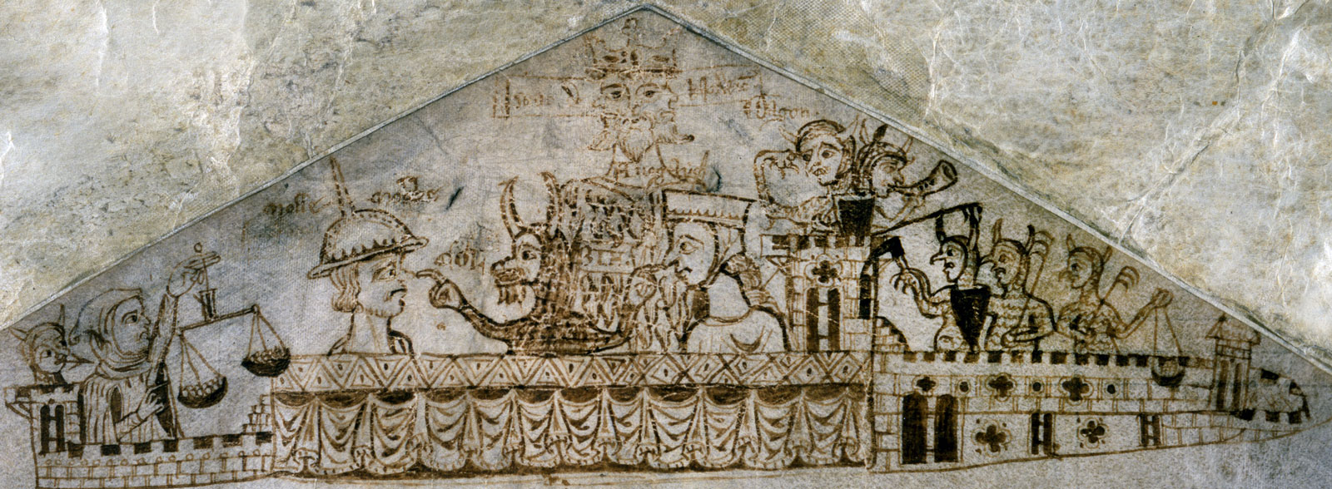
Notes:
Image: Upper margin of the Exchequer Receipt Roll, Hilary and Easter Terms, 1233 (National Archives) This image is not an illustration but a ‘doodle’ – this was drawn by an unknown scribe on a tax roll in the thirteenth century. It may well be the first visual image (or oldest surviving at least) showing the invented images of Jewish people that would form much of the visual language of antisemitism in Europe. Ask students to identify what they can see in the images. How are the depictions of ‘Jewish’ figures similar and distinct from the images on the previous slide? What is being claimed about Jewish people in these depictions? Money: On the left of the image, a Jewish figure is depicted with weighing scales weighed down with coins. Physical features: Much like in the images from The Poisonous Mushroom, the figures are depicted with imagined physical features drawn from a visual language of antisemitism. The forces of evil: In this earlier, primarily Christian, image Jews are associated with a number of demonic figures – horned figures wielding weapons and attacking the castle. The central demon tweaks the nose of a morose looking ‘Jewish’ figure.

Slide 5
Roots of Antisemitism – how can we use this film?
Notes:
The film can be found here: https://www.iwm.org.uk/learning/resources/the-way-we-lived-exploring-jewish-life-and-culture Explain that students need not take notes on the film – they just need to take it in while watching. The film contains a great deal of information over a large chronological sweep of history which will support the student’s work in subsequent tasks. You may wish to ‘chunk’ the film to support children’s working memory by playing the medieval segment of the film (up to 5:06), discussing it, and then moving on to the early modern and modern section (5:06 – 12:01). At the end of the film, or after each chunk, you will wish to question students’ understanding on what they have seen. What do they think is the most significant knowledge to take from the film and why?

Slide 7
Notes:
1CE Onwards – This can open a conversation about the theological basis for Christian antisemitism. See the lesson guidance on Christian discomfort to support this. 1555CE – When discussing these restrictions on Jews, address the misconception that the ghettos of early modern cities were the same as the ghettoes of Nazi Germany, and discuss how that can be challenged with students. 1806CE – Here you can explore the ‘Enlightenment’ push to remove restrictions on Jews in Napoleon’s law codes. You should emphasise that in some territories the restrictions were restored after Napoleon’s defeat and explore the nature of ‘assimilation’. You can also reenforce here that the history of antisemitism is not a single narrative trajectory leading teleologically to the Holocaust, and that things could have been otherwise. 1859CE – Ensure that teachers understand the primacy of this card in understanding the move from ‘religious’ anti-Judaism to ‘racial’ antisemitism, and the importance of that for student understanding. 1879CE – Here you can discuss the origins of the term ‘antisemitism’ and explore possible misconceptions around identity relating to Jews being a ‘race’ or ‘religion’. 1903CE – Here you can explore the centrality of conspiracy theories to the world-view of ‘modern’ antisemitism, and the inflammatory power of conspiracist thinking. 1942CE – With this card, you can connect to the learning about Leon Greenman that participants previously have. You can then explore with teachers the eliminationist nature of Nazi antisemitism, which made is distinct from other ‘modern’ antisemitic movements. You can discuss with teachers how best to emphasise this distinction with students.

Slide 8
Nazi Antisemitism: where did it come from?
Notes:
Acknowledgements
Lesson plan and materials created by Darius Jackson, Andy Pearce and Paul Salmons © Darius Jackson, Andy Pearce and Paul Salmons 2014
Artwork adapted from a design by Cheryl Lowe
Roots of Antisemitism film by Paul Salmons and Rachel Donnelly (Imperial War Museum, 2013)
For further information about the lesson see Darius Jackson ‘”But I still don’t get why the Jews”: using cause and change to answer students’ demand for an overview of antisemitism’, Teaching History, 153 (2013).
The metaphor of locks and keys is from Chris Culpin.
All images are from Morguefile Free Photos apart from the keys for the ‘Modern Keys’ and the padlock and keys on the front and back slides, which are from Darius Jackson.
Examples of students work is by Freya and Inga Jackson.

