Slide 1
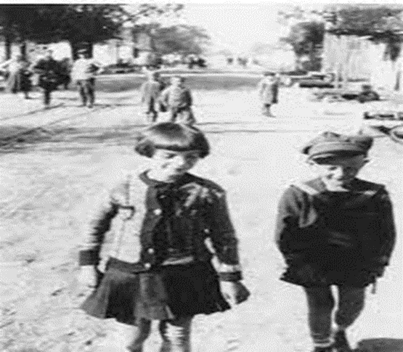
Who were the six million? Exploring Jewish life before the Holocaust

Slide 2
Develop student knowledge and understanding about:
The diversity of Jewish life in Europe before the Second World War
What was lost as a result of the Holocaust
The long history of Jewish communities across Europe
The important contributions made by Jewish people to their communities and countries

Slide 3
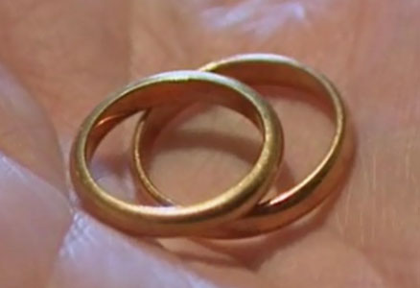
What do you see?
Notes:
What do you see? Approach this in two ways: in both a literal sense and then in a more abstract way.
What do you see on a literal plane? Can we unpack this with our students? How do we know? How do we know they are rings? How do we know they are wedding rings? How do we know they are old?
What do we see beyond the literal? What questions does this raise for us? Marriage, where is the owner etc.

Slide 4
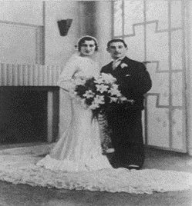
Who are they?
Was it a happy marriage?
How did they meet?
When did they live?
Did they have children?
What jobs did they do?
Notes:
These are the owners of the objects. This is Leon Greenman and Else van Dam on their wedding day, the day when they exchanged the rings.
What new information can we extract from this image? - fashion, old fashioned, wealthy.
What questions might your students have? Then reveal the annotated questions. Curiosity of students, encouraging enquiry and questions.

Slide 5
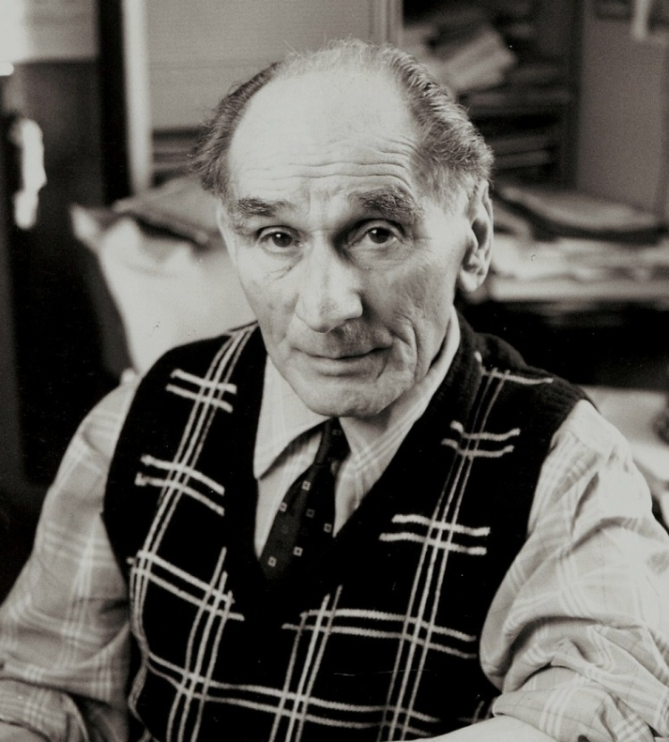
Who were they? How did they meet?
How did Leon meet Else?
Where did they get married?
Where did they live after they married and why?
Notes:
As you watch this film clip listen for the answers to the questions on this slide. Here is Leon as an older man. Whole film part of a 3 hour interview, the Shoah Foundation, IWitness.
Esther van Dam, Leon called her Else.
They met when Else was on holiday in Rotterdam. She was from the Netherlands but working as a seamstress in London.
Leon was singing and Else was in the audience, he walked her home. She knew that he would be her husband as he was the first boy who didn’t try to kiss her on the way home, page 8.
Does anything surprise you about their story? Travel, very cosmopolitan – very ‘modern’? Leon born in London but lived in Rotterdam
Married in a Shul, East London Synagogue in Stepney, 9th June 1935 – this is the first time we think about this couple as being Jewish. Shul is Yiddish for school, often used to describe a synagogue (Yiddish medieval German with Hebrew lettering, mainly used by Ashkenazi Jews, those who originated in Eastern Europe).
Honeymoon in Brighton.
Lived in Rotterdam so that Else could care for her grandmother and Leon travelled for work.

Slide 6
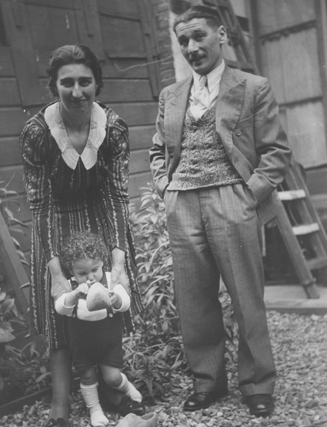
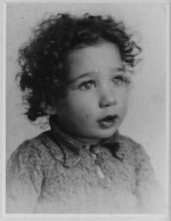
Did they have children?
Notes:
Introduce Barney – named after Leon’s father Barnett. Born on 17 March 1940. Germany invaded the Netherlands on 10 May 1940.
Image taken in the summer of 1942, Rotterdam, in the garden of neighbours. Shortly after this image was taken it was forbidden for Jews to visit non-Jews. In October 1942, along with other Jewish families from Rotterdam, the Greenmans were deported to Westerbork transit camp – a holding camp before deportation to the East.

Slide 7
A note from Leon
Notes:
Play the short clip giving the context of the rings and Leon’s note.

Slide 8
What do you see now?
Notes:
The objects have not changed, but how – if at all – has your perception of them? What may have caused this change?
Students may see other things now they have the context.
Question of significance: what is the significance of a pair of wedding rings? What is the significance of these particular wedding rings?

Slide 9
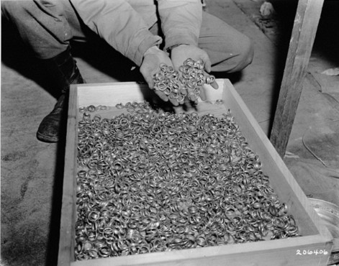
www.ushmm.org
Notes:
A soldier dips his hands into a crate full of rings confiscated from prisoners in Buchenwald, found by American troops in a cave adjoining the concentration camp. Original caption reads:
‘These are a few of the thousands of wedding rings the Germans removed from their victims in order to salvage the gold. U.S. First Army troops found these rings with watches, precious stones, eyeglasses, and gold teeth fillings, in a cave adjoining the Buchenwald concentration camp near Weimar, Germany. 5/5/45.’
Another link here is that Leon was finally liberated from Buchenwald by the Americans on 11 April 1945. Get students to consider Who were all these people? What lives did they live before the genocide? What do each of these rings/pairs of rings represent?

Slide 10
What do you see?
Notes:
This image shows the site of the former town of Trochenbrod.
Leave the initial questioning very open. Students may describe what they can see: grass, trees, sky, telegraph poles, track. Draw out what impression this image creates: space, emptiness, any signs that something was once in this space?
© Christian Herrmann

Slide 11
The ‘lost town’ of Trochenbrod
Notes:
All of these photographs show inhabitants of the town of Trochenbrod in the 1930s. All images and testimony appear in the book ‘The Heavens are Empty: Discovering the Lost Town of Trochenbrod’, Avrom Bendavid – Val, published by Pegasus Books, NY. Permissions pending.
Crowd photograph shows some of the inhabitants of Trochenbrod. Taken by Ruchel Abrams in 1930, whilst on a visit from Cleveland, Ohio.

Slide 12
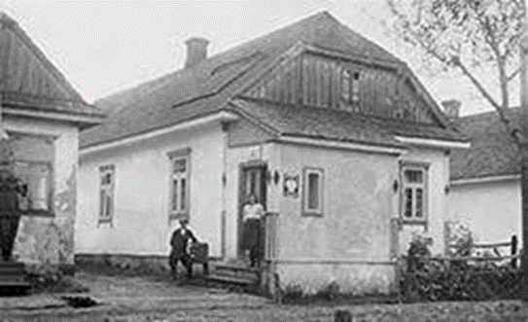
The ‘lost town’ of Trochenbrod
Notes:
This photograph of Trochenbrod’s post office was taken in the late 1930s. The Polish postmistress Janina Lubinski is standing on the doorstep. She hid Jews in her attic during the 1942 murders. Along with her son (shown in the image on the next slide) they were the only non Jewish residents in the town of Trochenbrod. Ellie Potash is standing on the step of his house which is next door (his daughter is shown in the image on the next slide). The post office was originally built as a house. You can see that a section of the roof could be opened to the sky for the Sukkot holiday, the Feast of the Tabernacles.

Slide 13
The ‘lost town’ of Trochenbrod
Notes:
This photograph shows the main street of Trochenbrod in 1939.
The girl in the foreground is Baisa-Ruchel Potash (Betty Gold). Just three years after this photograph was taken she hid in the forest with her family and was one of the few survivors from the town.
The boy next to her is her playmate, Ryszard Lubinski, son of the Polish postmistress and the only non Jewish child to be born in the town of Trochenbrod. Their parents appear on the image of the post office (see previous slide).

Slide 14
The ‘lost town’ of Trochenbrod
Notes:
The Pale of Settlement was established in the western part of the Russian Empire in 1791. It imposed geographical restrictions upon the Jews of the Russian Empire who were forced to live within the Pale boundaries.
By 1885 there were over 4 million Jews living in the Pale. Many lived in shetls, towns or villages with a majority Jewish population. The word sheltl comes from the Yiddish shtot, which means town. Shetls were Jewish communities within East European towns, essentially a Jewish village within a Gentile town. Trochenbrod had many similarities to Shetls across the Pale (home, family, Jewish traditions of primary importance). Trochenbrod differed in that it was a free-standing Jewish town, relatively isolated, and most of its inhabitants were farmers.
Jewish inhabitants of the Pale were not merely restricted territorially but also occupationally. In the main engaged in commerce and crafts, very few had the opportunity to work in agriculture, unlike the pioneering Trochenbroders.
Competition led to high levels of poverty and many sought to emigrate in the final years of the 19th and early 20th century. Life in the Pale had become even more challenging because of anti-Jewish laws and attacks (pogroms).
According to a 1897 census, 99% of those living in the Pale spoke Yiddish.
The Pale was abolished in 1917, but the majority of Jewish people in Eastern Europe continued to live within its former boundaries.

Slide 15
The ‘lost town’ of Trochenbrod
1791 – Russia’s Jewish Pale of Settlement was established in the western regions of the Russian Empire. Most of Russia’s Jews would live in this area – they were forbidden to live outside of it.
1804 – Jews are only allowed to live in the larger towns and cities of the Pale. Those who farm on unused land are exempt from this rule. The first Jewish families begin to settle the land that will become the town of Trochenbrod.
1813 – Trochenbrod’s first baby is born.
1827 – All Jewish boys must serve in the Russian army until the age of 45. Settlement in Trochenbrod increases.
1897 – Trochenbrod begins to modernise and has a range of industries. It becomes a regional commercial centre with a population of approximately 1,600 Jews.
1914 – The town is on the Eastern Front during the First World War and its inhabitants suffer terribly.
1921 – Trochenbrod becomes part of Eastern Poland.
1930s – the town is thriving, roads have been improved, there is electricity and a telephone service. It has become the place to shop and do business in the region.
Notes:
Students consider: What can we learn about pre war Jewish life in Eastern Europe from the history of the town of Trochenbrod? What can we learn about Jewish life in Trochenbrod before the war?

Slide 16
Memories of Trochenbrod
‘To me Trochenbrod looked like a street that had been picked up from a city and plopped down somewhere in the wilderness, except that the street was mud. Seeing the street being paved convinced me that what we all expected was starting to happen – Trochenbrod was going to become a city, a Jewish city. Why would I leave it?’
Peshia Gotman describes watching the start of the project to pave Trochenbrod’s street in 1938, just before she migrated to the US.
Notes:
Peshia Gotman. Quoted in ‘The Heavens are Empty’ Avrom Bendavid-Val, p.74.

Slide 17
Memories of Trochenbrod
‘Although there were plenty of poor people in Trochenbrod, they were all very wealthy. Why? Because they felt their lives were rich and they were satisfied. There’s a saying, “Want what you have, and then you’ll have what you want.” Ninety-five percent of Trochenbrod people were like that. They were salt of the earth, as they say. The very concept of stealing was unknown to them – take something that belongs to someone else, what’s that?
The people who read your book, I want to tell them that there was once a Jewish town of worthy people, hard-working people, honest people, trusting people. All they wanted was to raise children who would also be good people. That’s what Trochenbrod was.’
Shmulik Potash describes what Trochenbrod was like before the war.
Notes:
Shmulik Potash. Quoted in ‘The Heavens are Empty’ Avrom Bendavid-Val, p. 75 – 76.

Slide 18
Memories of Trochenbrod
‘The postmistress’s son was a friend of mine. They’d invite me at Christmas to celebrate with them. We were good friends with them. I remember going to his house and seeing the Christmas tree and thinking it was so beautiful, so much fun with the ornaments and everything, and the house was decorated and we had cookies. I liked it, but I knew it wasn’t our holiday. Maybe I didn’t even know it was a holiday, just a celebration of some sort. Anyway, I knew it had nothing to do with us. It was just fun.’
Betty Gold was born Baisa-Ruchel Potash and she lived in Trochenbrod as a child. She describes spending Christmas with her friend Ryszard Lubinski, son of the Polish postmistress and the only non Jewish child ever to be born in the town of Trochenbrod. The friends are photographed together on Trochenbrod’s main street in 1939.
Notes:
Betty Gold (Baisa-Ruchel Potash). Quoted in ‘The Heavens are Empty’ Avrom Bendavid-Val, p. 166.

Slide 19
Memories of Trochenbrod
‘On Friday everyone finished work early and after lunch everyone, young and old, would dash to the ritual bathhouse to take a bath, would then get dressed in Sabbath array and would go to the synagogue. In summer it was a pleasure to hear the friendly greetings ‘Shalom aleichem’ and the music of the voices of the fathers and the children were carried from the synagogues the length of the street and would enter into every limb. After supper we would sit out on our front steps and breathe in the delightful scents of the grass, the blossoms and the pine trees of the Radziwill forest. We had no electric light but there was light in our hearts and our eyes sparkled and illuminated the darkness around. We went to sleep soundly and peacefully without fear of burglars or thieves.’ David Schwarz describes his childhood memory of the Sabbath in Trochenbrod in the early twentieth century.
Notes:
David Schwarz. Quoted in ‘The Heavens are Empty’ Avrom Bendavid-Val, p. 22.

Slide 20
The ‘lost town’ of Trochenbrod
‘Trochenbrod was different from all other towns in Europe because everyone who lived there was Jewish. And because it was hidden deep in the forest, this town of 5,000 people was almost unknown beyond the nearby Ukrainian and Polish villages. Government authorities paid little attention to Trochenbrod, and Jewish customs were the only ones that mattered. All of Trochenbrod observed Jewish holidays and celebrated Jewish festivals like one huge family. Children played in the yards and fields, chuckling, yelling in Yiddish, and running up and down Trochenbrod’s one long street in complete safety and freedom. At dinner time, the aroma of Jewish cooking filled every corner of the little town and wafted into the surrounding forest.
By the end of World War Two everything was gone. Everything – Trochenbrod’s houses, synagogues, shops and public buildings, as well as its people – had been destroyed. All that remained was a double row of trees and bushes surrounded by a clearing where its farm fields had been.’
Notes:
Extract from ‘The Lost Town: Bringing back Trochenbrod’ Avrom Bendavid-Val, p. 4 – 5.

Slide 21
The ‘lost town’ of Trochenbrod
1939 – With the outbreak of the Second World War, Trochenbrod falls under the control of the Soviet Union.
1940 – Jewish refugees from German occupied Western Poland increase the town’s population from 5,000 to 6,000 inhabitants.
1941 (June) – Nazi Germany invade the Soviet Union and Trochenbrod falls under Nazi occupation.
1942 (August) – Most of the Jews of Trochenbrod are murdered by the Nazis and their Ukrainian collaborators. (September) Everyone remaining in Trochenbrod’s ghetto is murdered. (December) The last few alive, approximately 20 workers, are murdered.
1950 – A Trochenbrod survivor visits the site of the town and finds no physical evidence of it.
Notes:
What happened to Trochenbrod during the Second World War?

Slide 22
What do you see now?
Notes:
Invite students to revisit this image, what do they see now when they look at this image? What does this space represent?
© Christian Herrmann

Slide 23
Documentary: ‘The Way We Lived: Introduction’
Notes:
Watch the short introductory section, 4 min 21 secs. The film is divided up into several chapters to make it easier to use in the classroom. The key statement in the film is that ‘across Europe there were many different ways of being Jewish’.

Slide 24
Who were the six million? Interactive map
Notes:
In 1933 9.5 million Jewish people lived in Europe. Jewish people had lived in Europe for over 2,000 years and there were Jewish communities in every European country. The figures on the map show Jewish populations in 1933 in those countries later controlled or occupied by the Nazis.*
Using this map, you will discover where Jewish people lived and how they lived. You will hear from individuals about their family life and their communities as they were before the Holocaust.
Hover over the following countries to find out more about this diverse and vibrant history of communities, families and individuals: Czechoslovakia, Denmark, France, Germany, Greece, Hungary, Netherlands, Poland.
*The population figures on the map are based upon detailed research by the United States Holocaust Memorial Museum. The figure for the Channel Islands is approximate and is thought to be somewhere between 30 to 50 people.

Slide 25
Who were the six million? Interactive map
Which country had the oldest Jewish community?
Which country had the largest Jewish community?
What similarities can you identify between Jewish communities?
What differences can you identify between Jewish communities?
Which adjectives would you use to describe Jewish life in Europe before the Holocaust?
Notes:
Reflections

Slide 26
Who were the Jewish people of Europe before the Holocaust?
‘There was no one way to be a Jew, they were traditional and modern, and orthodox and progressive, and every shade in between. They were Nobel Prize winners and they were tailors and tradesmen. They were wealthy and they were so poor they couldn’t afford shoes for their children in the winter. They went to religious schools, they prayed, and they respected the 2,000 year old Jewish tradition. But they also went to the movies, played sports and danced to the tango. They fell in love, had fun. They were busy with life, looking forward to the future.’ Sheryl Silver Ochayon, Holocaust educator
Drawing upon the images, case studies and oral testimonies you have studied, find evidence to support this statement.
Write your own response to the overall enquiry question ‘Who were the Jewish people of Europe before the Holocaust?’
Notes:
Assessing student knowledge and understanding.

Slide 27
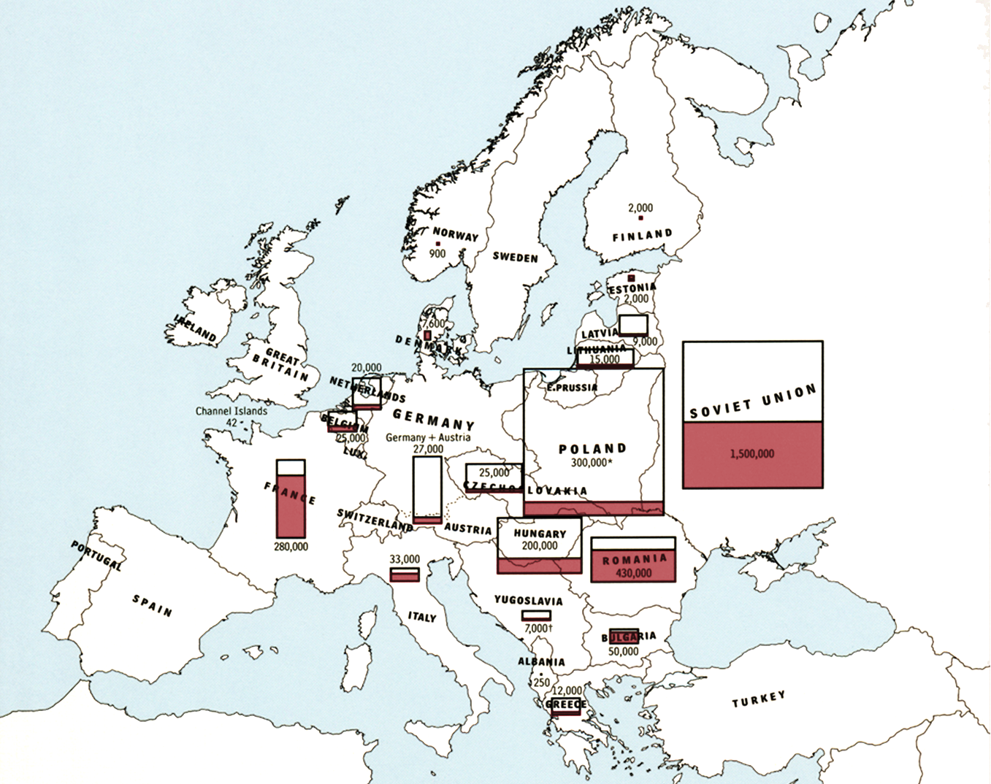
Notes:
Ask for ideas as to what this map represents and what it reveals. What do these spaces represent?
You might initially simply draw attention to the visual differences between this slide and slide 24. This is a powerful representation of the numerical impact of the Holocaust on the Jewish populations of Europe. However, direct students towards the white spaces within each box and ask what this actually reveals and what it stands in for. It tells us of the scale of the Holocaust, but what does it say about what was lost? Is it possible to see or represent something – or someone – if they no longer exist?
For reference, the Poland figure of 300,000 includes 200,000 people who survived the Holocaust inside the Soviet Union. The Yugoslavia figure of 7,000 is a combined total of Croatia, Bosnia-Herzegovina, Serbia and Slovenia.

