Slide 1
Key events

Slide 2
Notes for teachers
These cards are for use with the lesson ‘What happened to the Jews of Europe and non-Jewish victim groups?’
The cards should be affixed to the wall beneath the relevant year before starting the lesson
Ideally these slides should be printed in colour on A4 paper and laminated
For further guidance please refer to the detailed lesson plan

Slide 3
Hitler becomes Chancellor of Germany
1933
30 January
Hitler is made leader of the German government by President von Hindenburg. However, the Nazis are not yet in total control.
Only three Nazis are in the top level of his government
Laws must still be agreed by the Reichstag (Parliament)
The President (who is supported by the army) has the power to sack Hitler and appoint another Chancellor at any time

Slide 4
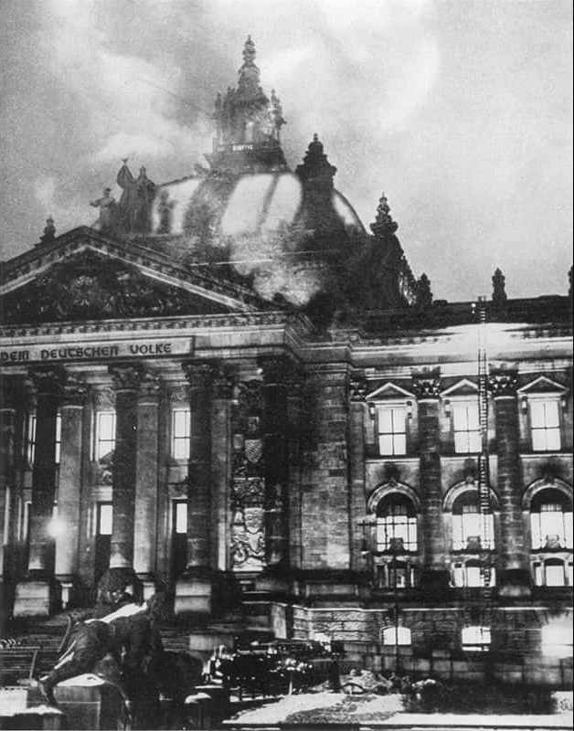
Emergency Decree
1933 28 February
The German parliament (Reichstag) is set on fire. The Nazis use the event to say that a Communist revolution is about to happen.
Hitler is given emergency powers by the President. He uses them to take away freedom of speech, assembly and the press. Hitler gives the Gestapo the power to arrest anyone believed to be against the government. They can hold someone prisoner without trial for as long as they want.
The Reichstag burns, February 1933. Photo: Wiener Library

Slide 5
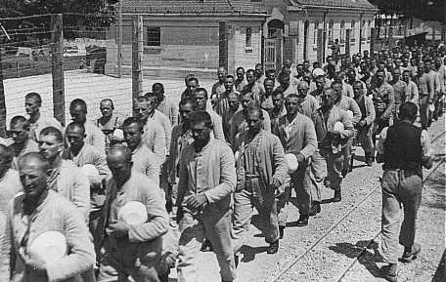
Dachau concentration camp opens
1933 20 March
Dachau is the first Nazi concentration camp to open. It becomes a ‘model’ for later camps. It is first built to hold Communists, trade union leaders and other political opponents of the Nazis.
Soon the concentration camp system expands. It becomes an instrument of terror used against anyone seen by the Nazis as enemies or as a threat.
Prisoners carrying bowls in the Dachau concentration camp, Germany. Between 1933-1940. Photo: Gedenkstaette Dachau

Slide 6
The ‘People’s Court’
1933 May
The ‘People’s Court’ is set up. Their job is to try people accused of treason.
The court does all of its work in secret.
There is no jury.
It has the power to order the death penalty.
There is no appeal except to Hitler himself.

Slide 7
Enabling Law
After the Reichstag building is burned down, politicians of the German parliament meet at the Kroll Opera House in Berlin.
1933 23 March
On 23 March 1933 the politicians meet in a threatening atmosphere surrounded by Nazis wearing brown-shirt and black-shirt uniforms. They vote to give Hitler emergency powers for four years.
During this time Hitler can make laws without asking the politicians to agree to them. This is the end of democracy in Germany - Hitler is now a dictator.

Slide 8
Hitler becomes Führer of Germany
1934 August
The army promises the Führer their loyalty and obedience. Hitler now has absolute power.
After the death of President von Hindenburg, Hitler combines the roles of head of state and head of government, President and Chancellor, into the all-powerful Führer (Leader).

Slide 9
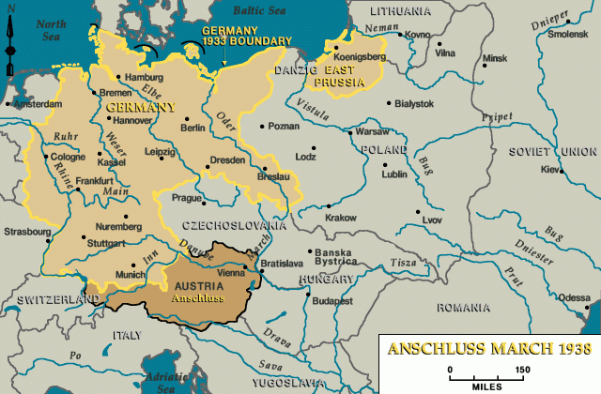
Austria becomes part of Greater Germany
1938 March
Map: www.ushmm.org
On 12 March the German army enters Austria. Most Austrians welcome them. The Austrian people are asked if they wanted to be part of Germany. The majority do, so Austria officially became part of Germany.

Slide 10
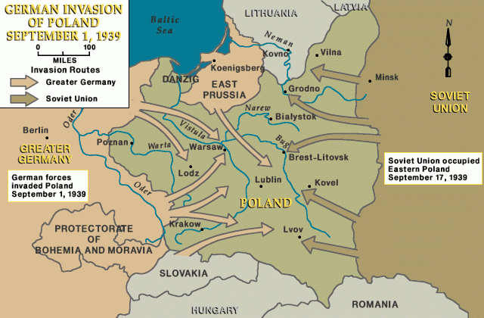
Germany invades Poland
1939 1 September
Map: www.ushmm.org
On 1 September Nazi Germany invades Poland. Two days later Britain and France declare war. In October the Soviet Union join Germany and also invade Poland. Within weeks Poland is defeated.

Slide 11
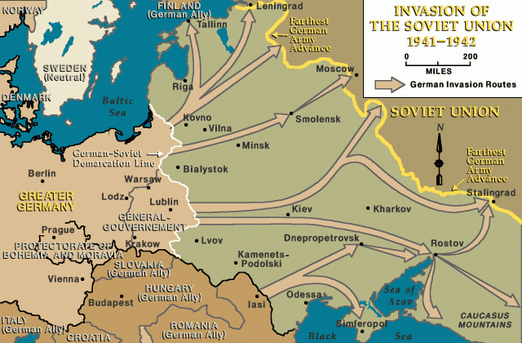
Germany invades the Soviet Union
1941 22 June
Map: www.ushmm.org
On 22 June Nazi Germany and its allies invade the Soviet Union. It is a surprise move. From the start war in the East is particularly brutal. In the first months the Nazis are very successful. They push deep into the Soviet Union. By December things begin to change.

