Slide 1
Holocaust Memorial Day 2023: A Window on ‘Ordinary People’ KS4 Tutor Time Stimuli & Suggestions
RA Lenga & N Wetherall 2022

Slide 2
Holocaust Memorial Day 2023: Ordinary People.
On 27th January, we mark the 78th anniversary of the day in 1945, that Auschwitz-Birkenau, the largest Nazi concentration camp, in occupied Poland, was liberated.
Nearly 1 million ordinary, innocent Jewish people were murdered there and in many other places, in a crime known as The Holocaust.
6 million Jewish people across Europe were murdered by the Nazis and their collaborators, including 90% of all Europe’s Jewish children (around 1.5 million). It was an unprecedented crime against humanity.
This session will take a closer look at how this genocide began with measures to segregate, marginalise, persecute and deny ordinary, Jewish people their human rights.
In particular it will examine one of the earliest acts against them – the boycotting of Jewish shops and businesses.

Slide 3
This is a window.
Inserted in to a building, a window gives us a view to the outside world.
It also allows us a view to what is inside.
A window lets in light, but also offers us protection from what is outside.
If we obstruct the window, we can not see in or out clearly.
If we look closely, a window offers us a reflection of ourselves or others.
Can you look out of your window?
What can you see?
Notes:
Tutors may like to extend this activity in a number of ways. They may like to encourage tutees to draw the view from their classroom window, or perhaps draw the view from a window in their house from memory. This may also inspire drawings of reflections of themselves as ‘ordinary people’ in their window, or perhaps observational drawings of ‘ordinary people’ outside, going about their ‘ordinary lives’.

Slide 4
What can be seen through this window?
Notes:
This activity is to stimulate discussion about the lady in the image. Students can be encouraged to make comment about what the lady is wearing, what surrounds her, including what can be seen in the background. Further discussions could stimulate inferences that could be made about how old the lady might be, what her social status is based on how she is presented/what she is wearing and what occupation she holds.
Focus on her gaze may illicit inferred responses on what she may be looking at, or towards. Her gaze is being held by someone or something – is she interested in something or someone she has seen? Is she waiting for something? You may like to stimulate a discussion on her facial expression to support emotional literacy – does she look interested? Pleased? Annoyed? Shocked? One of her shoulders is stooped lower that the other. Is she surprised by something? Recoiling? Or is she weighed down by something she is holding?

Slide 5
What can be seen through this window?
Notes:
Now we can see more of the lady, how much of what we had inferred has changed? Tutors may like to further the discussion about the details regarding what the lady is wearing, what she is carrying and her stance. We can see that she is carrying an umbrella and a briefcase/satchel – does this tell us more about her social status? Her occupation? Students may like to make a comment here on her choice of clothing and make links to the weather. She is wearing thick, knee-high boots, a thick coat and a hat & scarf. If we look closely, the man behind her shoulder to the left of the image has his coat collar turned up. What can be said about the climate? Can we make an inference about the time of year that this photograph may have been taken?
Her gaze can now be followed to something or someone on the right hand side of the image.
A partial view of a window can be seen – we can see a large window to the right, with a thick window frame.
Questions which stimulate discussion around where the lady is in relation to her location – the large stone brick construction may help students infer that this is a street? A town? The window and window frame may provide further information – can students make inferences about the building in which this window is placed?

Slide 6
What can be seen through this window?
Notes:
Now we can follow the gaze of the lady further, discussions can be centred on what the lady is looking at. Students may like to make comment on what can now be seen. At this point, students may begin to make observations about the man in uniform and what he is doing. Further focus could draw student attention to the pieces of paper that have been/are being applied to the window. We can now see the size of the window and if we look closely, we can begin to see in, although our view is obscured by the man in uniform and the pieces of paper. These observations may illicit student inferences about what type of building this is and what the partially obstructed item might be.
Tutors may like to draw attention to the word that can be seen in full on the large sign – ‘kauft’. Here, tutors could encourage students to find out what this word means. This is a German word, so directing students towards a German dictionary or selecting ‘German’ in Google Translate will allow students to find out that this word means ‘buy’. ‘Kaufen’ is the verb ‘to buy’ in the German language. Once students have translated the word, what can now be inferred about the type of building and possible contents?
Questions can be asked here to the students about what the man in uniform is doing. He is applying smaller pieces of paper to the window. They obscure the view in to the window, but also encourage the person looking in to read the sign/poster he is applying. This is what the lady appears to be looking at.

Slide 7
What can be seen through this window?
Bundesarchiv Bild 102-14468, Berlin, NS-Boykott gegen jüdische Geschäfte
Notes:
Now the image has been revealed in full, students can further their discussions on what can be seen now. They will be able to see clearly what the lady is looking at – the two men in uniform, outside a shop that is selling clothing. They will also be able to see the sign in full. Further opportunities for students to translate the German language could be offered here – the German reads Deutsche! Wehrt Euch! Kauft nicht bei Juden! This is translated as ‘Germans! Defend yourselves! Don’t buy from Jews!
Some students will now be able to contextualise the image, having observed one of the men in uniform wearing an armband with a swastika on it and may be able to link the words in the sign to the men outside the shop.
Questions could be asked to the students about what is happening here? What are these men doing? They are obscuring the view in to the shop – what do students think their intention is?
In terms of emotional literacy, you may like to draw student’s attention back to the lady – what does her facial expression and stance seem to suggest about how she feels about what she is looking at? Is there anything that can be said about the expressions and stance of the men in uniform?
You may like to use the ‘Guided Questions’ resource here, to allow students the time to reflect on their findings and generate summative answers.
This is a photograph that was taken in Germany on the 1st April 1933.
The two men in uniform are Nazi soldiers. (The Sturmabteilung, or SA, was a paramilitary organisation associated with the Nazi Party and its rise to power)
One soldier is applying a sign to the window of a clothing shop.
This shop is owned by Jewish people.

Slide 8
A Window on ‘Ordinary People’ Guided Questions
Can you determine the type of shop in the picture?
What are the uniformed men doing?
Can you work out what is written on the placard?
What might the Jewish owners and staff be thinking/feeling at this action?
Who might the woman on the left of the image be? Is she a passer by? Might she have planned to go in to the shop?
Bundesarchiv Bild 102-14468, Berlin, NS-Boykott gegen jüdische Geschäfte
What might she be thinking as she approaches the scene and sees the men with the poster?
What do you think she might do? If she protests and enters the shop what might be the reaction of those around the scene?
What do you think she would do in that situation, all things considered?

Slide 9
A Window on ‘Ordinary People’
In the weeks and months after the Nazis came to power, the persecution of Jewish men, women and children, escalated. Violence and discrimination against Jewish people became more frequent.
On April 1st 1933, the Nazis tried to persuade people not to use shops and businesses owned by Jews. This became known as the ‘April Boycott’. It was the first official action by the Nazi state against the Jewish population.
Storm Troopers ‘Sturmabteilung’ (SA) stood in front of Jewish-owned department stores and retail establishments, and outside the offices of Jewish professionals, holding signs and shouting slogans such as "Don't Buy from Jews" and "The Jews Are Our Misfortune”.
It was intimidating and frightening experience for Jewish people.

Slide 10
Thinking Deeper…
KS4
On April 1st 1933, the Nazis carried out the first nationwide, planned action against Jews: a boycott targeting Jewish businesses and professionals. Here you can see one of the Jewish-owned shops with a Nazi sign posted on the display window.
Why do you think the sign was written in English as well as German?
What were the Nazis trying to do in saying ‘buy only at ‘German’ shops?’
How might the ordinary shopper, like the one seen in the widow’s reflection, have reacted to this? What choices did they have?
What impact do you think this would have had on the Jewish community?
Berlin, Germany, April 1, 1933. USHMM
What can be inferred from this source about tactics used by the Nazis to discriminate against the Jewish people of Germany?
Notes:
A boycott sign posted on the display window of a Jewish-owned business reads: "Germans defend yourselves against Jewish atrocity propaganda. Buy only at German shops!" Berlin, Germany, April 1, 1933.

Slide 11
What did the Boycott mean for ordinary Jewish families and business owners?
Here Holocaust survivor, Zvi Aviram, describes the 'Boycott Day' in Germany, which he witnessed as a child.
How does Zvi’s witness testimony and reflection help us understand the impact of the Boycott?
Why is a personal account like this useful to building our understanding of how life changed for German Jews in the early months and years of the Nazi’s coming to power?
Interestingly, the boycott was ignored by a number of individual Germans who continued to shop in Jewish-owned stores, but it marked the beginning of a nationwide campaign against Jews which was to bring wider support from German society and intimidation and fear to German Jews
KS4
Notes:
https://www.youtube.com/watch?v=t1jbyf4kqZk (1.17mins)
Tutors may like to use the ‘A Window on Zvi Aviram’ response sheet to gather summative answers to the questions.

Slide 12
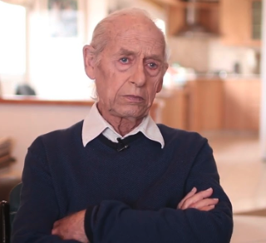
A Window on Zvi Aviram Guided Questions
KS4
How does Zvi’s witness testimony and reflection help us understand the impact of the Boycott?
Why is a personal account like this useful to building our understanding of how life changed for German Jews in the early months and years of the Nazi’s coming to power?
Zvi Aviram, Yad Vashem

Slide 13
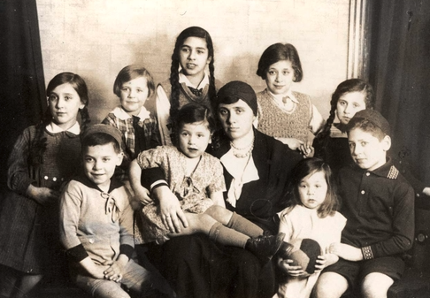
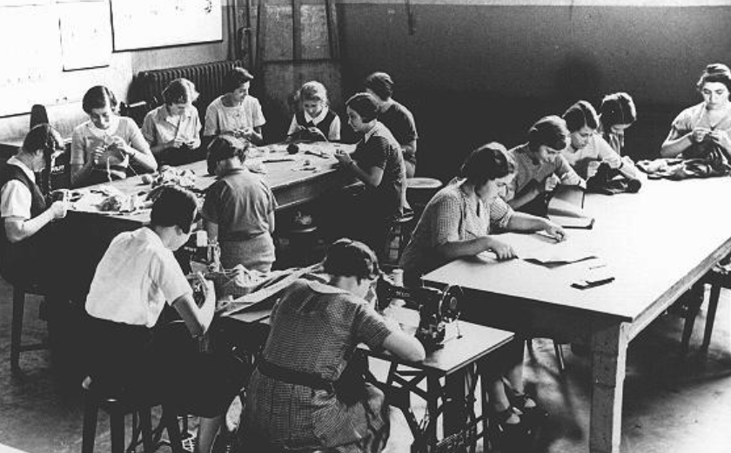
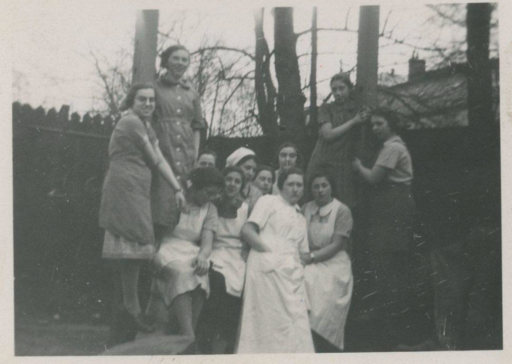
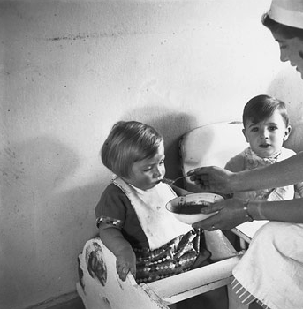
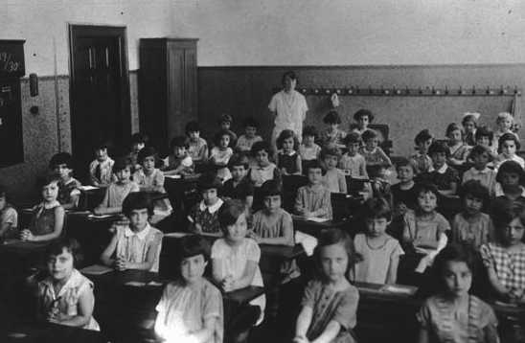
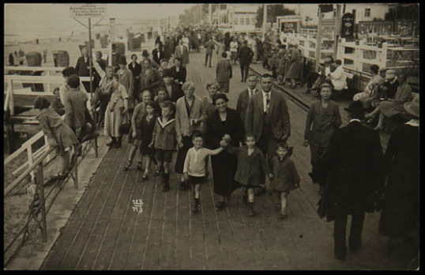
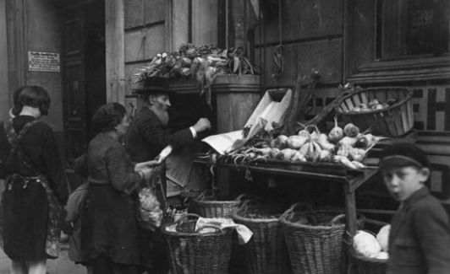
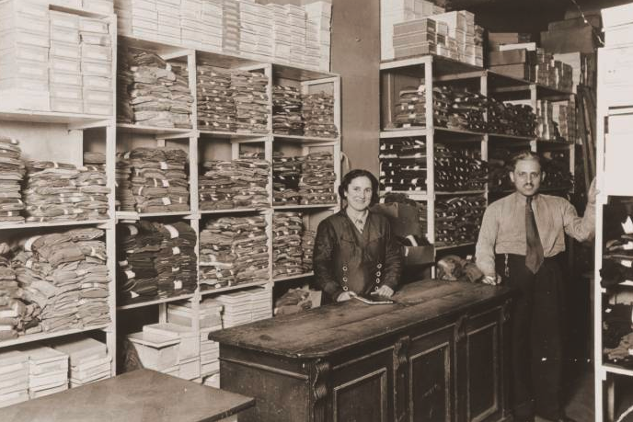
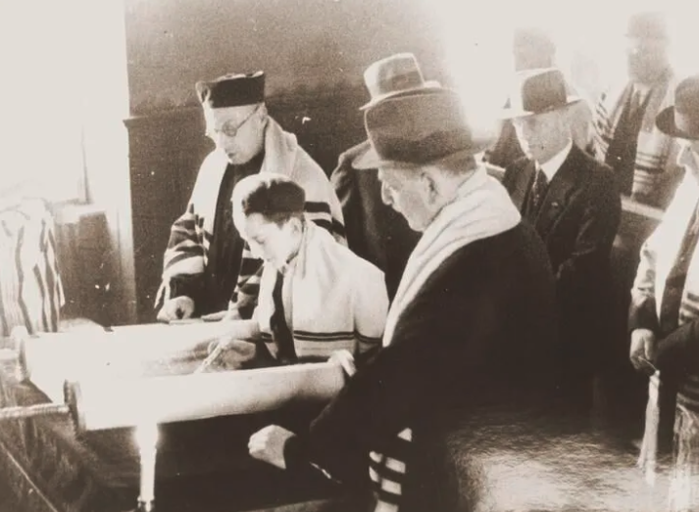
A Window on ‘Ordinary People’
Study these photographs carefully. What do these images tell us about Jewish people who lived in Germany before the Second World War?
Notes:
Image Sources L-R
Girls in a sewing class at the Adas Israel school, maintained by the German Jewish community. Berlin, Germany, 1930s, USHMM
Pupils of the technical college for tailors in Johnsallee, Hamburg, March 1937, 7 x 5 cm Source: Picture Database of the Institute for the History of the German Jews, 21-015/550, collection Ursula Randt.
Group portrait showing the Carlebach family, mother Lotte Carlebach with nine children, before the war Source: Yad Vashem, Photo Archive 1869/243,
Feeding small children at the Jewish Children‘s Relief Organization, photograph by Herbert Sonnenfeld, Berlin, 1933
A first-grade class at a Jewish school. Cologne, Germany, 1929-1930, USHMM
Herrmann Family – Jewish textile merchants from Königsberg, Swinemunde, National Holocaust Centre & Museum
Bar Mitzvah at Zerrennerstrasse Synagogue, Pforzheim, Germany, Facing History/USHMM/Stadtarchiv Pforzheim
Jewish migrants, Berlin Scheunenviertel, Bundesarchiv, Bild 183-1987-0413-505 / P. Buch / CC-BY-SA 3.0
Jewish business owners David and Janka Penner in their dry goods store, Berlin, USHMM

Slide 14
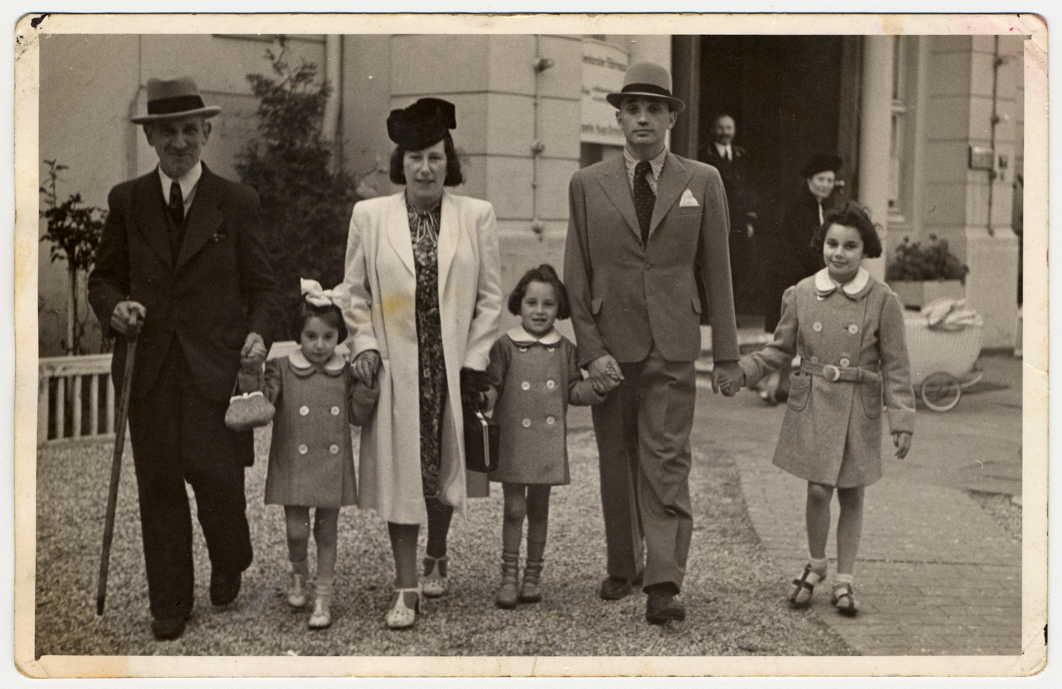
A Window on ‘Ordinary People’
Germany’s Jews were well integrated into German life. They did most things ordinary German people liked to do – go to cinema, shops, restaurants, cafes, go to school, work, study. Some Jews, went to synagogue, observed Jewish festivals and holy days, but others were not particularly religious.
Jews worked as tailors, civil servants, doctors, nurses, maids, lawyers, journalists, factory workers, teachers – ordinary jobs.
Notes:
Image Source (top three from previous slide, credits in teacher notes).
(bottom): A German Jewish family from Hamburg.
From left to right are Wilhelm Jotkowitz, Renate, Edith, Karen, Werner and Marion Gumprecht. Wilhelm Jotkowitz, Edith's father, was unable to leave with the others and later perished in the Mintz ghetto. USHMM collection.

Slide 15
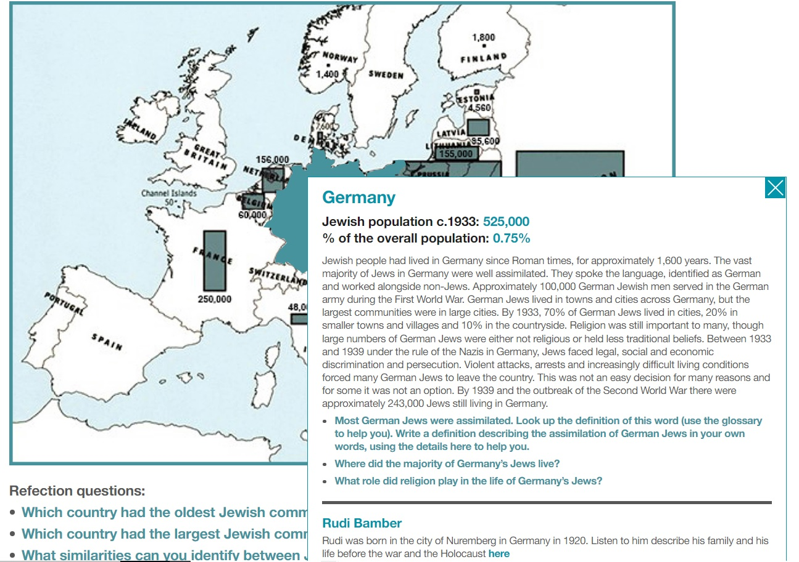
A Window on Jewish Life in Germany
In 1933, about 600,000 Jews lived in Germany. This was less than one percent of the total population (that’s very small).
Most Jews in Germany were proud to be Germans. More than 100,000 German Jews had served in the German army during the First World War and won medals for bravery. They had contributed to the arts and science in outstanding ways.
Some Jews were poor, while other Jews were middle class. Some worked in or owned small businesses – some were successful and helped the economy, but not all.
Most however, were ordinary people, like everyone else, leading normal lives.
Yet Nazi propaganda put out dangerous lies and conspiracies about Jews wanting to control the world with money and power.
The April 1, 1933, boycott aimed to intimidate Germany’s Jews and discourage the German public from shopping at Jewish businesses. It marked the beginning of Nazi efforts to drive Jews from the German economy. The April 1, 1933, boycott aimed to intimidate Germany’s Jews and discourage the German public from shopping at Jewish businesses. It marked the beginning of Nazi efforts to drive Jews from the German The April 1, 1933, boycott aimed to intimidate Germany’s Jews and discourage the German public from shopping at Jewish businesses. It marked the beginning of Nazi efforts to drive Jews from the German economy.
Explore pre-war life, the fate & experience of Germany’s Jews, using our interactive map
Notes:
This text/information is complete for all Key Stages. However, a reduced version will exist in the KS3 presentation/resources.

Slide 16
Thinking Deeper…
KS4
How did life change for German Jews?
For much of the 1930’s, the Nazis concentrated on excluding Jewish people from areas of German society. They passed hundreds of anti-Jewish laws.
Using the timeline, select the six laws which you think were the most significant.
Consider… what was taken away by these laws, what Jewish people would no longer be able to do and how this may have impacted their lives.
The timeline of a selection of anti-Jewish laws passed, 1933-39, can be found in Unit 3.1 (page 35), of our textbook, Understanding the Holocaust: How and why did it happen?
Notes:
Tutors may like to use the ‘A Window on How Life Changed for German Jews’ resource sheet to collect summative answers.

Slide 17
A Window on How Life Changed for German Jews Guided Questions
KS4
For much of the 1930’s, the Nazis concentrated on excluding Jewish people from areas of German society. They passed hundreds of anti-Jewish laws.
Using the timeline, select the six laws which you think were the most significant and explain the impact of these laws. Write each of the laws and your explanation in to each window below.
Consider… what was taken away by these laws, what Jewish people would no longer be able to do and how this may have impacted their lives.

Slide 18
A Window on ‘Reflection’
KS4
This is a window.
If we look closely, a window offers us a reflection of ourselves or others.
We are ‘ordinary people’, capable of ‘extraordinary things’. We can choose to ‘stand up’ against prejudice and discrimination and take action to speak out or educate others about these issues, which are very current and present in our communities today.
Possible Outcomes:
Create an assembly or lesson to present to younger students about prejudice and discrimination and where this leads if left ‘unchecked’.
Download the HMD Theme Vision from hmd.org.uk and create an informative leaflet informing readers of the terms ‘perpetrator’, ‘collaborator’, bystander.
Write a letter to your local MP or local Police Hate Crime Division, informing them about what you have learned and what you as a school, group or individual are planning to do to combat prejudice & discrimination in all its forms.

Slide 19
Glossary of terms
This slide has been created to help with understanding some of the commonly used terminology.
Boycott To purposely stop using something as a form of protest
Persecution To treat someone badly, particularly because of their race, religion, political views, or social position
Discrimination Unfair treatment of different people or groups
Obscure To keep something from being seen
Exclude To deny someone access to something

Slide 20
Holocaust Memorial Day 2023: A Window on ‘Ordinary People’ KS4 Tutor Time Stimuli & Suggestions
RA Lenga & N Wetherall 2022

