Slide 1
Holocaust Memorial Day 2023: A Window on ‘Ordinary People’ KS3 Tutor Time Stimuli & Suggestions
RA Lenga & N Wetherall 2022
Notes:
Opening Slide. Image If you are asked about the image here, it depicts Süßkind (“Susskind”) von Trimberg, a Jewish poet from the Holy Roman Empire in the thirteenth century, and it is taken from the Codex Manesse. You may wish to explore this image, commenting on the depiction of the Jewish poet in contrast to the Christian figures in the picture. He wears a Judenhut and traditional facial hair marking him as Jewish, yet he is richly dressed in a dyed fur cloak, indicating a level of material comfort. The Christian figure is likely to be a land-holding bishop of some kind (which were common in the Holy Roman Empire) who is a patron of Süßkind, or is hearing a performance (medieval poetry being largely an oral tradition). The centre of power on the left-hand side of the image is explicitly Christian – with a banner showing the cross and a crook indicating the bishop’s role as ‘shepherd’ of the Christian flock. It might be worth reflecting with participants on how even a successful Jewish figure in the medieval world was dependent on the good will of an exclusively Christian land-holding class (either ecclesiastical or secular) that they could never join and were excluded from – Jews could not hold land in most of Europe, could not marry Christian feudal aristocrats and could of course not advance in the Christian church. Jews were expelled from a number of cities in the Holy Roman Empire, dependent on local politics, and were constantly at risk of pogrom, expropriation or exile.

Slide 2
Holocaust Memorial Day 2023: Ordinary People.
On 27th January, we mark the 78th anniversary of the day in 1945, that Auschwitz-Birkenau, the largest Nazi concentration camp, in occupied Poland, was liberated.
Nearly 1 million ordinary, innocent Jewish people were murdered there and in many other places, in a crime known as The Holocaust.
6 million Jewish people across Europe were murdered by the Nazis and their collaborators, including 90% of all Europe’s Jewish children (around 1.5 million). It was an unprecedented crime against humanity.
This session will take a closer look at how this genocide began with measures to segregate, marginalise, persecute and deny ordinary, Jewish people their human rights.
In particular it will examine one of the earliest acts against them – the boycotting of Jewish shops and businesses.

Slide 3
This is a window.
Inserted in to a building, a window gives us a view to the outside world.
It also allows us a view to what is inside.
A window lets in light, but also offers us protection from what is outside.
If we obstruct the window, we can not see in or out clearly.
If we look closely, a window offers us a reflection of ourselves or others.
Can you look out of your window?
What can you see?
Notes:
Tutors may like to extend this activity in a number of ways. They may like to encourage tutees to draw the view from their classroom window, or perhaps draw the view from a window in their house from memory. This may also inspire drawings of reflections of themselves as ‘ordinary people’ in their window, or perhaps observational drawings of ‘ordinary people’ outside, going about their ‘ordinary lives’.

Slide 4
What can be seen through this window?
Notes:
This activity is to stimulate discussion about the lady in the image. Students can be encouraged to make comment about what the lady is wearing, what surrounds her, including what can be seen in the background. Further discussions could stimulate inferences that could be made about how old the lady might be, what her social status is based on how she is presented/what she is wearing and what occupation she holds.
Focus on her gaze may illicit inferred responses on what she may be looking at, or towards. Her gaze is being held by someone or something – is she interested in something or someone she has seen? Is she waiting for something? You may like to stimulate a discussion on her facial expression to support emotional literacy – does she look interested? Pleased? Annoyed? Shocked? One of her shoulders is stooped lower that the other. Is she surprised by something? Recoiling? Or is she weighed down by something she is holding?

Slide 5
What can be seen through this window?
Notes:
Now we can see more of the woman, how much of what we had inferred has changed? Tutors may like to further the discussion about the details regarding what the woman is wearing, what she is carrying and her stance. We can see that she is carrying an umbrella and a briefcase/satchel – does this tell us more about her social status? Her occupation? Students may like to make a comment here on her choice of clothing and make links to the weather. She is wearing thick, knee-high boots, a thick coat and a hat & scarf. If we look closely, the man behind her shoulder to the left of the image has his coat collar turned up. What can be said about the climate? Can we make an inference about the time of year that this photograph may have been taken?
Her gaze can now be followed to something or someone on the right-hand side of the image.
A partial view of a window can be seen – we can see a large window to the right, with a thick window frame.
Questions which stimulate discussion around where the woman is in relation to her location – the large stone brick construction may help students infer that this is a street? A town? The window and window frame may provide further information – can students make inferences about the building in which this window is placed?

Slide 6
What can be seen through this window?
Notes:
Now we can follow the gaze of the woman further, discussions can be centred on what the woman is looking at. Students may like to make comment on what can now be seen. At this point, students may begin to make observations about the man in uniform and what he is doing. Further focus could draw student attention to the pieces of paper that have been/are being applied to the window. We can now see the size of the window and if we look closely, we can begin to see in, although our view is obscured by the man in uniform and the pieces of paper. These observations may illicit student inferences about what type of building this is and what the partially obstructed item might be.
Tutors may like to draw attention to the word that can be seen in full on the large sign – ‘kauft’. Here, tutors could encourage students to find out what this word means. This is a German word, so directing students towards a German dictionary or selecting ‘German’ in Google Translate will allow students to find out that this word means ‘buy’. ‘Kaufen’ is the verb ‘to buy’ in the German language. Once students have translated the word, what can now be inferred about the type of building and possible contents?
Questions can be asked here to the students about what the man in uniform is doing. He is applying smaller pieces of paper to the window. They obscure the view into the window, but also encourage the person looking in to read the sign/poster he is applying. This is what the lady appears to be looking at.

Slide 7
What can be seen through this window?
Bundesarchiv Bild 102-14468, Berlin, NS-Boykott gegen jüdische Geschäfte
Notes:
Now the image has been revealed in full, students can further their discussions on what can be seen now. They will be able to see clearly what the woman is looking at – the two men in uniform, outside a shop that is selling clothing. They will also be able to see the sign in full. Further opportunities for students to translate the German language could be offered here – the German reads Deutsche! Wehrt Euch! Kauft nicht bei Juden! This is translated as ‘Germans! Defend yourselves! Don’t buy from Jews!
Some students will now be able to contextualise the image, having observed one of the men in uniform wearing an armband with a swastika on it and may be able to link the words in the sign to the men outside the shop.
Questions could be asked to the students about what is happening here? What are these men doing? They are obscuring the view into the shop – what do students think their intention is?
In terms of emotional literacy, you may like to draw student’s attention back to the woman – what does her facial expression and stance seem to suggest about how she feels about what she is looking at? Is there anything that can be said about the expressions and stance of the men in uniform?
You may like to use the ‘Guided Questions’ resource here, to allow students the time to reflect on their findings and generate summative answers.
This is a photograph that was taken in Germany on the 1st April 1933.
The two men in uniform are Nazi soldiers. (The Sturmabteilung, or SA, was a paramilitary organisation associated with the Nazi Party and its rise to power)
One soldier is applying a sign to the window of a clothing shop.
This shop is owned by Jewish people.

Slide 8
A Window on ‘Ordinary People’ Guided Questions
Can you determine the type of shop in the picture?
What are the uniformed men doing?
Can you work out what is written on the placard?
What might the Jewish owners and staff be thinking/feeling at this action?
Who might the woman on the left of the image be? Is she a passer by? Might she have planned to go in to the shop?
Bundesarchiv Bild 102-14468, Berlin, NS-Boykott gegen jüdische Geschäfte
What might she be thinking as she approaches the scene and sees the men with the poster?
What do you think she might do? If she protests and enters the shop what might be the reaction of those around the scene?
What do you think she would do in that situation, all things considered?

Slide 9
A Window on ‘Ordinary People’
In the weeks and months after the Nazis came to power, the persecution of Jewish men, women and children, escalated. Violence and discrimination against Jewish people became more frequent.
On April 1st 1933, the Nazis tried to persuade people not to use shops and businesses owned by Jews. This became known as the ‘April Boycott’. It was the first official action by the Nazi state against the Jewish population.
Storm Troopers ‘Sturmabteilung’ (SA) stood in front of Jewish-owned department stores and retail establishments, and outside the offices of Jewish professionals, holding signs and shouting slogans such as "Don't Buy from Jews" and "The Jews Are Our Misfortune”.
It was intimidating and frightening experience for Jewish people.

Slide 10
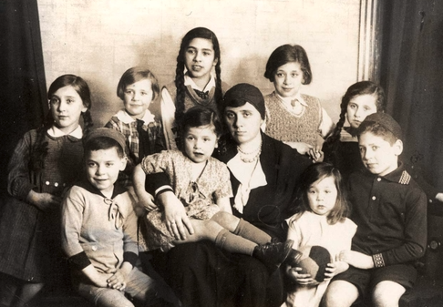
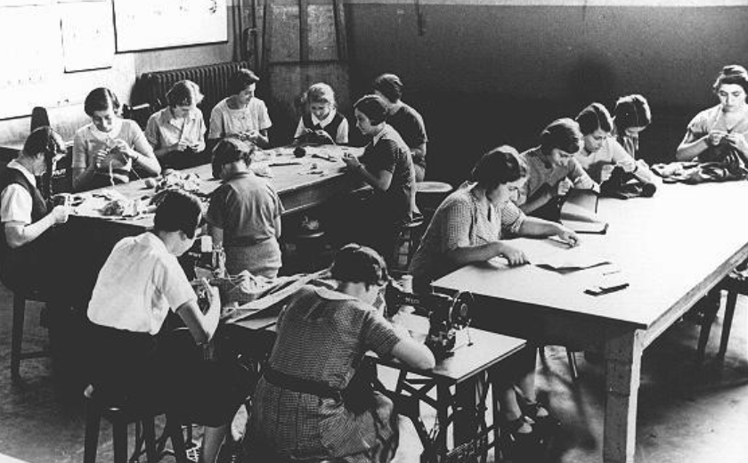
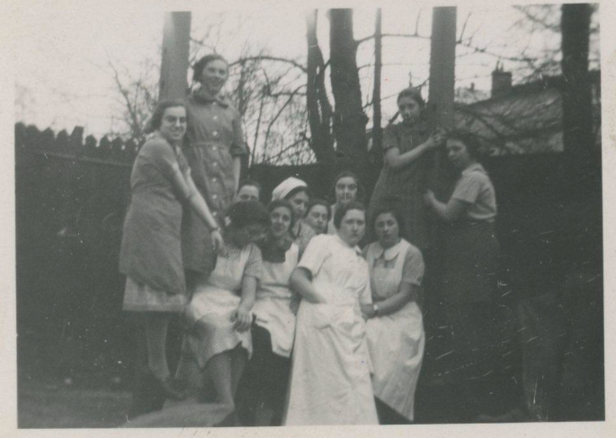
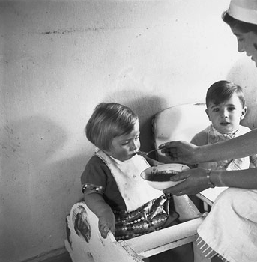
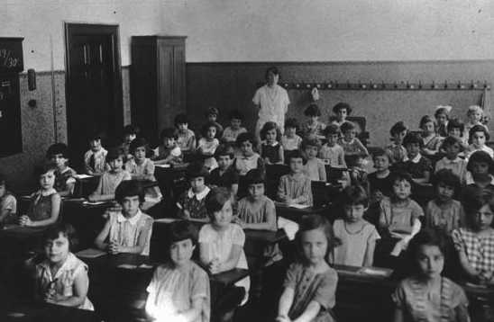
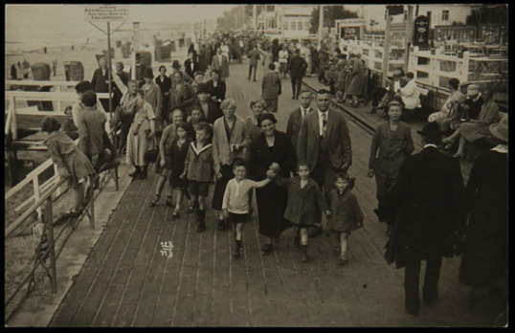
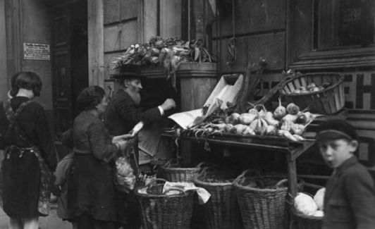
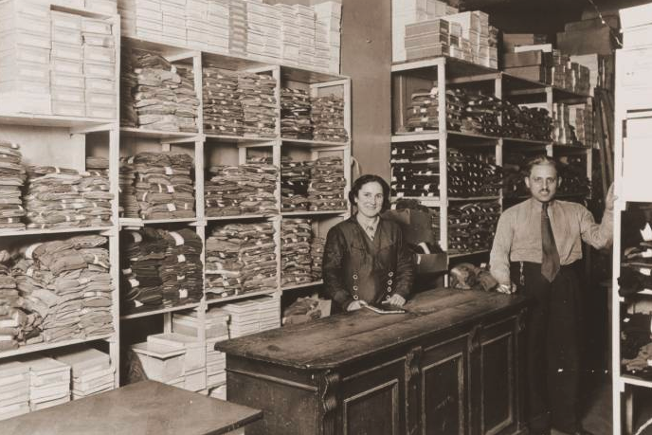
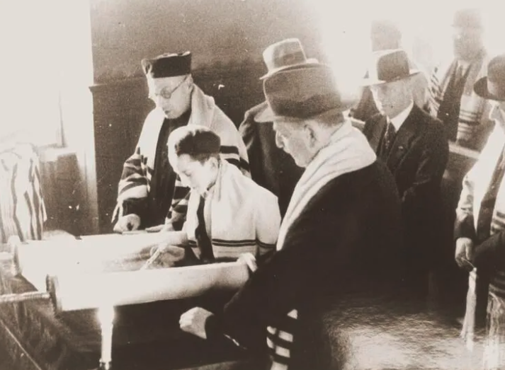
A Window on ‘Ordinary People’
Study these photographs carefully. What do these images tell us about Jewish people who lived in Germany before the Second World War?
Notes:
Image Sources L-R
Girls in a sewing class at the Adas Israel school, maintained by the German Jewish community. Berlin, Germany, 1930s, USHMM
Pupils of the technical college for tailors in Johnsallee, Hamburg, March 1937, 7 x 5 cm Source: Picture Database of the Institute for the History of the German Jews, 21-015/550, collection Ursula Randt.
Group portrait showing the Carlebach family, mother Lotte Carlebach with nine children, before the war Source: Yad Vashem, Photo Archive 1869/243,
Feeding small children at the Jewish Children‘s Relief Organization, photograph by Herbert Sonnenfeld, Berlin, 1933
A first-grade class at a Jewish school. Cologne, Germany, 1929-1930, USHMM
Herrmann Family – Jewish textile merchants from Königsberg, Swinemunde, National Holocaust Centre & Museum
Bar Mitzvah at Zerrennerstrasse Synagogue, Pforzheim, Germany, Facing History/USHMM/Stadtarchiv Pforzheim
Jewish migrants, Berlin Scheunenviertel, Bundesarchiv, Bild 183-1987-0413-505 / P. Buch / CC-BY-SA 3.0
Jewish business owners David and Janka Penner in their dry goods store, Berlin, USHMM

Slide 11
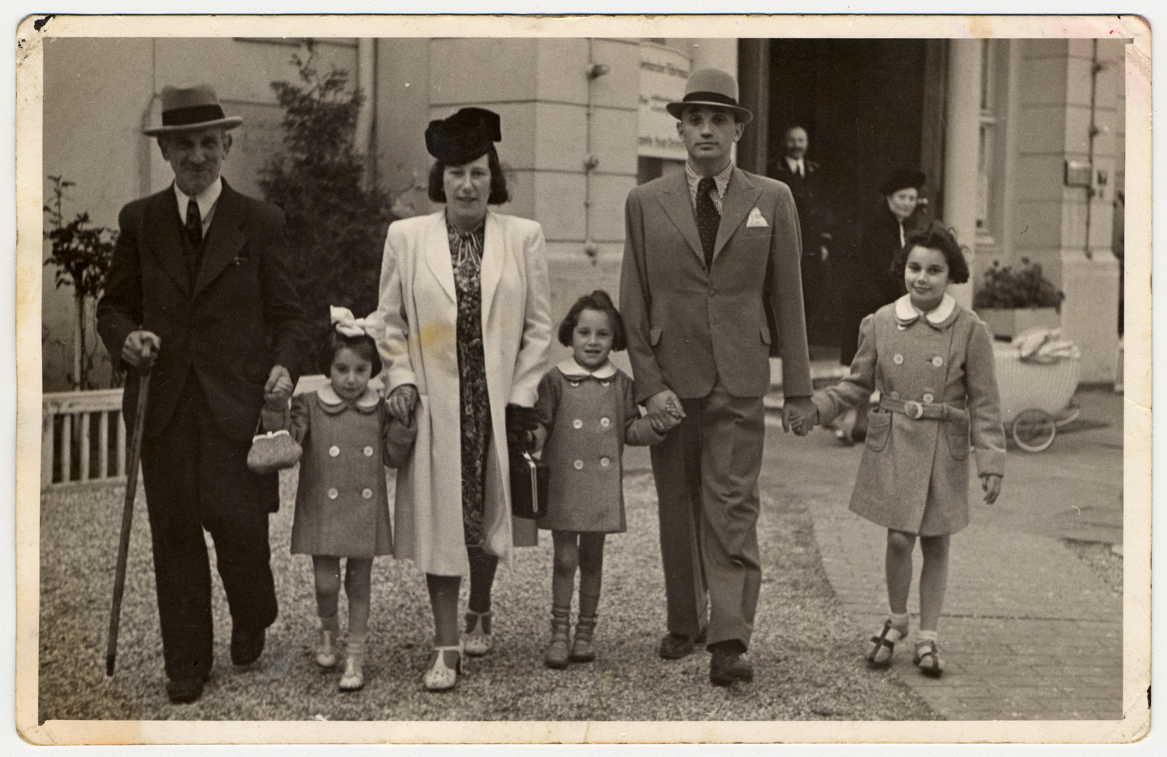
A Window on ‘Ordinary People’
Germany’s Jews were well integrated into German life. They did most things ordinary German people liked to do – go to cinema, shops, restaurants, cafes, go to school, work, study. Some Jews, went to synagogue, observed Jewish festivals and holy days, but others were not particularly religious.
Jews worked as tailors, civil servants, doctors, nurses, maids, lawyers, journalists, factory workers, teachers – ordinary jobs.
Notes:
Image Source (top three from previous slide, credits in teacher notes).
(bottom): A German Jewish family from Hamburg.
From left to right are Wilhelm Jotkowitz, Renate, Edith, Karen, Werner and Marion Gumprecht. Wilhelm Jotkowitz, Edith's father, was unable to leave with the others and later perished in the Mintz ghetto. USHMM collection.

Slide 12
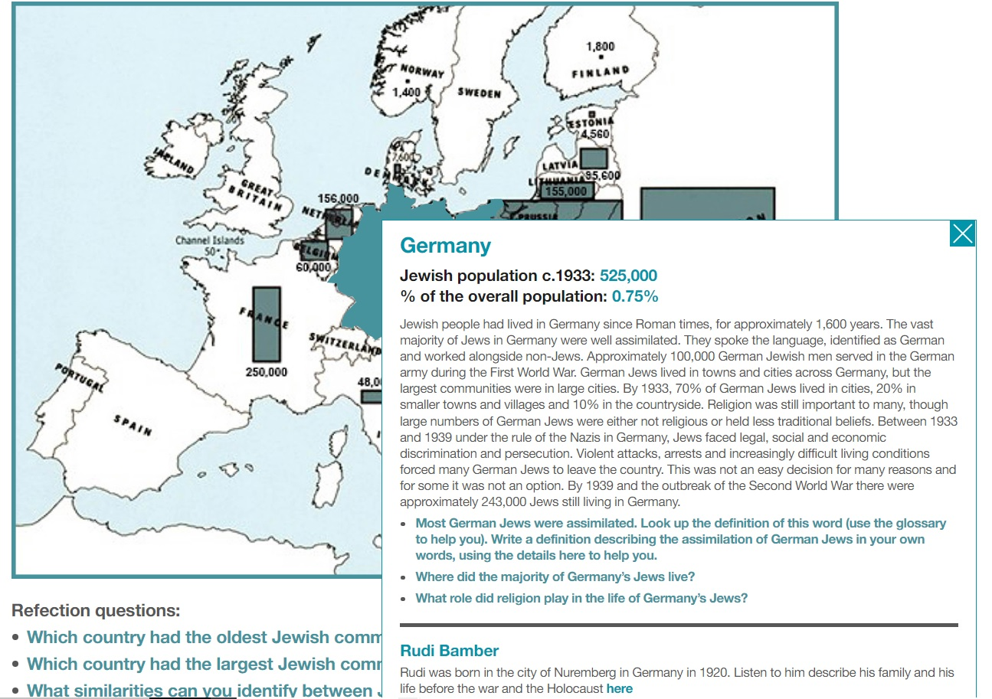
A Window on Jewish Life in Germany
In 1933, about 600,000 Jews lived in Germany. This was less than one percent of the total population (that’s very small).
Some Jews were poor, while some Jews were middle class. Some worked in or owned small businesses. Some were successful but not all.
They were ordinary people, like everyone else, leading normal lives.
Yet Nazi propaganda put out dangerous lies about Jews wanting to control the world with money and power.
The April 1, 1933, boycott aimed to intimidate Germany’s Jews and discourage the German public from shopping at Jewish businesses. It marked the beginning of Nazi efforts to drive Jews from the German economy. The April 1, 1933, boycott aimed to intimidate Germany’s Jews and discourage the German public from shopping at Jewish businesses. It marked the beginning of Nazi efforts to drive Jews from the German The April 1, 1933, boycott aimed to intimidate Germany’s Jews and discourage the German public from shopping at Jewish businesses. It marked the beginning of Nazi efforts to drive Jews from the German economy.
Explore pre-war life, the fate & experience of Germany’s Jews, using our interactive map
Notes:
This text/information is complete for all Key Stages. However, a reduced version will exist in the KS3 presentation/resources.

Slide 13
A Window on ‘Reflection’
This is a window.
If we look closely, a window offers us a reflection of ourselves or others.
We are ‘ordinary people’, capable of ‘extraordinary things’.
On reflection, having investigated the persecution of Jews in Germany, what has been learned?
Take a moment to reflect…
Notes:
Tutors may like to ask tutees to use the ‘A Window on Reflection’ resource sheet here. Individually, or collectively, students may like to add what they have learned, either in words, phrases, pictures or a combination of all three, in to the ‘Reflection’ portrait template. These can be reflections of knowledge, thoughts, emotions, feelings – as they study their ‘reflection’ and knowing what they know now, how has their identity changed or been added to? These ‘Reflections’ could be collected together and displayed in the classroom, perhaps on the window?

Slide 14
A Window on Reflection ‘Ordinary People’ Portrait

Slide 15
Glossary of terms
This slide has been created to help with understanding some of the commonly used terminology.
Boycott To purposely stop using something as a form of protest
Persecution To treat someone badly, particularly because of their race, religion, political views, or social position
Discrimination Unfair treatment of different people or groups
Obscure To keep something from being seen
Exclude To deny someone access to something

Slide 16
Holocaust Memorial Day 2023: A Window on ‘Ordinary People’ KS3 Tutor Time Stimuli & Suggestions
RA Lenga & N Wetherall 2022

