Slide 1
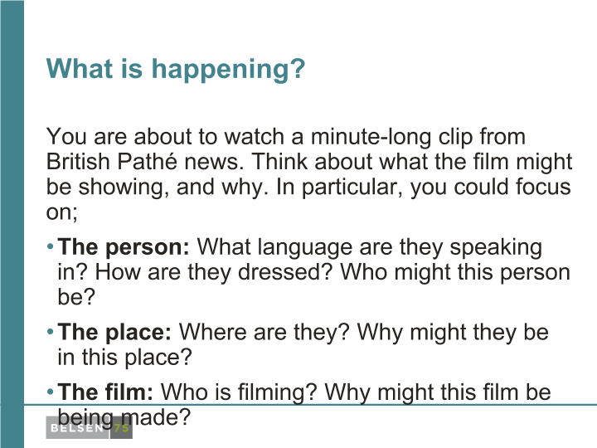
What is happening?
You are about to watch a minute-long clip from British Pathé news. Think about what the film might be showing, and why. In particular, you could focus on:
The person: What language are they speaking in? How are they dressed? Who might this person be?
The place: Where are they? Why might they be in this place?
The film: Who is filming? Why might this film be being made?

Slide 2
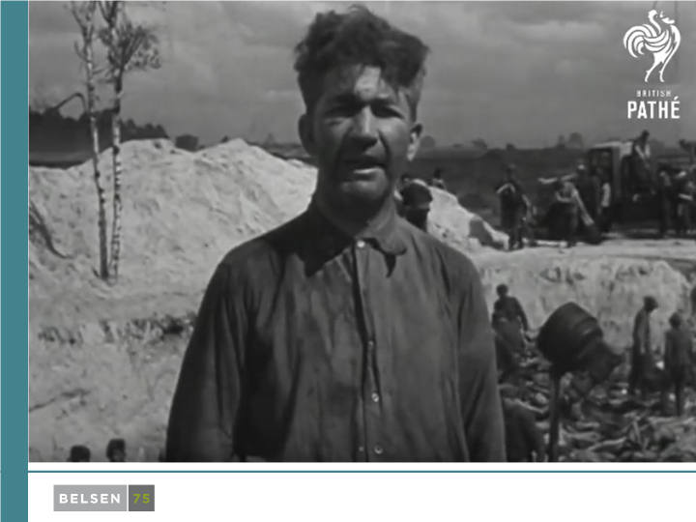

Slide 3
How did the British deal with the perpetrators at Bergen-Belsen?
How did the British deal with the perpetrators at Bergen-Belsen in 1945?
Was 'justice' done?

Slide 8
The Belsen Trial: the charge
There were two charges based on two different camps: Bergen-Belsen, and Auschwitz-Birkenau, where a number of staff had previously worked.
The staff working there were charged with committing a war crime.
The trial records describe the war crime as:
"between 1st October 1942 and 30th April 1945 when members of the staff... responsible for the well-being of the persons interned there, in violation of the laws of certain of such persons causing the(ir) deaths."

Slide 22
This programme is delivered by UCL Centre for Holocaust Education, the Holocaust Educational Trust, with support from the National Holocaust Centre and Museum, and made possible thanks to funding from the Department for Education

