Slide 1
Antisemitism then & now
Reflections from survivors of Bergen-Belsen

Slide 2
Tomi Reichental
© Tomi Reichental

Slide 3
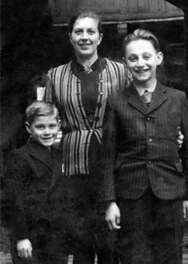
Tomi Reichental
Tomi was born in Merašice, Czechoslovakia, in 1935. His grandparents owned and worked in the village shop, while his father managed the family farm.
Life changed after Czechoslovakia began to be broken up in 1938. Things happened slowly at first, but gradually antisemitic laws impacted the family as prejudice against Jews became more socially acceptable.
The Reichentals survived the first wave of deportations in 1942. However, when these resumed in 1944, Tomi, his mother, and his brother travelled to Bratislava – the capital city. From there it they planned to go into hiding with other relatives. However, they were found and arrested by the Gestapo. Tomi and his relatives were then sent to a concentration camp called Sered. From there they were put onto a cattle wagon, and 7 days later arrived at Bergen-Belsen. It was November 1944.
Just over five months later, they were liberated.
Tomi’s family in 1942: Tomi, Mother and Miki. This is the photo that Tomi’s father carried with him during 1944-1945, not knowing if his family was alive or dead. © Tomi Reichental

Slide 4
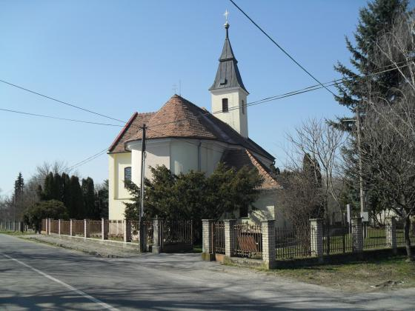
Merašice
Tomi and his family lived in a small village called Merašice. Today Merašice is in Slovakia, with a population of just over 400 people. When Tomi was born the village was part of Czechoslovakia.
During Tomi’s childhood, the two main industries in Merašice were farming and a brickworks.
Contemporary photograph of the Roman Catholic Church in Merašice .
‘A vast, colourful array of flora grew in and around the village. It’s something that I’ll never forget, that heady scent of perfume that persisted no matter where I stood, and attracted umpteen bees and flying insects. One of my favourite times of year was harvest time when all of us children, usually half-naked under the blue sky, would run to the fields to watch the big, noisy steam engine work away – a welcome improvement on the horse and plough’
‘It was a typical village, with the one pub and the Catholic Church providing the entire social life for the locals…
The old church was probably the most striking building in the village, its simple Gothic interior dating back to 1397, and the steeple was the first thing a visitor would see as they approached the village’

Slide 5
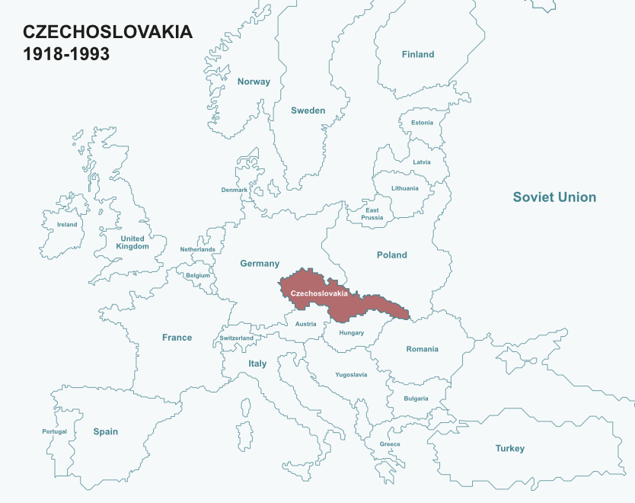
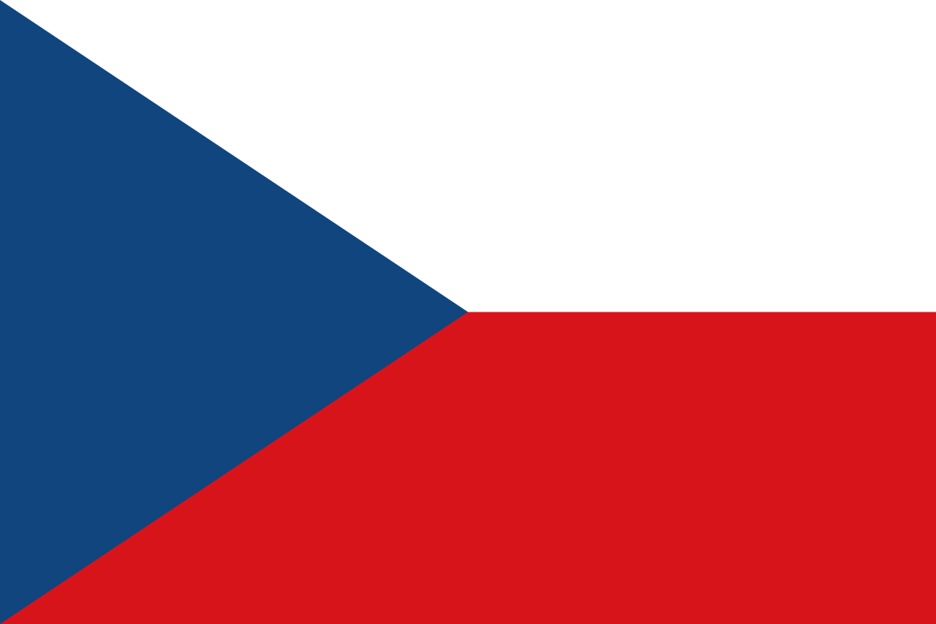
Czechoslovakia (1918-1993)
The Republic of Czechoslovakia was created in 1918 after World War One. It was one of a number of countries created after the collapse of the Austro-Hungarian Empire. Between 1918-1938 it was a democracy.

Slide 6
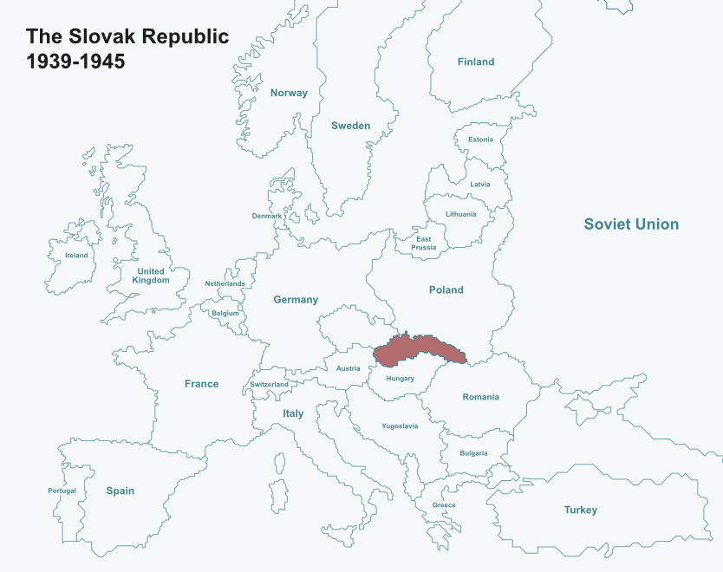
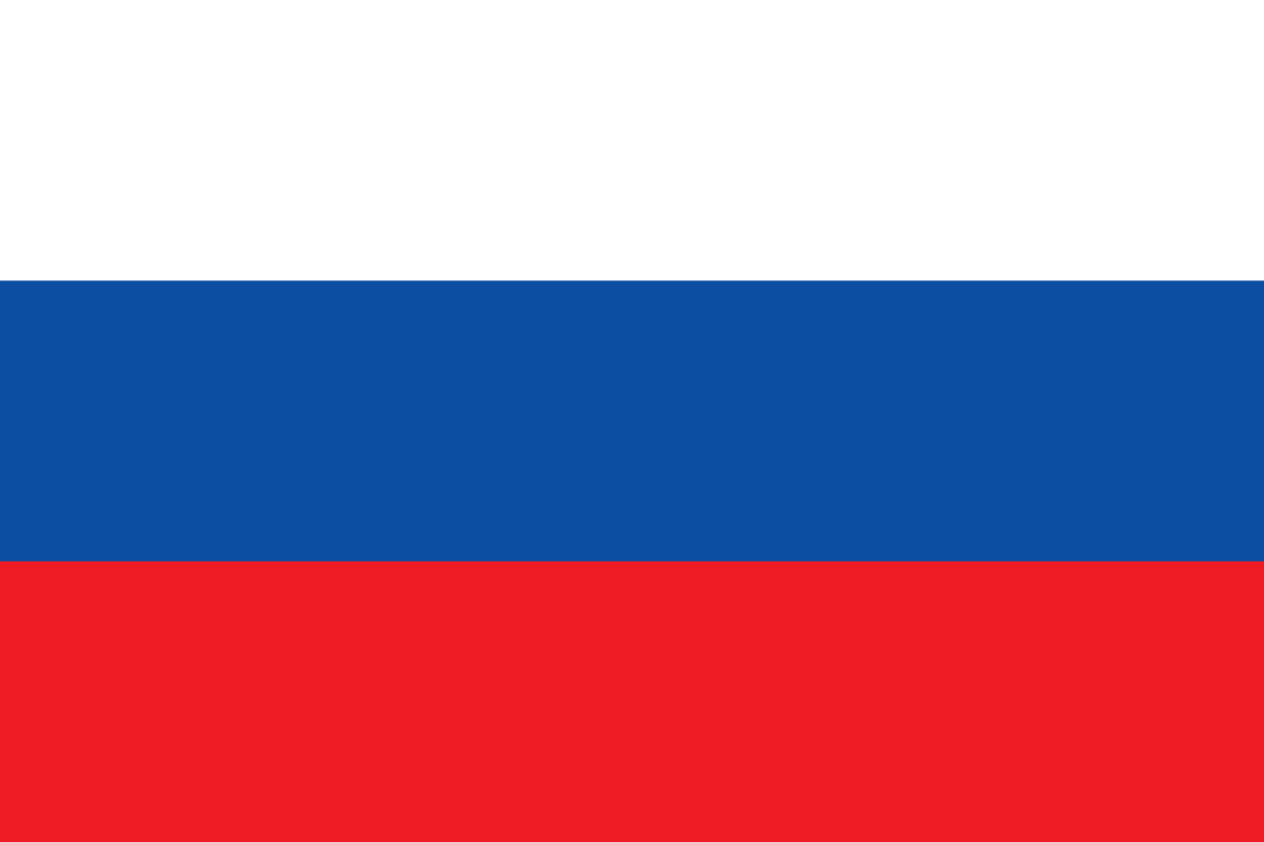
The Slovak Republic (1939-1945)
In October 1938, Czechoslovakia was forced to surrender part of its land to Nazi Germany. In March 1939, Nazi Germany invaded the rest of the country – taking over two more areas. What remained of Czechoslovakia became the independent Slovak Republic. The Republic was authoritarian and formally protected by Nazi Germany.

Slide 7
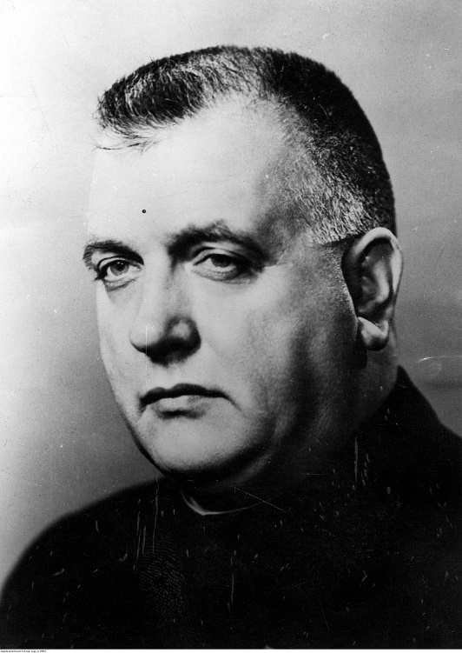
Jozef Tiso
Jozef Tiso was a Roman Catholic priest who entered politics after World War One. He became President of the Slovak Republic from October 1939 to April 1945.
Tiso was a well-educated man and talented public speaker. He was known in the 1920s for being good at negotiating and finding compromise. During the 1930s, his political views began to change. Tiso had always been a nationalist, but he increasingly opposed democracy.
Tiso did not like Jewish people. His public writing in the 1920s was often antisemitic, and once President of the Republic, he oversaw both the creation of anti-Jewish laws and the deportation of Jews living in the Slovak Republic.
Bundesarchiv, Bild 146-2010-0049 / o.Ang. / CC-BY-SA 3.0
‘People ask whether what is being done to the Jews is Christian. Is it human? Is it not robbery? …I ask is it Christian when the nation wants to free itself from its eternal enemy – the Jew … Slovak, cast off your parasite’
Jozef Tiso, August 1942

Slide 8
Grandfather’s shop
A close ally of Nazi Germany with antisemitic beliefs, the government of the Slovak Republic chose to discriminate against Jewish people in various ways. One way was to take control of businesses owned by Jews or close them down.
In April 1940, the government passed a law whereby Jewish business could choose to give over half of the business to a Christian. Unsurprisingly, few volunteered to do this.
So in November 1940, the law was changed – the government now had the power to take over or close down any business owned by Jews. By 1942, nearly every Jewish business – around 12,000 of them – had been seized by the government or given to Christian owners.
‘My grandfather’s shop was the only decent one for miles around. Far from big, the shop was basically a small room with a counter that separated the public from the small living area out back. It was a mixed hardware store that provided everything from flour, sugar, needles and thread to paper, glue and whatever the busy housewife needed to clean the house’
‘On 31 May 1941 the little shop became just another miserable statistic when it was liquidated…It was a brutal shock to Opapa. The shop was his lifeline…His customers relied on him…He never recovered from this humiliation, rarely leaving the house because, as he saw it, he no longer had much reason to do so.’

Slide 9
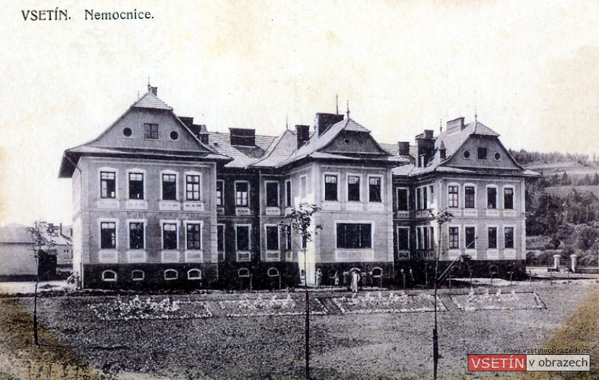
Uncle Desider
On 1 October 1938 areas on the German-Czechoslovakian border legally became part of Nazi Germany. The Sudetenland, as this region was called, was given to Germany under the terms of the Munich Agreement – a document signed by France, Britain, Germany and Italy which was intended to try and avert Nazi Germany declaring war on Czechoslovakia. Over the next six months, much of the Western half of the country fell under Nazi control, coming to be known as the Protectorate of Bohemia and Moravia.
Photograph of the hospital at Vsetin, Moravia Courtesy of vsetinvobrazech.cz
Tomi’s Uncle, Desider, was a surgeon working at the Vsetin hospital. As a Jew he lost his job in May 1939, but continued to work there for free. In January 1940 he was arrested on suspicion of aiding the resistance, and signed an uncharacteristic confession. Two years later, he was found guilty of treason and given a death sentence. He was beheaded in April 1943.
‘Three letters and one exclamation mark, “JEW!” persecuted me all my life, everywhere’
Desider Reichental

Slide 10
Football
After the creation of the Slovak Republic, life for Jewish people in Slovakia became increasingly difficult. Jewish people were no longer able to work in certain jobs, and prejudice against Jewish people became more and more acceptable.
Tomi’s family did what they could to shelter him and his brother from the growing hostility. However, it was soon impossible to protect them completely.
‘There were some things that I couldn’t help noticing. Miki and I spent hours playing football with the other kids in the village square. I was usually the goalkeeper while Miki, a talented player, was a popular addition to any team. A passer-by would hear the excited shouts of “Pass it, Miki, over here!” or “Come on, Tomi, kick it out!” and assume we were all the same.
With the publication of the Jewish Codex…things began to change…
No longer did Miki score goals; from now on it was, “Hey, the Jew scored!”, and no longer was a player urged to kick the ball to Tomi, it was, “Give the ball to the Jew!”’
Notes:
Badge from:
https://www.yadvashem.org/artifacts/featured/jewish-badges/slovakia.html
Quote from: I was a boy in Belsen, Tomi Reichental

Slide 11
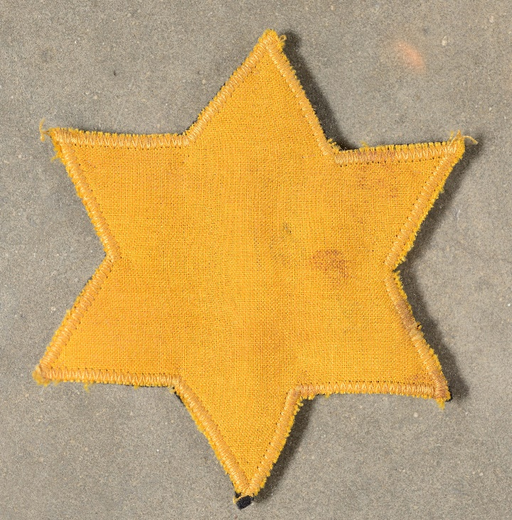
The yellow star
‘She asked me to give her my coat as she needed to sew something on it. I was intrigued when she produced a yellow star.
‘What is it Auntie?’ I asked.
‘She didn’t exactly smile as she replied: ‘You’re a big boy now, Tomi, so this means that you’ve to wear this any time you leave the house…’
Her explanation satisfied me and I didn’t give it another thought’
On 9 September 1941 the government of the Slovak State began to persecuted Jews in new ways. A law called the Jewish Codex was introduced: this prevented Jews from doing certain jobs, and doing things like going to parks, driving cars or riding bikes, or owning binoculars. Jews aged 6 and over had to wear a yellow star on their clothes.

Slide 12
Boys
According to the Jewish Codex – the anti-Jewish law introduced in September 1941 - Jewish children were not allowed in Slovakian schools. Tomi and his brother were sent by their parents to stay with their Aunt Renka in the city of Nitra where there were a number of Jewish schools.
On his first day, Tomi finished school at lunchtime and made his way back to his Aunt’s house.
‘I saw three boys standing in front of the corner shop. There was something about them that made me nervous. I felt my chest tighten as the three of them, in silence, watched me approach. Then, as I passed them by they muttered at me ‘Zid! Zid! Zid! (Jew! Jew! Jew!). Confused and suddenly very scared I took off down the street, unable to stop until I reach Aunt Renka’s front door…That was probably the first time that I felt really different.
Of course, it would only get worse…Cries of ‘Dirty Jew’, ‘Smelly Jew’, ‘Pig’ followed me as I sprinted home, always frightened. After a while I wasn’t just shouted at; when they started spitting at me I was obliged to run across the road, and sometimes stones were fired after me as a ran’
Notes:
Badge from:
https://www.yadvashem.org/artifacts/featured/jewish-badges/slovakia.html
Quote from: I was a boy in Belsen, Tomi Reichental

Slide 13
Arrested
‘That morning our mother…led Miki and me to a shop that stood across the road from the National Opera House where we were told to wait for her to return with our grandmother…
A few minutes went by, and then some more, and more after that. There was no sign of her…
…the door was pushed open. Miki and I looked up eagerly at the two figures entering the shop, absolutely expecting to see our mother and grandmother, but it wasn’t them. It was two men…wearing long leather coats with a swastika…
“You are Jewish?” Miki shook his head. ‘No my name is Miki Vyda. I’m not Jewish.” …It was a bit of a shock when the man persisted: “But you are Jewish.” Again my brother denied it. Without warning, the man slapped Miki across the face. “Tell me the truth. We have your mother.” However, Miki refused to give in…The man turned to me then: “You are Jewish, aren’t you?” Following my brother’s lead, I said my new name: “No, my name is Tomas Vyda. I’m not J-’ Before I finished my sentence the man had given me a blow across my face, almost knocking me off my feet. I was very small for my age. Miki jumped in horror, instinctively protecting me by blurting out: “No, don’t beat him! Yes, yes, we are Jewish.” The man smiled in satisfaction. “You could’ve just said this in the beginning and saved yourself a beating.”
We were under arrest, escorted between the two Gestapo agents to the shop where we were re-united with our mother and grandmother.
…
After all our near brushes with capture since leaving Merašice, our luck had finally run out.’
Notes:
Image from:
https://en.wikipedia.org/wiki/Slovak_National_Theatre#/media/File:Bratyslawa_Teatr_Narodowy.jpg

Slide 14
The Holocaust in Slovakia
In December 1940, a national census found that there were 88,951 Jewish people living in the Slovak Republic. By the end of the Second World War, it is estimated that around 60,000 of these people had been murdered.
In October 1941Jozef Tiso and other members of the government met with leading Nazis at Hitler’s headquarters. The meeting was to discuss deporting Jews out of Slovakia, to be “resettled” in occupied Poland. After further negotiations, the Slovakian government agreed to pay Nazi Germany 500 marks for each Jewish person that was deported.
Deportations began in March 1942, and ran until October. During this time, around 58,000 Jews were deported. Only a few hundred would survive, as most were sent to the death camps in occupied Poland.
In October 1942, deportations stopped. This was in response to pressure from the Vatican, the bribing of officials by Jewish activists, and growing awareness of what deportation truly meant. In August 1944, Nazi Germany tried to crush a national uprising by occupying Slovakia. The deportation of those Jews still in Slovakia resumed, with many being sent to Auschwitz.

Slide 15
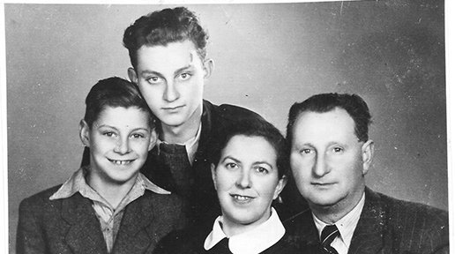
Liberation & aftermath
When Bergen-Belsen was liberated, the only relatives Tomi knew were alive were those around him: his mother, his brother, his cousin Chava, and his Aunt Margo. However, Margo and Chava required medical attention and Tomi himself was unwell. After receiving treatment in the “Human Laundry”, Tomi spent a few weeks in the camp’s hospital where he helped his Aunt back to health.
Soon after being reunited with his relatives, Tomi received news of his father. In mid-July 1945, Tomi left Bergen-Belsen – travelling first by bus to Prague, then Bratislava, and finally Merašice.
Tomi’s immediate family in 1948: Tomi, Miki, Mother and Father. Courtesy Tomi Reichental
‘When my father heard that we were alive he sent a card to us in Bergen-Belsen – and there it was on the board! … It was a magical moment’
‘It was a strange experience seeing those buses branded with our national flag and the destination of Prague on the sign. You might think that we’d jump for joy, but we didn’t…Death was still all around us as the news of murdered relatives began to filter through the noticeboards alongside the names of survivors.’

Slide 16
This programme is delivered by UCL Centre for Holocaust Education, the Holocaust Educational Trust, with support from the National Holocaust Centre and Museum, and made possible thanks to funding from the Department for Education

