Slide 1
Antisemitism then & now
Reflections from survivors of Bergen-Belsen

Slide 2
Freddie Knoller
© Rena Pearl www.renapearl.com

Slide 3
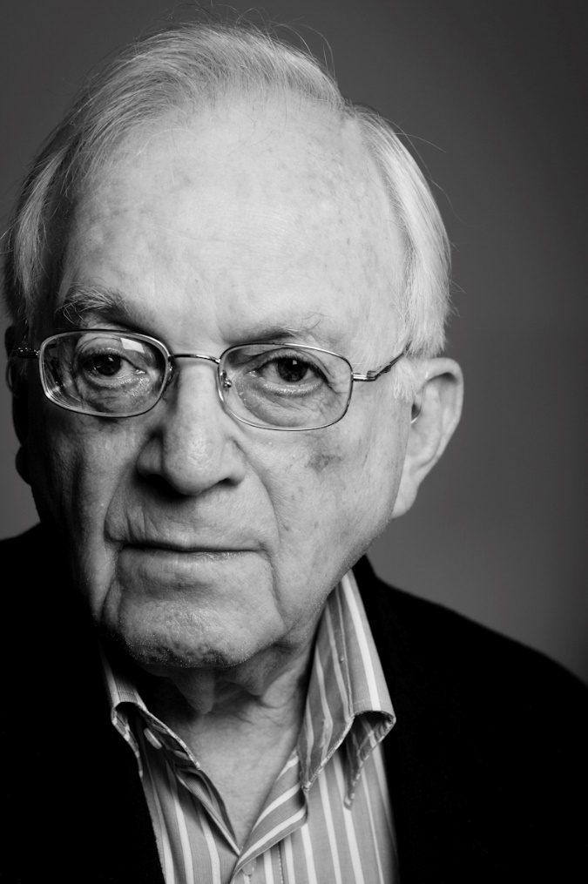
Freddie Knoller
Freddie was born in Vienna on 17 April 1921. His parents – David and Marja – had grown up in what is today Poland, before settling in Vienna. They had three children: Otto, Eric, and Freddie who was the youngest.
In November 1938 Freddie left Austria and headed to Belgium. He then spent the next two years on the move. Having spent time in refugee camps in Belgium, in 1940 he headed to France to try and outrun the invading German army. With the invasion of France by the Nazis, Freddie sought refuge first in the unoccupied zone of France before later travelling back to Belgium. Then, in December 1940 he found his way to Paris – a city he had always dreamed of visiting, now occupied by the Nazis.
For the next two and a half years, Freddie lived in Paris. He worked as a “guide” for German soldiers who wished to visit nightclubs and dancing girls. After leaving Paris in July 1943, Freddie spent time with French partisans before being captured and taken to the transit camp at Drancy. Deported to Auschwitz in October 1943, Freddie was part of a death march in January 1945. He arrived at Bergen-Belsen in March 1945.
Photograph of Freddie, aged 91 Courtesy of Freddie Knoller and John Landaw.

Slide 4
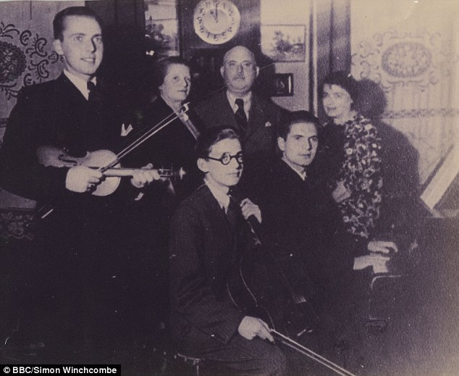
The Jews of Austria
At the beginning of 1938, Austria was home to around 190,000 Jewish people. They lived across the country, with the largest community in Vienna. Throughout Austria Jewish people were a minority: Jews made up just 4% of the total population, with this rising to 10% in Vienna.
The Jews of Austria were highly assimilated. During the first three decades of the twentieth century they had made considerable contributions to culture, politics and society. This continued after the Austro-Hungarian Empire collapsed after the First World War.
Austrian society was not free from antisemitism. Some politicians during the 1920s and 1930s were hostile to Jews, and although the Austrian Nazi Party did not have wide support it grew in influence after 1934.
Photograph from 1936 of the Knoller family. From left to right: Eric, Marja, Freddie, David, and Otto. A family friend is on the right.
‘That the Knoller boys played musical instruments was typically Viennese. It was our parent’s delight to hear us play; six was the age at which each of us was introduced to a musical instrument’

Slide 5
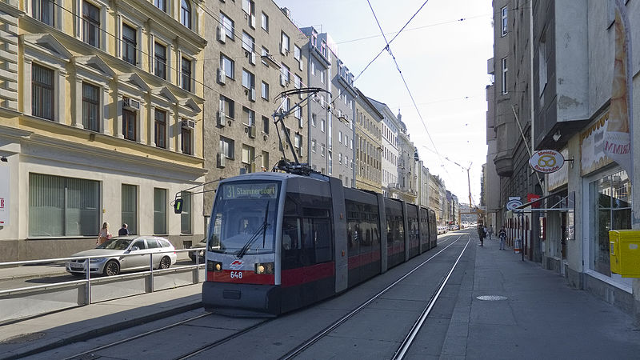
Vienna
Freddie and his family lived on Untere Augartenstrasse in central Vienna. Their home was a two-bedroom apartment, in which the Knoller family lived with their maid.
The apartment was very crowded, with no bathroom. Once a week, Freddie and his brothers would use a public bath ten minutes walk away. The family got their water from a basin in the corridor, which – together with a toilet – they shared with their neighbours.
Contemporary photograph of Untere Augartenstrasse, Vienna
‘Vienna was everything to us, our whole world – almost a city of Jews, we sometimes proudly felt – for were not the names of some of its famous sons Jewish?
…
The reality of our daily lives was that we mixed socially with only Jews, merely exchanging greetings with our Christian neighbours. Though there was nothing in our appearance to distinguish us from each other, we remained strangers’
‘We lived in the second district of Vienna…as the city’s gentiles called it, Matzes Insel, the Island of Matzos. Here we Jews were the majority and this made us feel secure. It was possible to forget that to be a Jew was to be a member of a small majority in Austria’

Slide 6
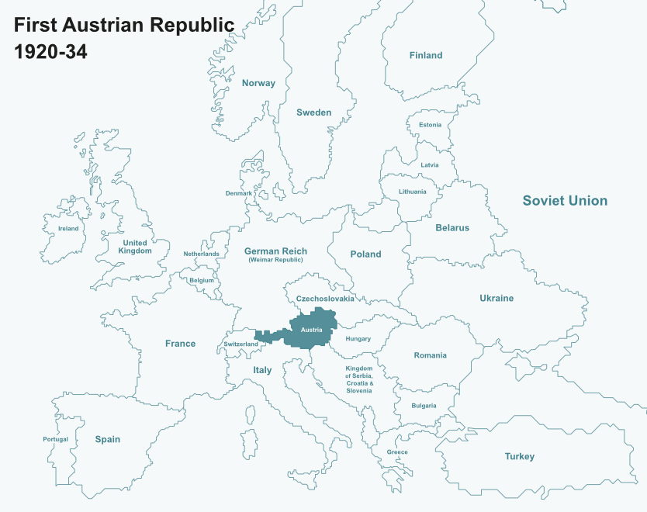
First Austrian Republic (1920-1934)
In the aftermath of the First World War the map of Europe was redrawn. One of the defeated powers – the Austro-Hungarian Empire – was succeeded in 1920 by a new state: the First Austrian Republic.
The Republic faced many challenges. Its territory was significantly smaller than the Empire, it lacked natural resources and was economically weak. It also had no history of parliamentary democracy.
It was a recipe for ongoing social and political tension, often leading to outbreaks of public violence.

Slide 7
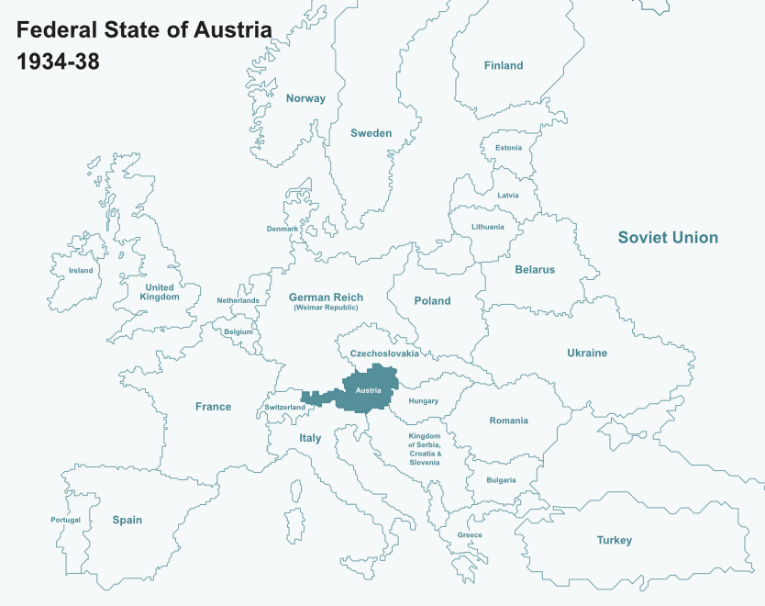
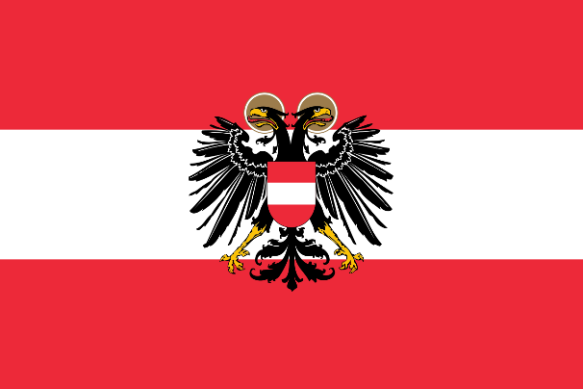
Federal State of Austria (1934-1938)
In the early 1930s the Austrian Republic was in crisis. By 1934, it had become a one-party authoritarian state. Its new rulers combined Catholic beliefs and fascist ideas.
The government faced various pressures. Some of these came from Nazi Germany, who increasingly called for Germany and Austria to become one united country. The Nazi Party in Austria even tried to seize power by force, but were defeated and then banned.
Though the government wished to protect Austria’s independence, they were fighting a losing battle.

Slide 8
Fighting back
‘I was six years old when I entered the Volksschule, or elementary school…it was here that I first experienced antisemitism. “Sau Jud! Jew pig!” called other six-year-olds after us, and spat at us. I decided the next time this happened I would fight my tormentor. Soon enough the familiar taunt was hurled in my direction and I turned and punched the boy on the nose. Blood streamed from his face and his friends sat upon me, beating me with their heavy satchels.
I ran home, clothes torn and body bruised. “How did you get in this state?” asked my mother anxiously, and I told her. Her response deflated all my pride in my fighting spirit. “You must not get into fights, especially with Christian children. If they insult you, just ignore it.” Father, returning home later from business, supported my mother entirely.
I was utterly bewildered by their attitude, too young to understand their ancient Jewish fear of rousing gentile wrath and reprisal. Yet the very next day the boy whose nose I had bloodied wanted to make friends with me.
“Look,” he said gruffly, “that was not a fair fight. Five on one is not fair.”
“Thanks,” I said, glad of his support…“I’m Karl Swoboda,” he said. We started talking and quickly discovered our shared enthusiasm for stamp collecting.’

Slide 9
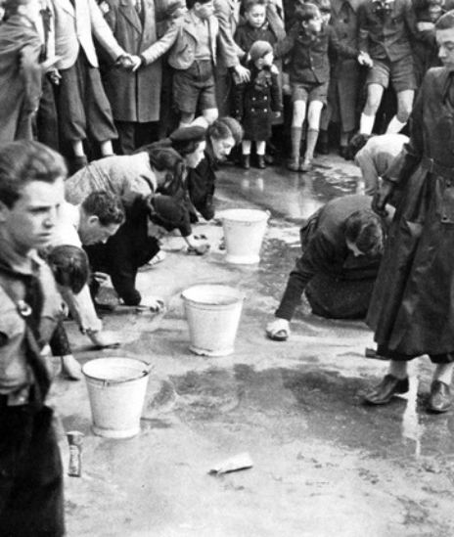
Anschluss
On 13 March 1938 Austria became part of Nazi Germany. This unification was known as the Anschluss and was the result of Nazi Germany putting intense pressure on the Austrian government for a number of years. Whilst many Germans and Austrians welcomed it, the Anschluss was controversial. So as to demonstrate popular support, the Austrian population was asked in April to formally vote for or against the unification. According to figures, 99.7% voted in favour. The Anschluss was a terrible development for Jewish people living in Austria. Almost immediately, a wave of violence and public humiliations broke out.
Members of Hitler Youth oversee Jews scrubbing the streets of Vienna, 1938 (Courtesey of Yad Vashem Photo Archive)
‘Out in the streets my mother and I saw swastika flags hanging from the window of almost every home. Brown-shirted Nazis…roamed the streets. We saw them stopping conspicuously Jewish-looking men and forcing them to clean away the plebiscite slogans. Further along the street was a sight that chilled our blood. SA men continuously kicked an old bearded Jew in the backside as he tried to scrape a slogan from the pavement. All around gentile Austrians, some of them women with infants, laughed…’

Slide 10
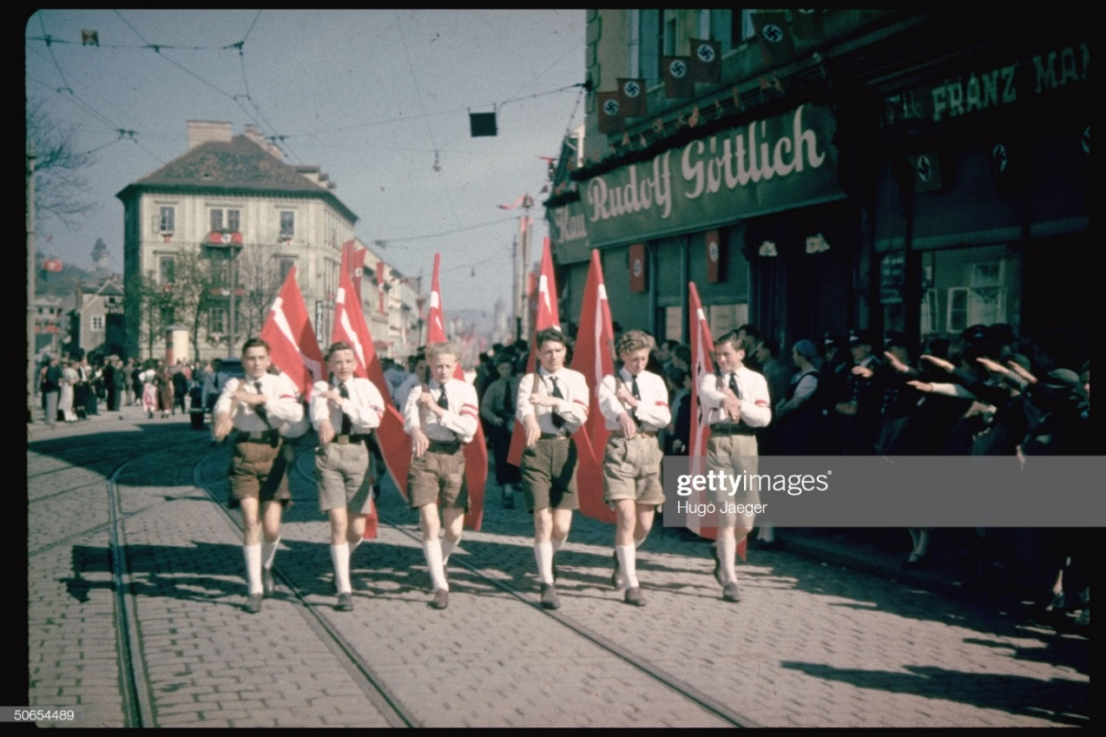
Karl Swoboda
Photo by Hugo Jaeger/Timepix/The LIFE Picture Collection via Getty Images
‘One shopping trip with my mother I remember particularly well. I hated shopping and so would wait outside for her…I saw a familiar figure approach. It was Karl Swoboda, smartly dressed in a Hitler Youth uniform, but the uniform did not deter me. I would speak to him. Hadn’t we spent many hours together over our stamps? As I opened my mouth to great him I saw that Karl had seen me, but he looked straight ahead. I called after him. “What’s the matter? Don’t you say hello?” He walked on…determined to disown me…’

Slide 11
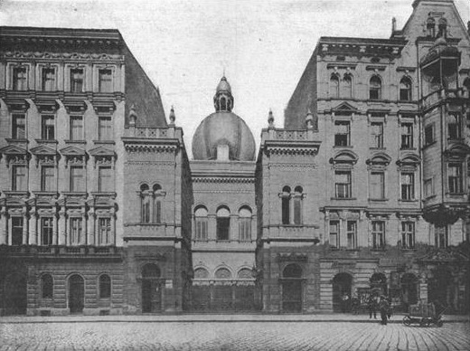
Kristallnacht
On the evening of the 9 November 1938 a wave of anti-Jewish violence took place across Germany and its new territories. Synagogues were destroyed, businesses were looted, and Jewish people were attacked by members of the Nazi Party, the SA, and members of the public. Violence was not new to the Jews of Vienna, yet Kristallnacht still brought new levels of misery.
‘At midnight Kristallnacht…came to our building. We heard a noise in the courtyard. Rushing to the window of our darkened home we saw…SA men, who then entered our building. We stepped away from the window in terror…
A period of silence followed, which ended with a violent crash of glass from below. A woman screamed and we heard a dull thud in the courtyard. We rushed back to the window and saw the dark shape of a person lying below…
The next morning I spoke to Mr Hagmann [the caretaker], who wore his habitual swastika armband. “It was Mr. Epstein who died,” he told me. “He tried to escape and jumped out of the window”…“is that what the SA told you?” I replied, “that a man just threw himself out of a window?” Mr Hagmann looked down. “Perhaps he was helped,” he murmured.
Photograph of the Polnische Tempel – the Knollers’ synagogue. On the night of the 9 November the family watched from their apartment window the ‘sky burning red with the flames of what we know must be our synagogue’. © ANL/Vienna, H 5175/4. Photo Albert Hilscher

Slide 12
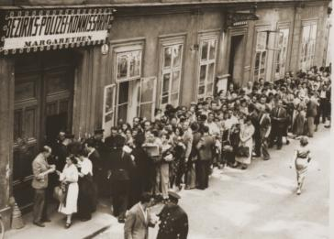
Emigration
Between the Anschluss in March 1938 and the outbreak of the Second World War in September 1939, life for the Jews of Austria became more and more challenging. New laws restricted what people could and could not do, while Jews faced increasing hostility in their daily lives.
Unsurprisingly, many wanted to leave the country and this came to suit the Nazis. But leaving was not straightforward. People needed somewhere to go, and the financial means to emigrate. While few countries were prepared to accept Jewish people, many lost their money and possessions because of new regulations.
Freddie’s parents tried desperately to find escape routes for the children. Eventually, an opportunity for Eric to emigrate to the USA in December 1938 arose. A similar chance opened up for Freddie, who followed some of his cousins to Belgium in November 1938. In April 1939, Otto made his way to England via Holland. The boys’ parents, meanwhile, remained in Vienna. They were deported to Theresienstadt, in October 1942, before being killed in Auschwitz in 1944.
Photograph of Jewish people queuing for exit visas at a Police Station in Vienna, 1938
‘We all took the tram…At another station…there was an antisemitic exhibition. The posters for this, displaying a caricature of a Jew…were in evidence all over the city. We scarcely noticed them now. They were the norm, as were the shops we passed daubed with white Stars of David’

Slide 13
Paris
In June 1940, Germany and France signed an armistice. Under its terms, France was divided in two. Germany occupied the north of the country, while a new French government friendly to Nazi Germany – known as the Vichy government – ruled the south.
Jews living in occupied France soon faced persecution. People had their jobs and property taken away and faced restrictions on their daily lives. In September 1940, Jews had to register with the police.
On 14 May 1941 there was a new development. For the first time, the Paris police conducted mass arrests. Jewish men aged 18-40 were told to report to the police, then taken into custody before being placed in detention centres. In total, over 5,000 Jewish people were arrested.
Freddie, who was living in Paris under a false identity, witnessed these events.
‘The streets were suddenly full of gendarmes [police]. “They’re rounding up Jews,” said Christos. I watched helplessly from the side-lines as these French policemen entered buildings and came out with their captives, whose only crime was their Jewishness. Often it was whole families they took, pushing them roughly into the waiting police vehicles, indifferent to their age, sex or state of health…I saw not a single SS man or Gestapo officer in sight’

Slide 14
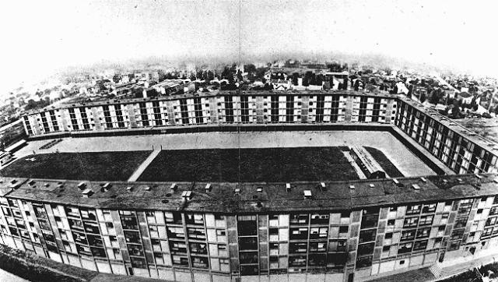
Drancy
In August 1941 the German authorities established detention centre in the Paris suburb of Drancy. Enclosed with barbed wire with room for 5,000 people, Drancy’s function changed in the summer of 1942. From June that year until July 1944, Drancy served as a transit camp for Jews who were to be transported to the East.
Freddie was arrested by Vichy police in August 1943. After confessing to being Jewish, Freddie was sent to Drancy. He arrived in September 1943. On arrival, a Jewish official working for the Germans registered Freddie, giving him a yellow star.
Photograph of the Drancy complex
“Have it sewn on your clothes,” he told me….“If you see a German officer, you must stop and stand to attention until he has passed. Do you understand?” I nodded…
I held the rough piece of cloth bearing that emblem of identity I had seen so often on the Paris streets: the yellow star, embossed at its centre with the single, black-lettered word “Juif”. I had managed to evade that identity for so long that I felt I was safe from it. But now it was as if the enemy had seized me roughly by the shoulder and was saying, “Wake up, fool! You have been dreaming. Did you think you could get away with it?” … All the same, I experienced a strange relief to have my faith back again…I felt almost defiant’

Slide 15
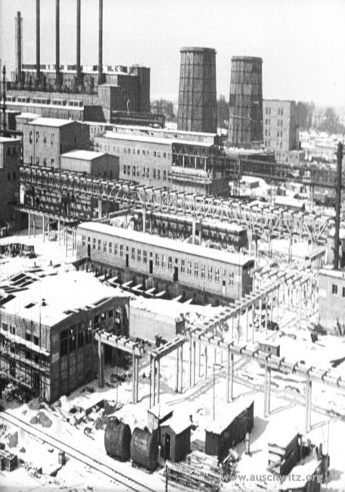
Auschwitz III - Buna
On 7 October 1943 Freddie was deported from Drancy on a transport containing 1000 people. Three days later, the train arrived at Auschwitz. 340 men from the transport were selected for work at the Buna synthetic rubber plant – a factory built in Auschwitz by the German company, I.G. Farben which used slave labour. Freddie was among those chosen for work. He was to live in the labour camp next to the factory.
Life at Buna was hard. As well as the hard labour, meagre rations and poor living conditions, there was also the brutal regime of roll-calls and selections – with the threat of violence never far away. It was not only the German staff who posed a danger. Kapos – fellow prisoners, often convicted criminals, chosen to carry out the orders of the SS in exchange for privileges – could be at least as vicious.
Photograph of the I.G. Farben factory located next to Auschwitz III. Courtesy Auschwitz-Birkenau State Museum
‘We were led outside in the dark to an open-air washing facility. There was a round bowl with six taps, and here we formed a queue. We moved forward quite quickly, but I was cold and impatient. Spotting an identical basin set apart, I bypassed the queue and went and stripped in front of this one. No sooner had I started washing than I was seized violently and a ferocious blow landed full in my face. My glasses smashed and fell to the ground. A Kapo shouted, “This basin is for Kapos only, you dirty Jew!” Blood streamed from my nose.’

Slide 16
Bergen-Belsen and beyond
On 18 January 1945 Freddie left Auschwitz. He was among a group of prisoners who, in freezing conditions, were marched 31 miles to the town of Gleiwitz. From there they were placed onto cattle wagons and transported to a concentration camp in Germany called Mittelbrau-Dora.
Mittelbrau-Dora provided slave labour for a nearby factory, located underground in a nearby hill. Protected from Allied bombing, the factory was used to produced thousands of V2 rockets which – the Nazis hoped – might help them win the war. Freddie was only at Mittelbrau-Dora for a few weeks. When the camp was evacuated in March 1945, he was taken to Bergen-Belsen from where he was liberated a few days before his 24th birthday.
In the days after liberation Freddie was nursed back to health. Once well again, he left Bergen-Belsen and travelled to France before emigrating to the USA in 1947.
‘One day an officer [from the British army] asked me if I wanted to join a group of inmates who were going on a foraging expedition for food at local farms…I leaped at the chance to see the world beyond the camp...We were on foot, pushing a trolley and accompanied by a British soldier. We came to a farm close by, where two women and a man, the farmer, met us. Heated discussion quickly followed…The soldier told us to go into the farmhouse and the outbuildings and take whatever food we could find…I discovered a large portrait of Hitler hidden behind a storage cupboard. I found a kitchen knife and took the portrait to the soldier, who was stood outside with the farmer and the women. I slashed the portrait. The farmer spat at me and shouted, “Du sau Jud!” A rage such as I have never experienced seized me, and I pushed the knife into his stomach. The soldier intervened at once…I do not know how seriously I injured the farmer’

Slide 17
This programme is delivered by UCL Centre for Holocaust Education, the Holocaust Educational Trust, with support from the National Holocaust Centre and Museum, and made possible thanks to funding from the Department for Education

