Slide 1
Antisemitism then & now Reflections from survivors of Bergen-Belsen
Experience cards: Anita Lasker-Wallfisch

Slide 2
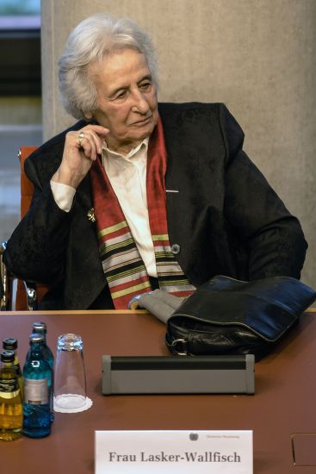
Anita Lasker-Wallfisch
©Till Rimmele/EPA-EFE/Shutterstock

Slide 3
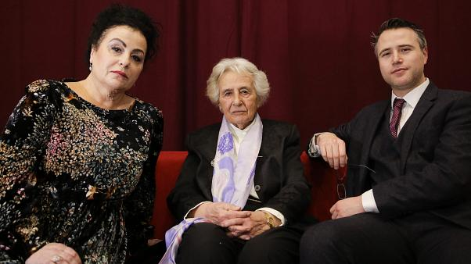
Anita Lasker-Wallfisch
Anita was born in July 1925 in Breslau – a city today located in Poland and called Wrocław, but which was then part of Germany.
Like all German Jews, life for the Lasker family was never the same after the Nazis came to power. However, it was not until the early 1940s that they found themselves in mortal danger. While Marianne managed to flee to England, Alfons and Edith were deported in 1942, never to be seen again.
Eventually, Anita and one of her sisters, Renate, were deported too and found themselves at Auschwitz. There, Anita was able to survive thanks to her skill as a talented cellist. As a member of the camp orchestra, she would play music as people entered the gas chambers.
Contemporary photograph of Anita (centre), with her daughter and grandson Credit: Markus Schreiber/AP/Shutterstock
In October 1944, Anita was part of a transport sent from Auschwitz to Bergen-Belsen – from where she was liberated six months later.

Slide 4
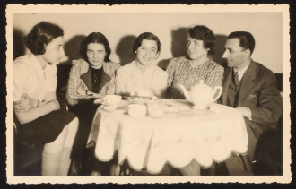
Breslau
Anita lived in Breslau with her family: her older sisters, Marianne and Renate, and her parents, Alfons and Edith. Her father was a lawyer who had fought in the First World War and been awarded the Iron Cross. Her mother was a talented musician.
The Jewish community in Breslau played an important part in the city’s development in the 18th and 19th centuries. In the first decades of the 20th century the city’s economy declined, and instances of antisemitism increased.
The Lasker family was middle-class. Like most Jewish people living in Breslau (and Germany more widely), they were very assimilated.
A photograph of the Lasker family, 1938 Courtesy of Anita Lasker Wallfisch
‘We lived in a spacious flat and we seemed to give each other plenty of space in every sense of the word. There was a general absence of rules at home, and yet there were some rules which were not to be broken: no child was ever allowed to sit on an armchair, for example; you did not “slouch”; nor did you sit around “doing nothing”…I can hear my parents’ voices now saying: “do something”…Considering that we must have been comfortably off…we lived very frugally’

Slide 5
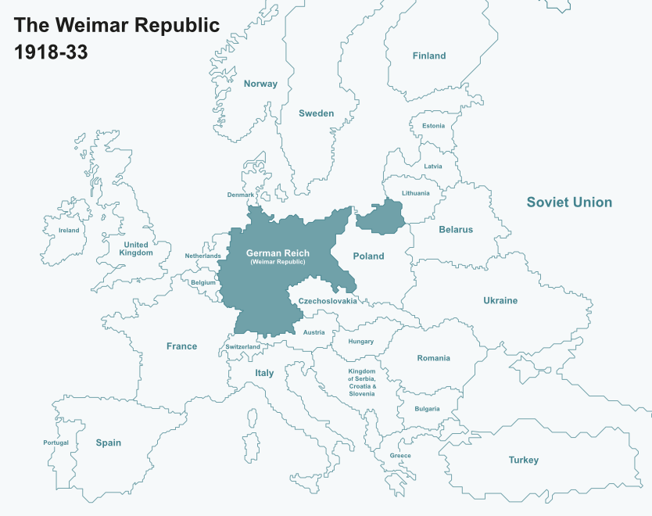
The Weimar Republic (1918-1933)
The Weimar Republic commonly refers to Germany in the years between the end of World War One and the creation of Nazi Germany.
The republic came into being following the abdication of Kaiser Wilhelm II and the end of the German Empire in 1918. From the beginning it faced many problems. Many of these related to the country’s economy, but the political structure of the republic was also a weakness.
For German-Jews, the years of the Republic were mixed. Jewish people had new opportunities and integrated themselves further into German society. At the same time, political antisemitism persisted, and in the late 1920s grew increasingly.

Slide 6
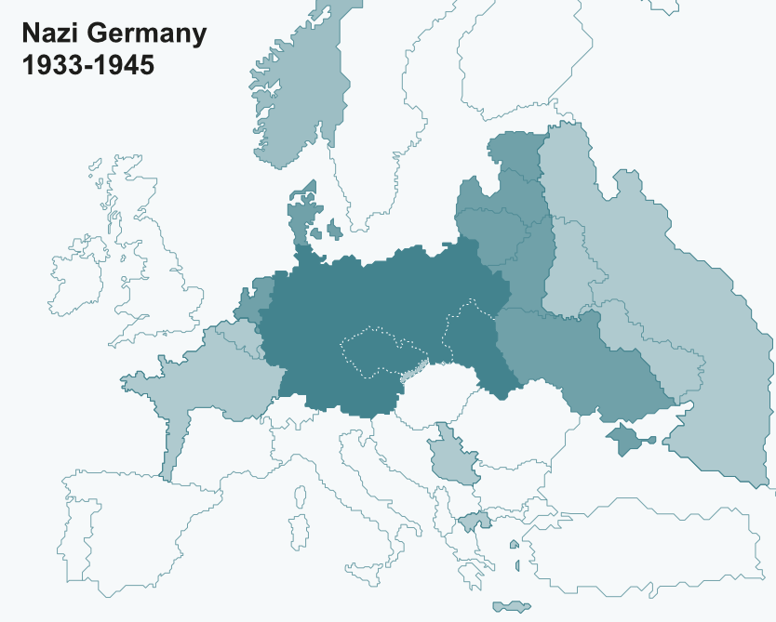
Nazi Germany (1933-1945)
On 30 January 1933, Adolf Hitler – the leader of the Nazi Party – was appointed Chancellor of Germany. Through a combination of violence, intimidation, propaganda and changes to the law, Germany became a totalitarian state. In August 1934, the death of the President allowed Hitler to seize total control of the country and become a dictator.
Towards the end of the 1930s Germany absorbed Austria and parts of Czechoslovakia. Its decision to invade Poland in 1939 sparked the Second World War and was followed by further expansion eastwards and westwards. In summer of 1941, Germany invaded its then ally, the Soviet Union, leading to a brutal conflict. Nazi Germany formally ended in May 1945 with its defeat by the Allies.

Slide 7
The Jews of Germany
When the Nazis came to power in January 1933, Jewish people in Germany were a very small minority. In a population of around 67,000,000, just 505,000 were Jewish – less than 0.75%.
Jewish people had lived in Germany for hundreds of years. While some continued to live in rural areas, an increasing number had moved to urban centres over recent centuries. There they had various occupations, from business and commerce, to owning shops or working in the media.
The vast majority of Jews living in Germany were very assimilated and proud of their nationality. A growing number were not religious: those who were, tended to believe in reform Judaism – a type of Judaism which was not traditional and was modern in its outlook.
‘We had a very happy home. We were three sisters and we all learnt to play an instrument. I played the cello. There was no particular emphasis on being Jewish…“Culture” was a very important part of our lives. We read the classics every Saturday afternoon, a great deal of chamber music was played in our home and we were brought up speaking French. …Life seemed normal and it was inconceivable that it should not continue to be so’

Slide 8
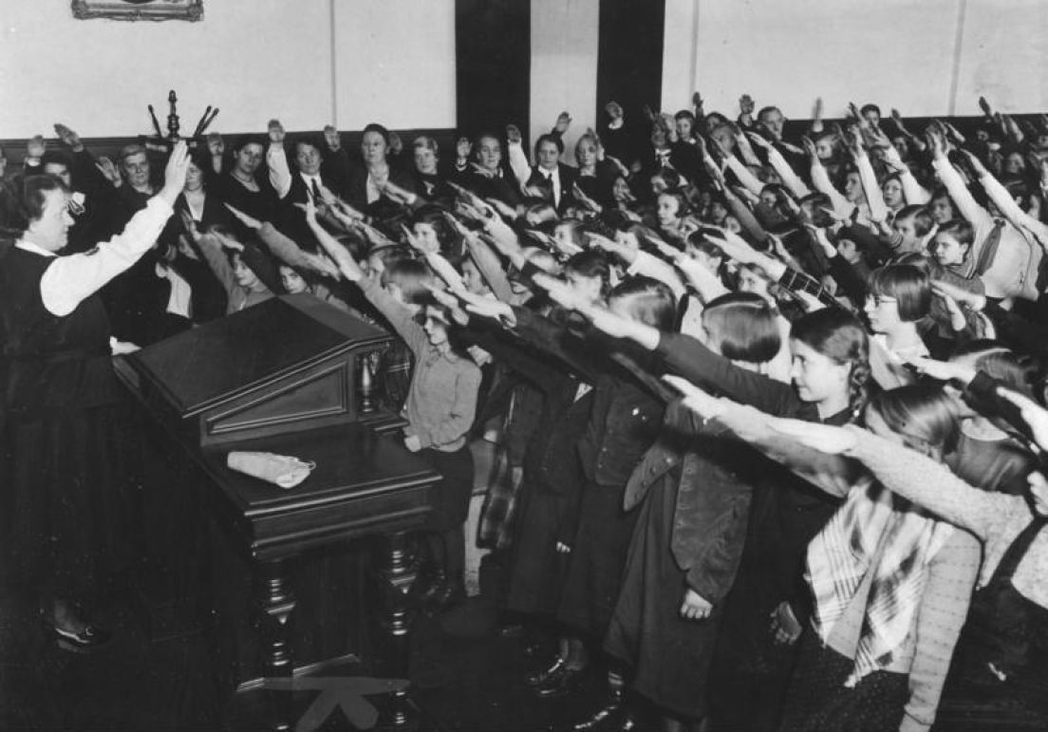
School
The education system was very important in Nazi Germany. For the Nazis, it allowed them to reach a large number of young people who were in the process of learning about the world around them. Because of this, the Nazis changed what schoolchildren would study and how. Certain subjects – such as sport and science – were given more priority than others. School textbooks were rewritten, so that they only included topics and information the Nazis wanted. Meanwhile teachers were expected to become members of the Nazi Party and undergo special training. From 1938, Jewish children were no longer allowed to go to schools with non-Jewish pupils.
‘Although life proceeded fairly normally, we had a growing awareness that all was not well. There were worried faces and there was talk of emigration. I was too young to understand what it was all about, but I knew something bad had happened. I had my first encounter with antisemitism. A fellow pupil in the small private school I attended would snatch the sponge from me as I was about to wipe the blackboard, and say: “don’t let the Jew have the sponge”; or children would spit at me in the street and call me “dirty Jew”. Since we had barely been conscious of our Jewishness at home, I found all this very bewildering’
A class of schoolchildren carry out the Nazi salute, Germany, 1934 Credit Bundesarchiv, Bild 183-2007-0329-501 / CC-BY-SA 3.0

Slide 9
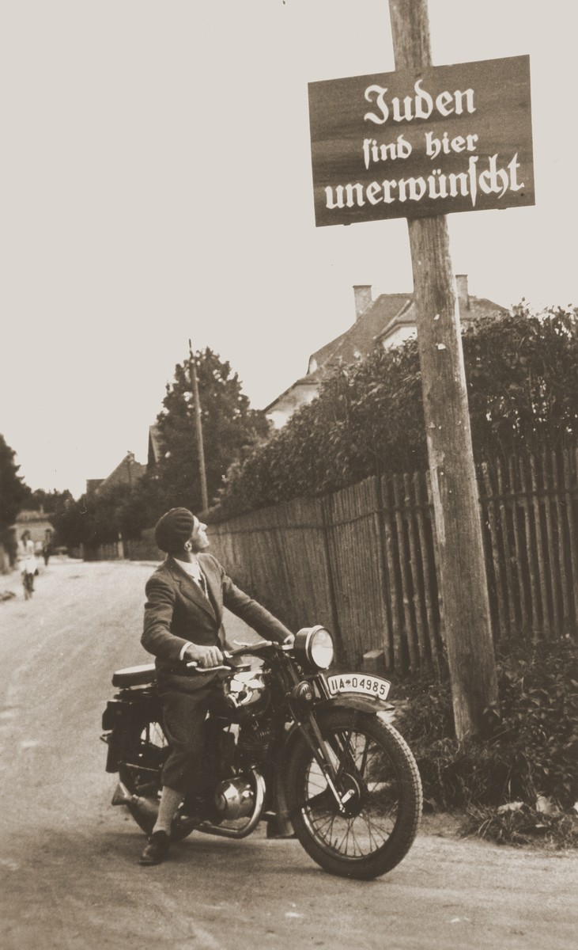
Persecution
‘The years went by, and the segregation of Jews and Aryans increased steadily. I remember certain laws coming into force. All Jewish females had to add the name “Sarah”, and all the males “Israel”, to their signature. We were no longer allowed to employ household help under the age of forty-five for fear of Rassenschande, racial pollution. Jews had to attend Jewish schools, and the infamous notice “JUDEN UNDERWÜNSCHT”, “Jews not welcome”, appeared more and more frequently in public places like restaurants and cinemas. Our lives were being very gradually undermined – so that, alas, the real threat behind it all could be ignored by over-optimistic people. My father was one of them. He was convinced that this nonsense would end one day soon, “when the Germans come to their senses”. However, many of our friends did leave the country, and even my own family began talking of emigration. But where could we go? How could we obtain the necessary papers? My father’s profession was a serious obstacle. He was trained in a legal system which was confined in Germany. How could he possibly earn a living in another country?’
A man stares up at a street sign saying ‘Jews are not welcomed here’, Germany, 1935 United States Holocaust Memorial Museum, courtesy of Margaret Chelnick

Slide 10
Surviving Kristallnacht
On 9-10 November, 1938, a wave of violence was unleashed against Jewish people living in Germany. Synagogues were set on fire, businesses owned by Jews were damaged or destroyed, and hundreds of Jewish men were arrested. The event came to be called Kristallnacht – ‘Night of broken glass’.
Kristallnacht hit the Jews of Breslau very hard. The synagogues were burnt down, shops were vandalised and looted, and nearly all Jewish men aged over 16 were arrested and taken to Buchenwald concentration camp.
‘My father escaped arrest…thanks to the courage of a great friend of ours, Walter Mathias Mehne, a violin-make in Breslau. He was not a Jew, and he deliberately ignored the fact that the streets were crawling with members of the Gestapo looking for Jews. He climbed the stairs to our flat, took my father with him, and drove him around the town in his car for the rest of the day. He could easily have been stopped and found himself in an embarrassing and highly dangerous position. The courage of…Mehne is all the more noteworthy since he was a well-known figure in Breslau’

Slide 11
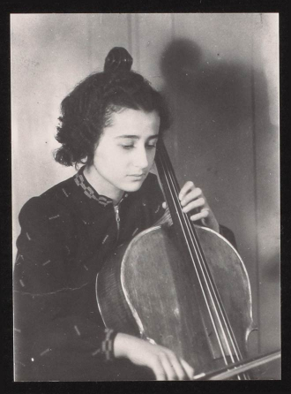
Learning to play
At a young age, Anita became interested in the cello.
As the 1930s went on, more and more Jewish people left Breslau. With the Nazi government passing laws that restricted how Jews and non-Jews interacted with one another, Anita’s parents found it impossible to find someone to teach her the cello.
Leo Rostal was talented cello player in Berlin. Whilst he was in Breslau for a concert, he visited the Laskers and heard Anita play. Impressed, he offered to teach Anita but she would have to move to Berlin.
Moving to Berlin was not straightforward. Anita needed special permission from the authorities. Eventually this was granted, and in May 1938 aged just 13 years old she moved to Berlin.
Anita was in Berlin when Kristallnacht happened. When it was over, her time in Berlin ended and she travelled back to Breslau to be with her family.
Photograph of Anita, 1938-1939 Courtesy of Anita Lasker Wallfisch
‘I soon got used to it and had a great time. I did the minimum amount of practising and loved wandering about…I felt extremely grown up I enjoyed my cello lessons very much and had a good friend in my teacher.

Slide 12
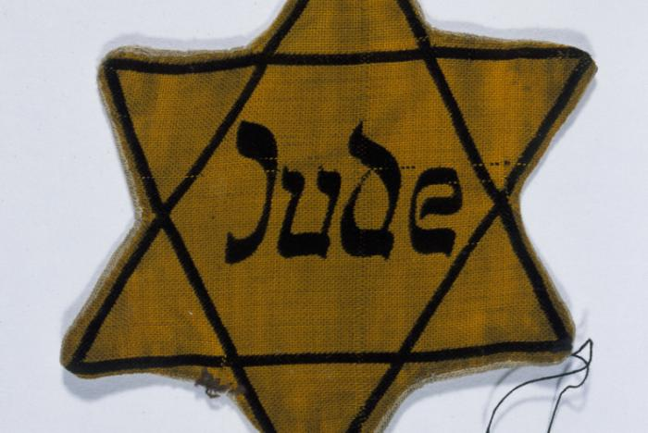
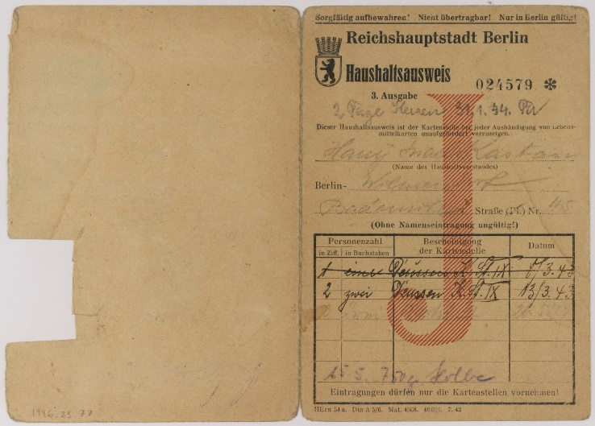
Wartime
The persecution of Jewish people living in Greater Germany continued throughout the Second World War. New restrictions and laws were continually being introduced: Jews were not allowed to own bicycles or radios, and in 1941 anyone over the age of 6 had to wear a yellow star. During wartime all Germans had food and other materials rationed, but Jewish people were given significantly less than non-Jews. They could also only go to the shops at certain times of the day.
To keep the German economy alive, it became compulsory for Jewish people to do forced labour. Aged just 16 years old, Anita and her sister Renate found themselves working in a paper factory.
United States Holocaust Memorial Museum, courtesy of Fritz Gluckstein
Example of a Star of David worn in German territories (above) and a ration card issued to a Jewish person in Germany (below)
‘…the problem of getting hold of food, with the restricted shopping hours for Jews, was virtually insurmountable. We got some relief by stealing “travel food coupons”, which had found their way to the factory for recycling. These coupons were undated and had no information on them about who they belonged to. Most important of all, there was no “J” for Jew printed on them, and they could be used in any shop…’
United States Holocaust Memorial Museum, courtesy of Hannah Kastan Weiss

Slide 13
Deportations
‘I am aware of the fact that on the night of the 8th to 9th April I took on responsibility not only for the rent and the gas, but for something much bigger. Especially because Renate was asleep at the time and I was alone…That night was decisive for me, although I only became conscious of its real significance much later. Yes, we should never cease to be thankful to our parents and we must live as though they can always see us…’
In October 1941 German Jews began to be deported to occupied Poland. There, they were sent either to ghettos or straight to death camps.
For a time, some Jewish people were able to avoid deportations: decorated or disabled war veterans, the elderly, and those married to non-Jews were among those who for some time were exempt. However, as time went by this was no longer guaranteed. By May 1943, the number of Jewish people living in Germany numbered less than 20,000.
On 8 April 1942, Anita’s parents were informed that they were being deported the next day and that they had to report to an assembly point. Her father left Anita – still only 16 years old - dictated instructions to her on how to manage the household. Following their deportation, Anita only heard three more times from her parents before word from them stopped. She later learned they were sent to a ghetto called Isbica, in German-occupied Poland, from where people were either deported to the death camps at Sobibor or Belzec, or were shot into mass graves.

Slide 14
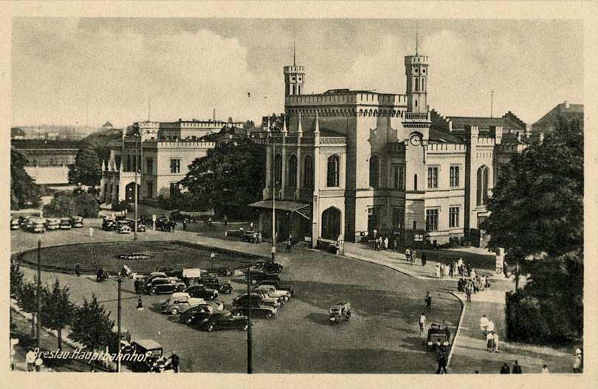
Arrest
Soon after her parents were deported, Anita’s grandmother was told to report for deportation. Anita and Renate were now totally alone in Breslau without any relations. It was decided that the sisters had to go into an orphanage.
At the orphanage, Anita and Renate agreed to try and escape Germany. They had planned to do so for some time – inspired by secret exchanges with prisoners of war at the paper factory. The sisters had started to help these men by creating false papers.
In the autumn of 1942, Anita and Renate made their move. They headed to Breslau train station, with the hope of reaching unoccupied France. They were arrested by the Gestapo, who had been watching them for some time. The sisters were put in prison. After being convicted of forgery and helping Germany’s enemies, Anita and Renate were separated. Eventually, Anita was put on a prisoner transport to Auschwitz.
A postcard of Breslau train station, 1942
‘We had ample opportunity to acquaint ourselves with prison life. In those days there was no preoccupation with the “well being” of prisoners. You were in prison, and there you stayed. No outings to the lavatory. You sat – and slept – and relieved yourself in your cell. The stench was disgusting…[the food]…was insufficient and we suffered from severe hunger…I also remember our total bewilderment, mixed with fear for the future, and a feeling of complete isolation and of time standing still’

Slide 15
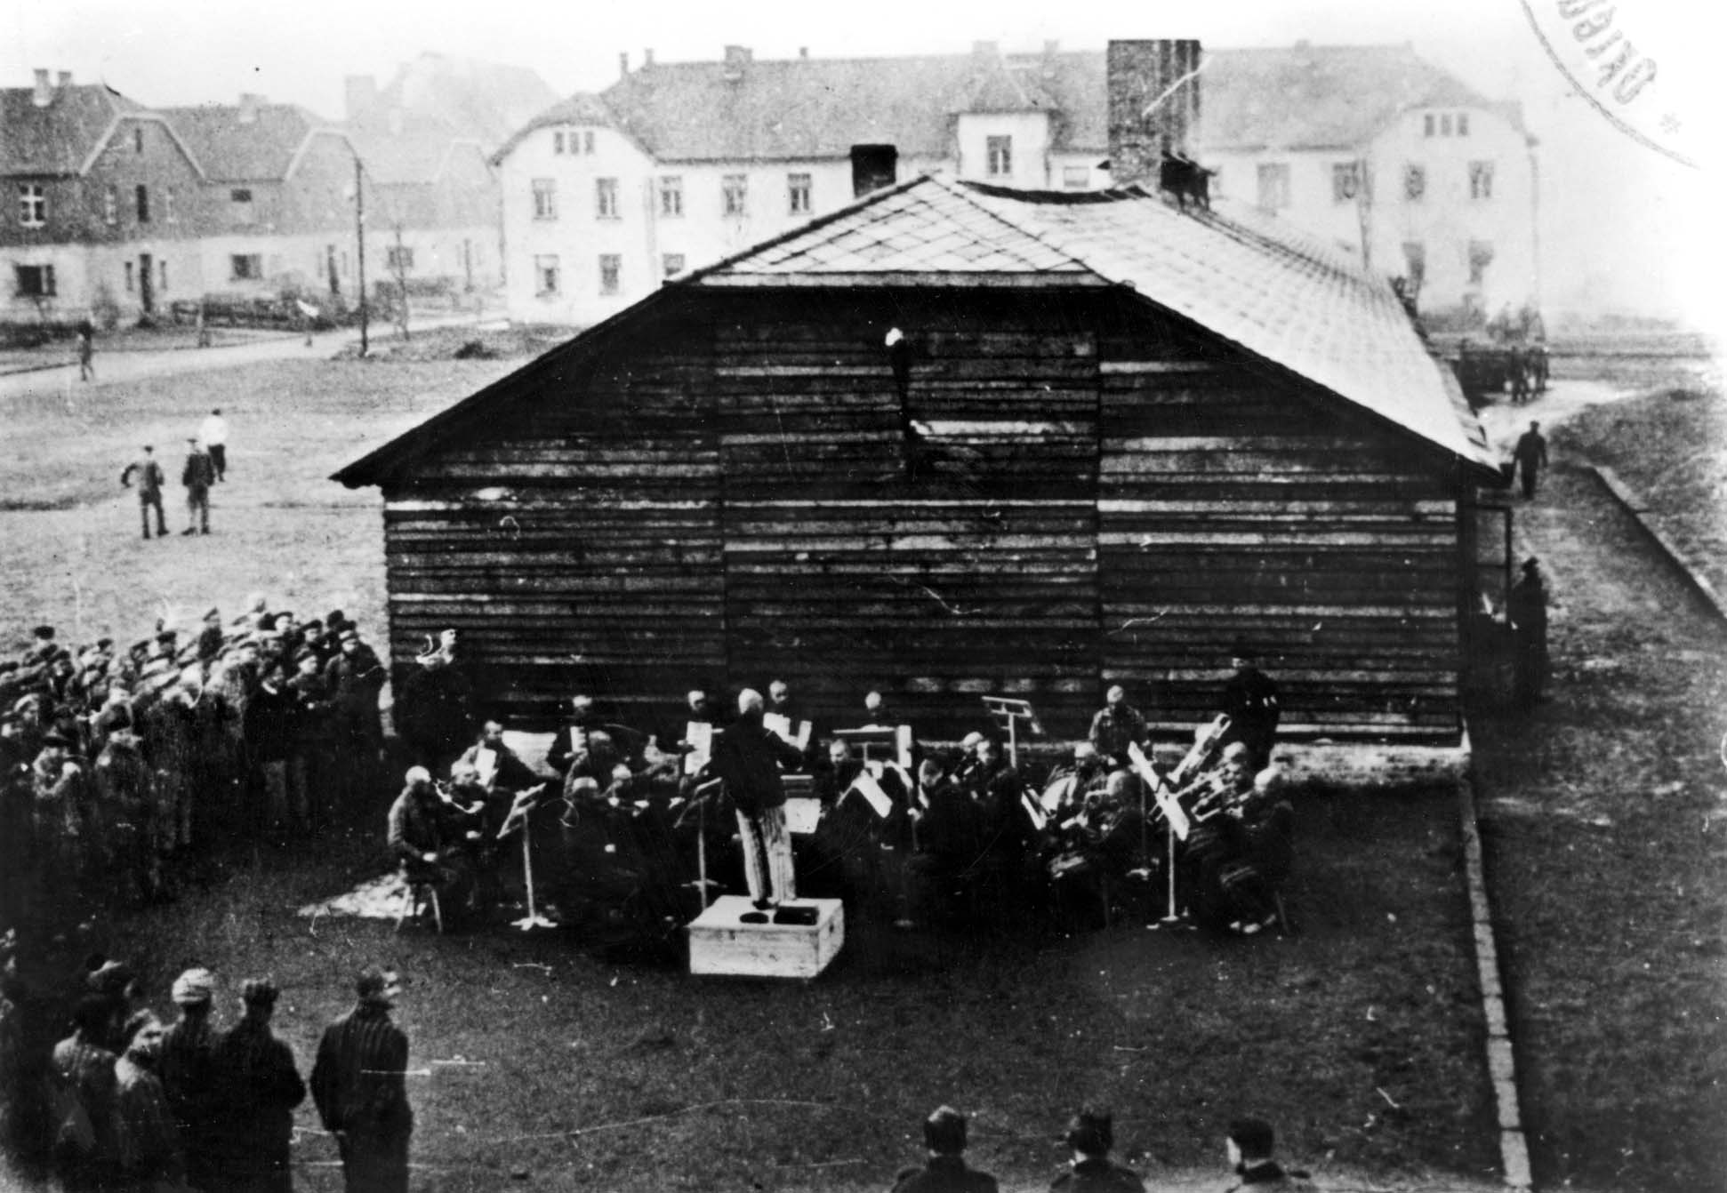
Auschwitz-Birkenau
‘At the first light of day, we were taken to a different barracks or “block”…There the “welcoming ceremony” took place: I had to take my clothes off, my head was shaved and the number 69388 was tattooed on my left forearm… I find it impossible to come to a firm conclusion as to which of the “initiations” was the most traumatic. The tattooing was not a pleasant experience…Maybe the shaving off of my hair was in fact the most traumatic experience. It made me feel totally naked, utterly vulnerable and reduced to a complete nobody. By now I had relinquished my clothes as well, and I stood there stark naked, without any hair and with my number of my arm. In the space of a few minutes I had been stripped of every vestige of human dignity and become indistinguishable from everyone around me’
Anita arrived at Auschwitz-Birkenau in December 1943. As she was tattooed and shaved, Anita revealed to the prisoner processing her that she was cellist. This news spread fast. The leader of the women’s camp orchestra soon appeared and invited Anita to an audition. After passing this test, Anita joined the orchestra. With the other musicians, her job was to sit and play music at the Main Gate each morning and evening so that those providing slave labour would march in time. On demand, they would also give concerts for the SS.
Photograph of the Auschwitz camp orchestra, June-September 1941 Courtesey of Yad Vashem Photo Archive

Slide 16
Belsen and after
‘I would like to be able to describe how it felt to be liberated. That would be a daunting task even for a professional writer. For years we had been subjected to the extremes of emotion and hardship. Despair – fear – hunger – misery – hatred – friendship. There is only so much one can take. We were completely burnt out. Our experiences in the war had been well beyond the scope of what normally would be piled on people during the course of a lifetime. And suddenly, it was over. We were “liberated”…I was nineteen years old and felt like ninety.
…
You must realise that we and our liberators saw the camp with different eyes. We had lived surrounded by filth and death for so long that we scarcely noticed it. The mountains of corpses in their varying degrees of decay were part of the landscape and we had even got used to the dreadful stench. It would be wrong to assume that everything was transformed the moment the first tank entered Belsen’
In October 1944, Anita – now, by fate, reunited with Renate – was put on a cattle wagon and transported to Bergen-Belsen. After enduring the final chaotic six months of the camp, she was liberated in April 1945. In the weeks that followed, Anita and Renate worked as interpreters for the British Army. Anita gave a talk to the BBC which was heard by her sister Marianne in England, and so they were able to enter into contact with each other.
In December 1945, Anita finally left Bergen-Belsen. After a short time in Brussels, Anita and Renate boarded a boat to England in March 1946. She would become a professional musician.

Slide 17
Antisemitism then & now Reflections from survivors of Bergen-Belsen

Slide 18
This programme is delivered by UCL Centre for Holocaust Education, the Holocaust Educational Trust, with support from the National Holocaust Centre and Museum, and made possible thanks to funding from the Department for Education

