Slide 1
How did the Bergen-Belsen come to be ‘the world of a nightmare?’
How did the camp at Bergen-Belsen evolve in space and time?

Slide 2
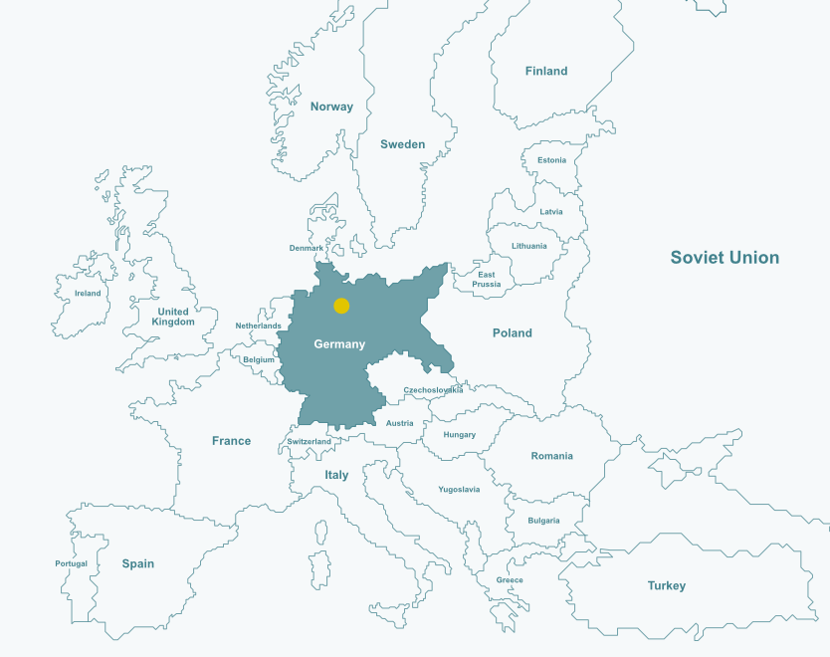
What have you learned about the Holocaust so far?
Where is Bergen-Belsen?
What do you know about it? How certain are you ?
Notes:
The map is intended as a prompt to encourage students to reflect on some of the things they have learnt about the Holocaust to date.
It is expected that students will have already had some lessons on a unit of study on the Holocaust. This is meant to connect with some of that learning, in particular the idea of what the Holocaust was, and some of the key events that unfolded in Germany and Poland in particular.
Unless students mention it themselves, make sure to emphasise with them that this was a continent-wide genocide. This lesson will focus on what the rest of the world was doing and how they reacted to events, Britain in particular.

Slide 3
Introduction: How does Richard Dimbleby describe his encounter with Bergen-Belsen?
How could this come to be?
01:40-02:37

Slide 4
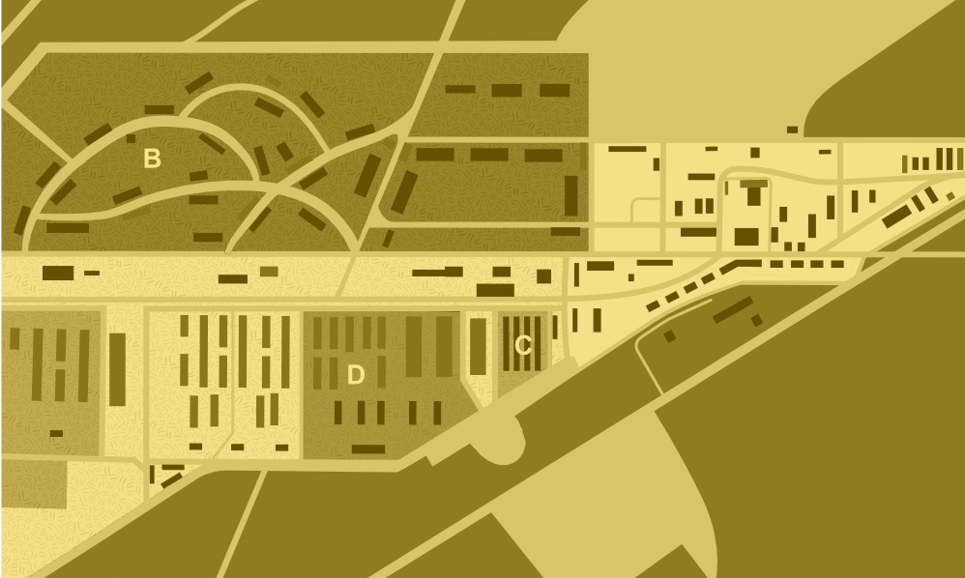
What can maps tell us?

Slide 5
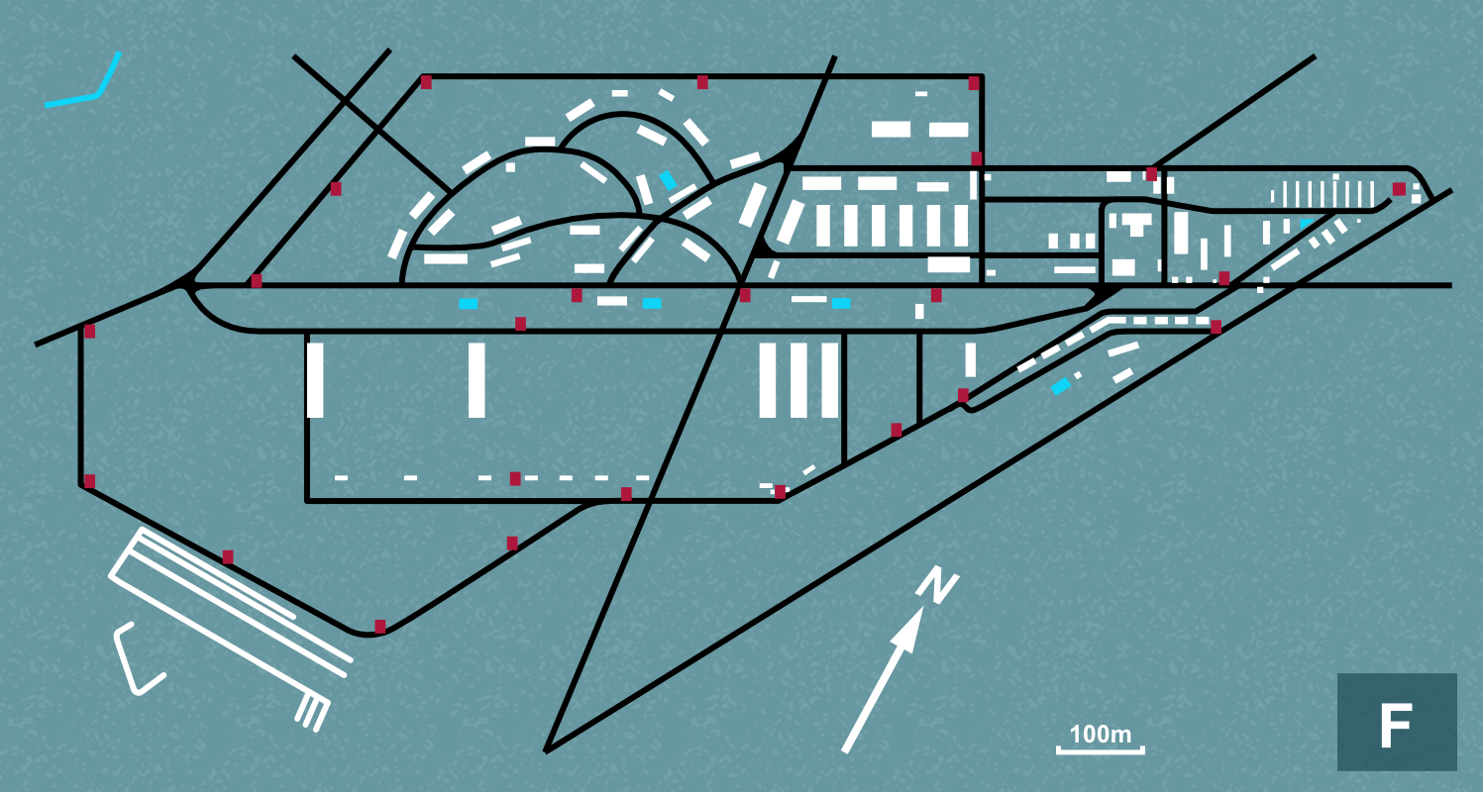
What is this showing you?

Slide 6
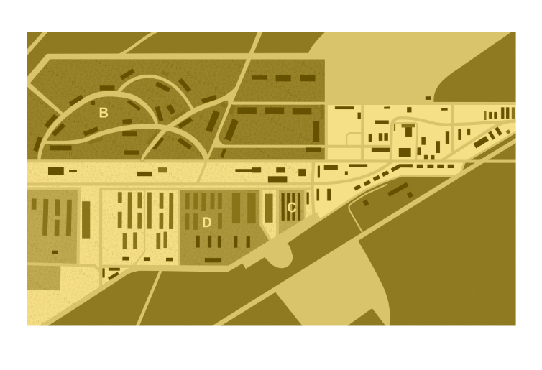
What can maps tell us?
You will be given 6 map cards and 6 date cards.
Place the 6 map cards in chronological order, with a date card next to each one.
Apart from the first card, on the next 5 write on a Post-it note at least 2 changes you can see from the previous map.
What are the maps showing you? What are they not showing? What further questions might you want to ask?

Slide 7
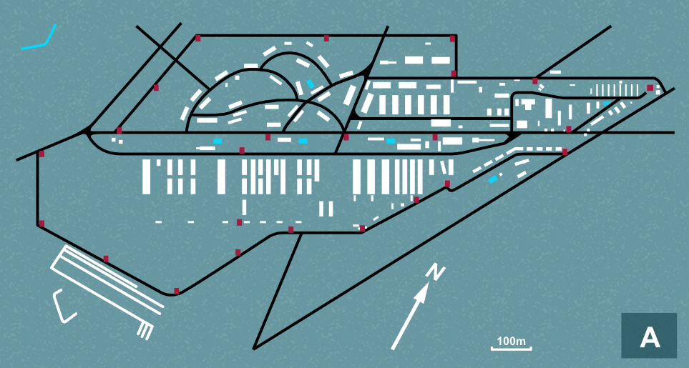
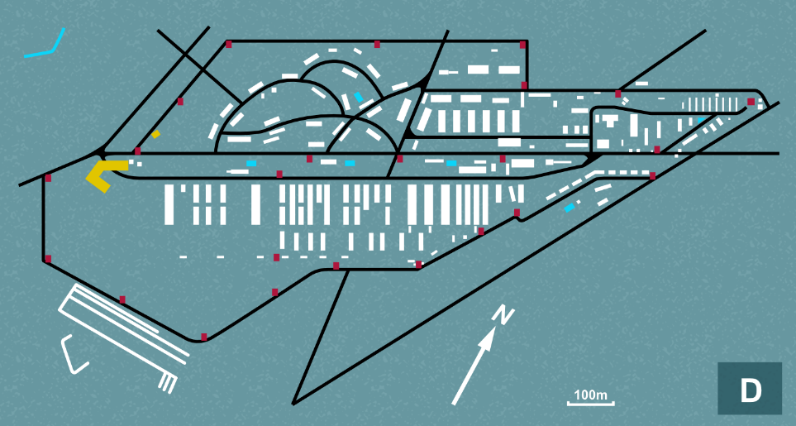
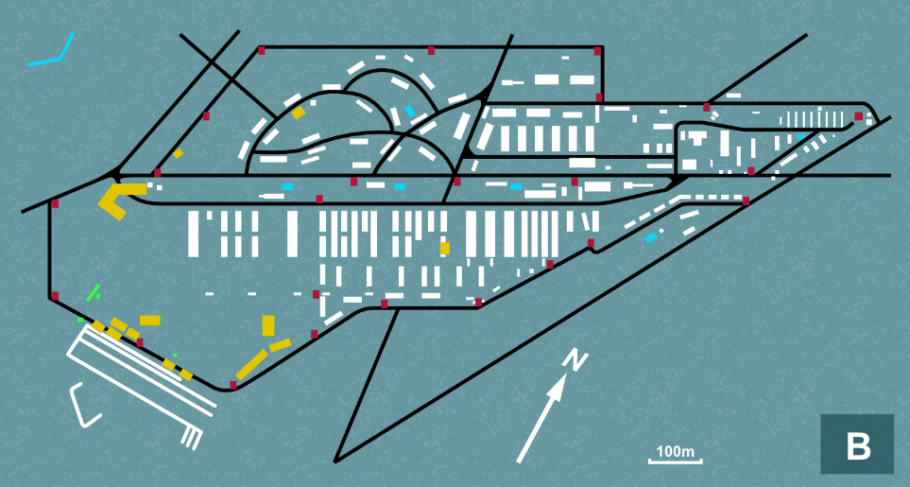
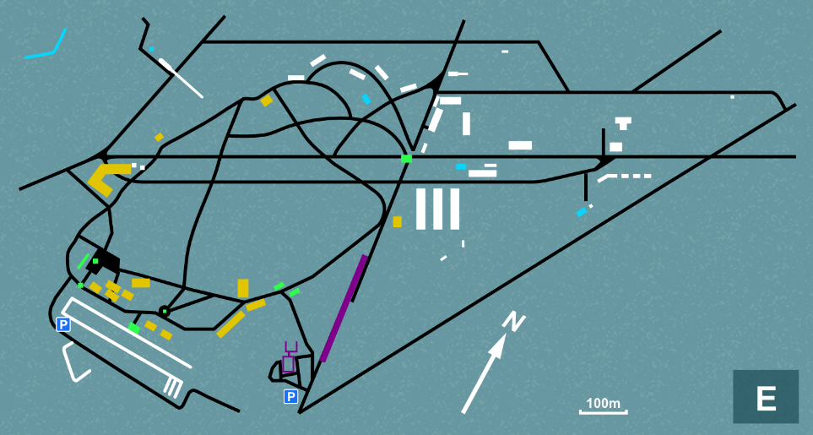
So… what changes, and why?
1935-39
1942-43
September
1944
February-March
1945
16th April-June
1945
Today

Slide 8
What can maps tell us?
Finally, you will be given 6 description cards – some from eyewitnesses, some from historians.
As a group, can you match them to the date cards?
What does this new layer of information tell you about the development of Bergen-Belsen now, and how it came to be ‘the world of a nightmare’?

Slide 9
Conclusions

Slide 10
So how did the camp at Bergen-Belsen come to be ‘the world of a nightmare?’
Which of the following statements about Bergen-Belsen would you agree/disagree with?
Bergen-Belsen was a death camp in occupied Poland, like Auschwitz.
The only real function of Bergen-Belsen throughout the war was to act as a recovery centre for Jews.
At the end of the war, it became the largest displaced persons camp in Germany.
When the British discovered the camp in April 1945, what they saw was typical of camp conditions.
Bergen-Belsen should be remembered as a triumph of the British policy of saving and rescuing Jews throughout the war wherever they could.
There is little the camp can tell us about the Holocaust.

Slide 11
‘The world of a nightmare’: how did the camp at Bergen-Belsen come to be?

Slide 12
This programme is delivered by UCL Centre for Holocaust Education, the Holocaust Educational Trust, with support from the National Holocaust Centre and Museum, and made possible thanks to funding from the Department for Education

