Slide 1
How did the camp at Bergen-Belsen come to be ‘the world of a nightmare’
Resources

Slide 2
RESOURCES 1: A5 COLOUR CARDS, SINGLE-SIDED

Slide 3
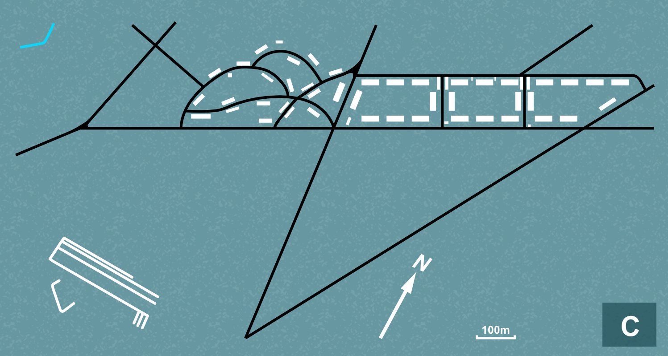
MAP C

Slide 4
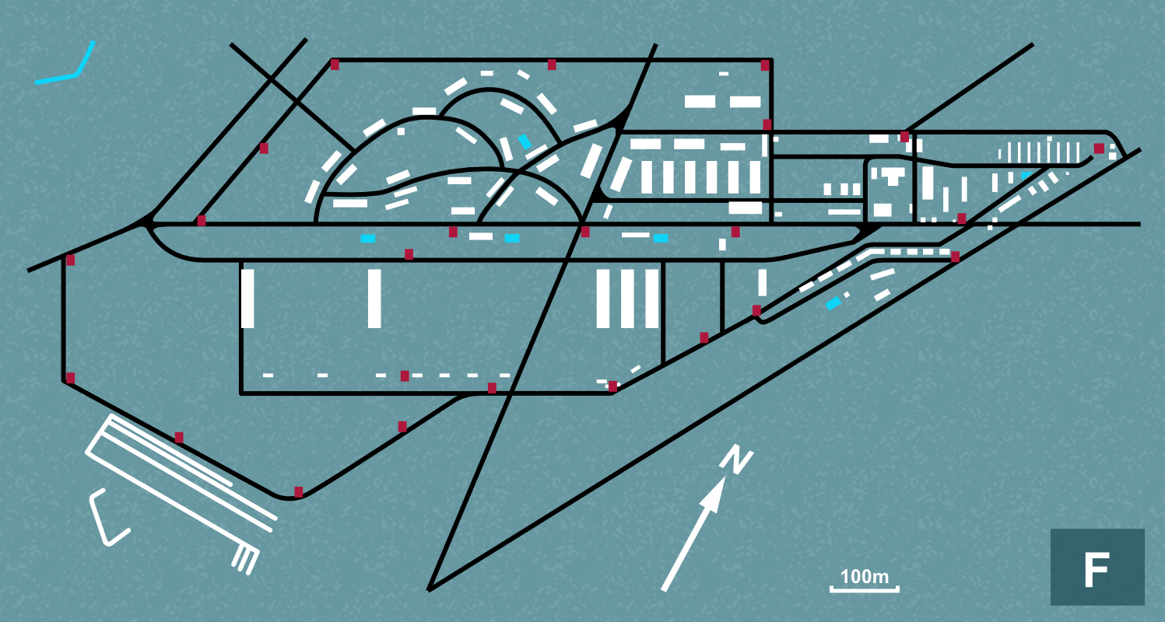
MAP F

Slide 5
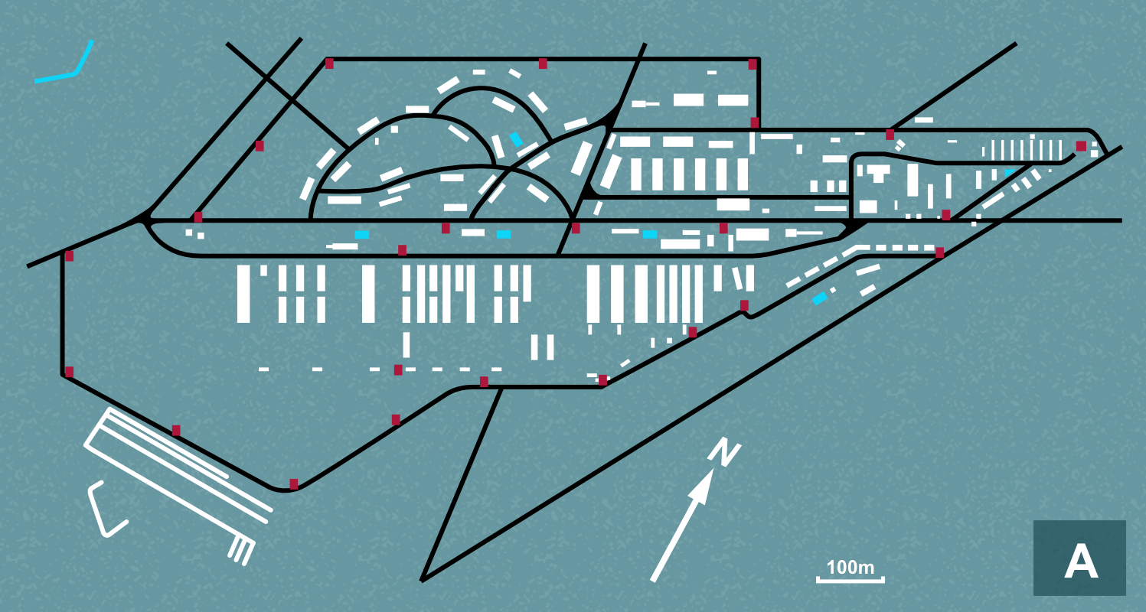
MAP A

Slide 6
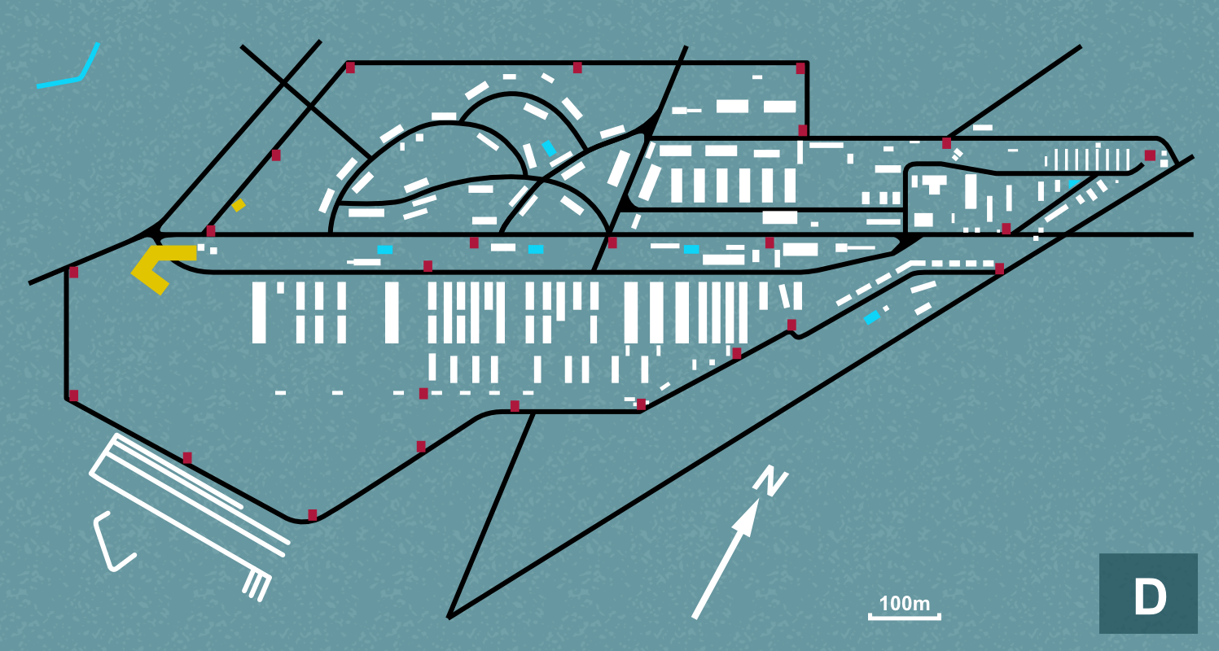
MAP D

Slide 7
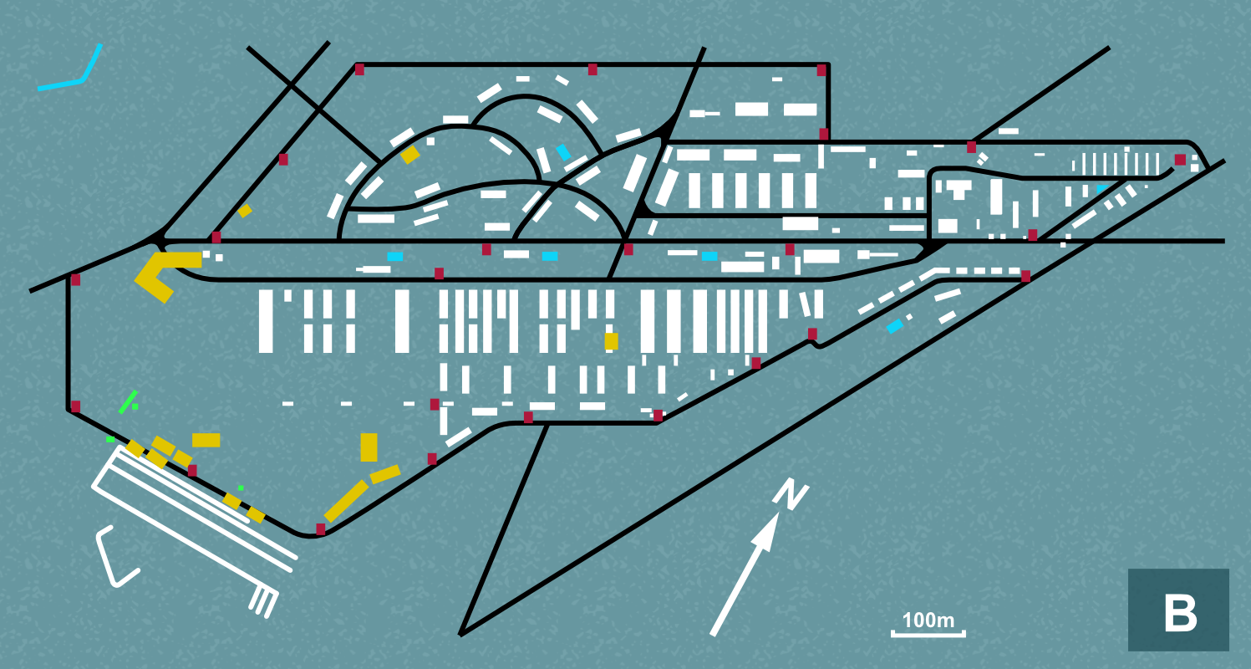
MAP B

Slide 8
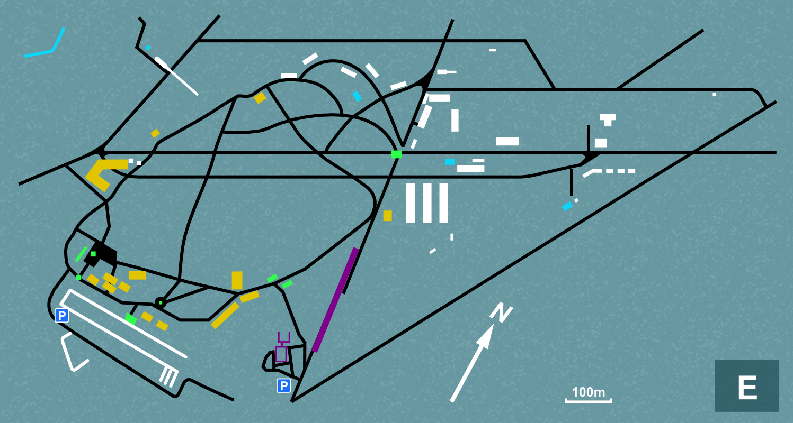
MAP E

Slide 9
Map Key

Slide 10
RESOURCES 1: A6 COLOUR CARDS, SINGLE-SIDED

Slide 11
1935-39

Slide 12
1942-43

Slide 13
September
1944

Slide 14
February-March
1945

Slide 15
16th April - June
1945

Slide 16
Today

Slide 17
RESOURCES 1: A5 COLOUR CARDS, SINGLE-SIDED

Slide 18
Description card 5
It was… built…as a Wehrmacht * military training complex training area and used to train armoured vehicle crews.
(Baxter, 2014: 9)
This was before war had broken out. Germany was ignoring the terms of the Treaty of Versailles and had started a program of rearmament.
*German Army

Slide 19
Description card 6
‘The winter… was very harsh. It was one of the coldest winters ever. That was when the mass deaths, the ‘great dying’ started. Typhoid fever and dysentery were raging through the camp and there was the hunger, the starvation. Your body couldn’t cope with the slightest ailments, and people were dying. Every day, hundreds of them were taken away on the carts.’
Mikhail Levin – Soviet Prisoner of War
(Lower Saxony Memorial Foundation, 2010: 62)
Once the Nazis had invaded the Soviet Union, around 100,000 of the 2 million Soviet prisoners of war were sent to camps in the Bergen-Belsen area. The Germans saw them as barely human.

Slide 20
Description card 1
4,000 mainly Hungarian women arrived. They were joined by women from camps and ghettos in Poland and formed a separate ‘women’s camp.’ However, there was no proper accommodation for them and they lived in tents… Amongst new women arrivals from Plaszow and Auschwitz were Margot and Anne Frank whose health quickly deteriorated…
The camp was now becoming seriously overcrowded.
(Cesarani, 2006: 18)
The last major Jewish community to be deported were Hungarian. At this time around 60% of the inmates were Jewish and lived in a section called the ‘Star Camp’: some were even exchanged for German prisoners of war.

Slide 21
Description card 3
Never in the history of the KL did so many prisoners die as fast of disease as in Bergen-Belsen… 18,168 died [in one month] from an average of 45,500.
(Wachsmann, 2015)
As the Nazis retreated, many Jews in Eastern camps such as Auschwitz were forced to flee on ‘death marches’ to camps like Bergen-Belsen in Germany, where numbers dramatically increased and conditions worsened.

Slide 22
Description card 4
‘Eventually we reached the entrance of the camp. Belsen did not look then what you have come to know now. The mountains of corpses were not there yet - that was to come. We just stood there and saw some creatures milling about. They were pretty dishevelled-looking. We observed someone with a Kapo armband scraping out an obviously empty soup vat, and my sister remarked drily: ‘If a Kapo needs to do that things must be pretty bad here.’
Anita Lasker-Wallfisch - survivor
(Cesarani, 2006)
In the East, as the Red Army advanced, they liberated camps such as Auschwitz, though most people had left by then. The British and Americans came across camps in the West, such as Bergen-Belsen and Dachau.

Slide 23
Description card 2
Bergen-Belsen is still very much a site of contested memory. For the Jews… the Poles… the British… Sinti and Roma, Soviet prisoners-of-war, Italian military internees, Jehovah’s Witnesses, homosexuals all have their own memories of Bergen-Belsen….
Bergen-Belsen is a place where some historical events are still far from clear… It is almost impossible to reverse fully the process of destruction of memory which began with the SS destroying all the papers relating to the camp and which continued in the first decades after liberation. (Schultze, 2006: 222-4)
Soon after liberation the British burned down the huts to stop the spread of typhus. The camp then became a ‘displaced persons’ camp for five years, before it was then was flattened, with nothing to tell people about it.

Slide 24
This programme is delivered by UCL Centre for Holocaust Education, the Holocaust Educational Trust, with support from the National Holocaust Centre and Museum, and made possible thanks to funding from the Department for Education

